Slide 2
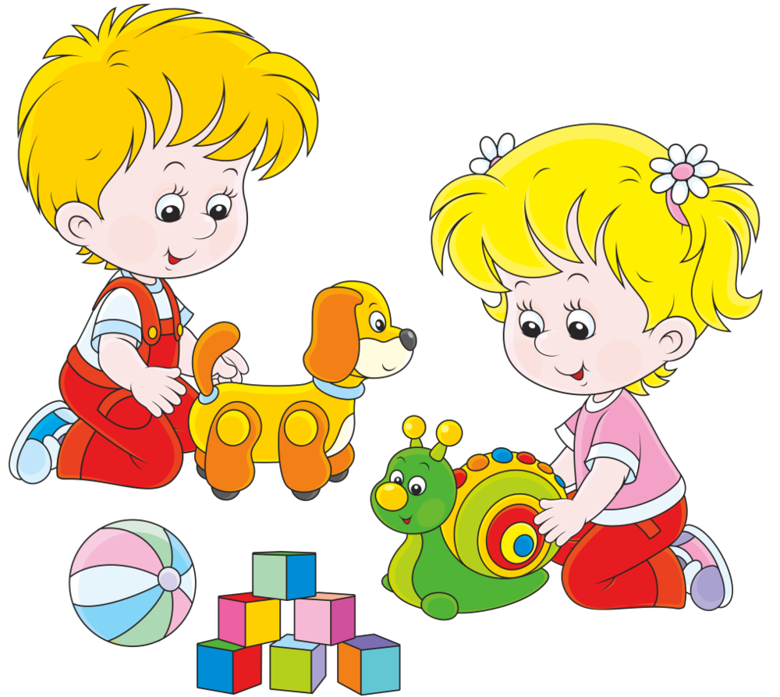
DOAN NGHIEN PRIMARY SCHOOL
CLASS 2

Slide 3
Friday, April 2nd 2021
Unit 16 In the playground
Listen, point and repeat.
pl
plane: máy bay
plant: cây
plum: quả mận
plate: cái đĩa

Slide 4
2. Point and say.

Slide 5
3. Chant.

Slide 6
4. Listen and tick.

Slide 7
5. Let’s talk.

Slide 8
6. Look and write.

Slide 9
7. sing.

