Slide 1







DAI LOC DEPARTMENT OF EDUCATION AND TRAINING
TRUONG HOANH PRIMARY SCHOOL
WELCOME TO OUR CLASS !
Subject: English 5
Class:5B
Teacher: Van Thi Lai

Slide 2
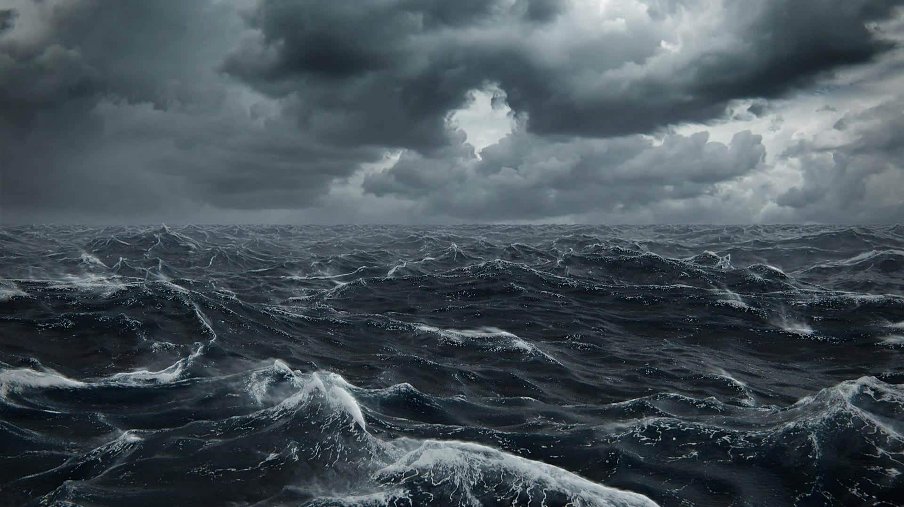


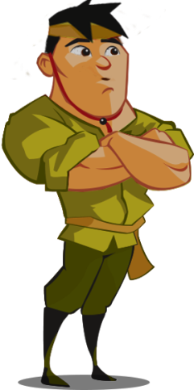
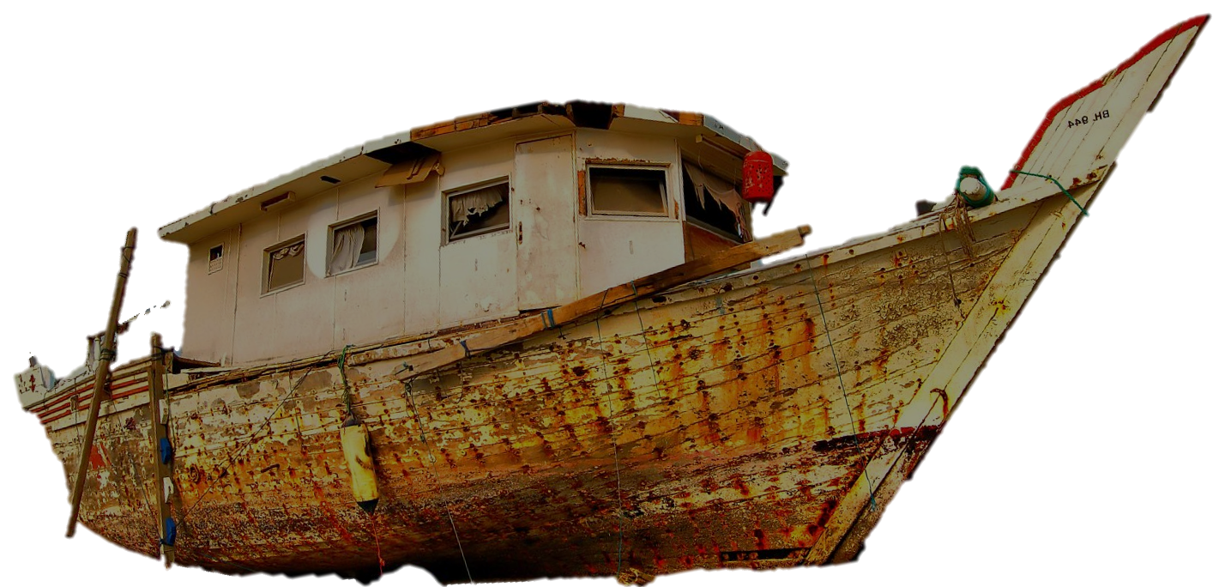
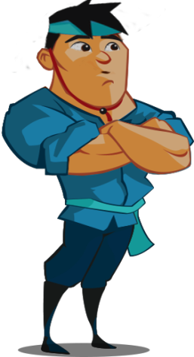
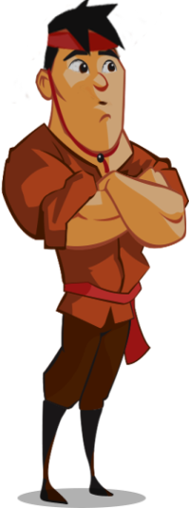
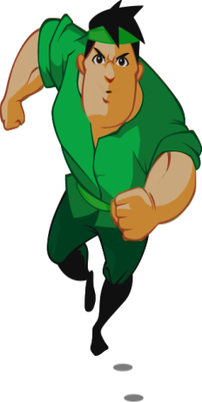
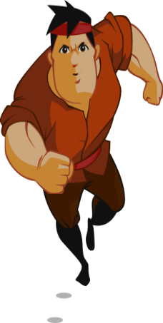
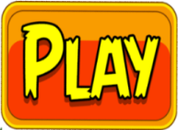
Warm up:
Save the fishermen

Slide 3


Five fishermen are in dangerous storm.
Help them by answering the questions correctly.

Slide 4
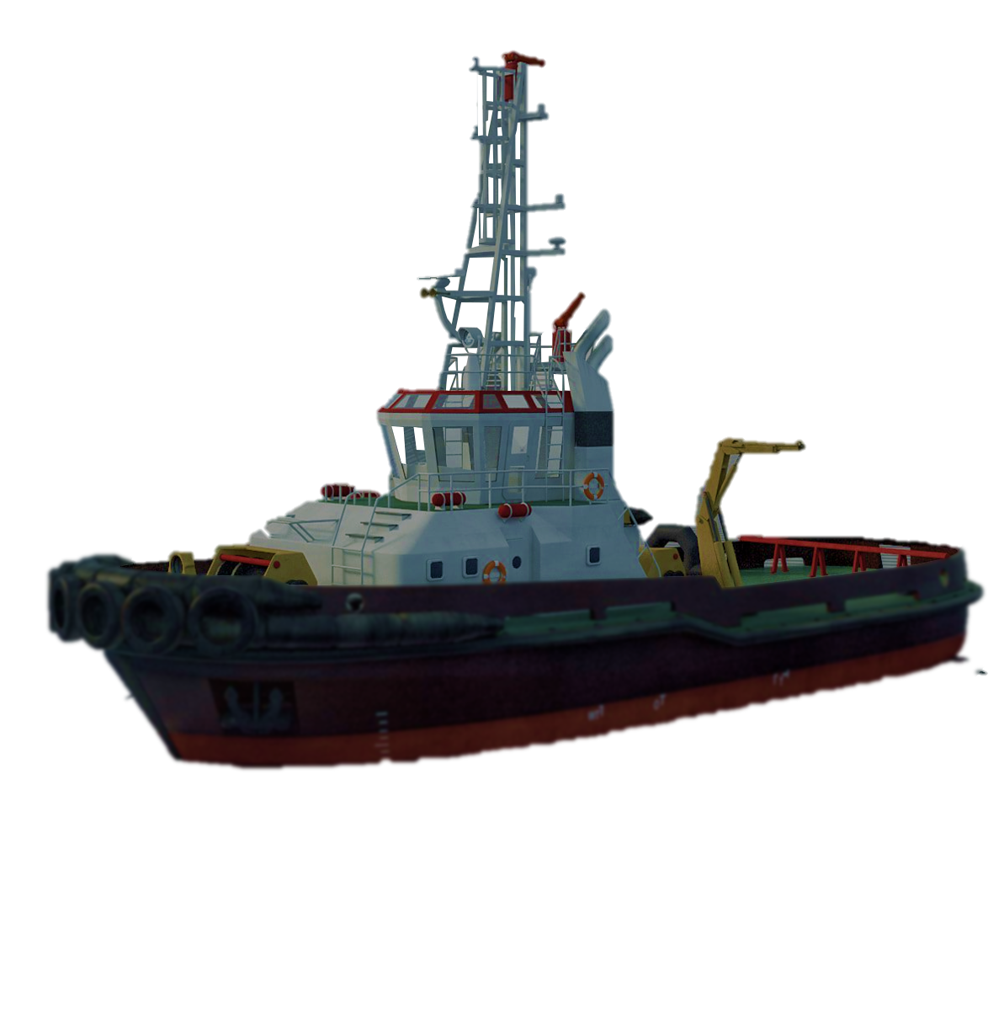
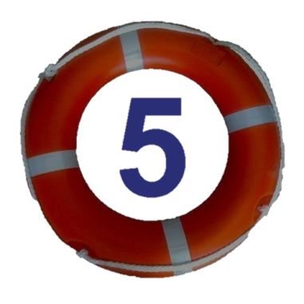
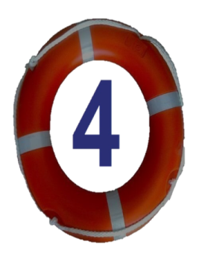
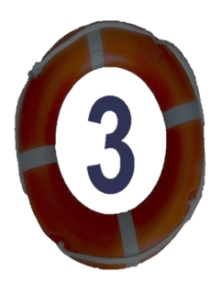
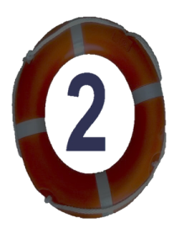
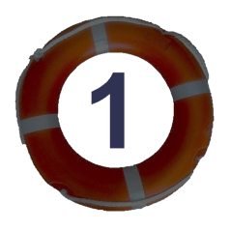

Slide 5



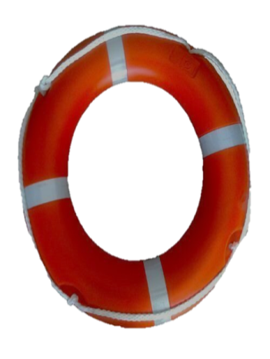

How many lessons do you have today?
I have three: Art, IT and English.

Slide 6
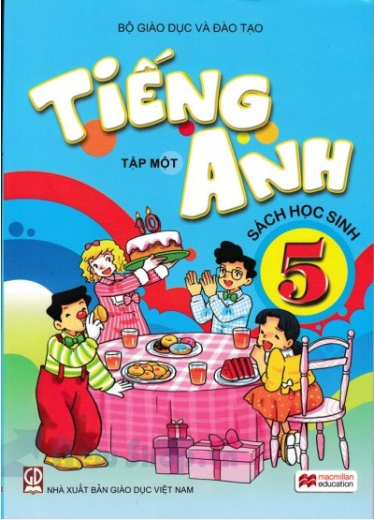
How often do you have English?
I have it four times a week.

Slide 7
Reorder the words.
many/today/ do/lessons/have/How/you/?
How many lessons do you have today?

Slide 8
Choose the best answer.
'
'
a. seaside They’ll be at the seaside on Sunday.
'
'
b. seaside They’ll be at the seaside on Sunday.

Slide 9

How many books do you have ?
I have four.

Slide 10
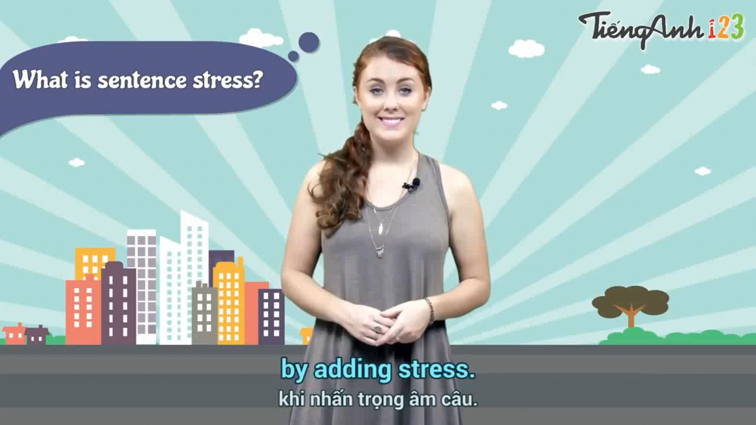

Slide 11
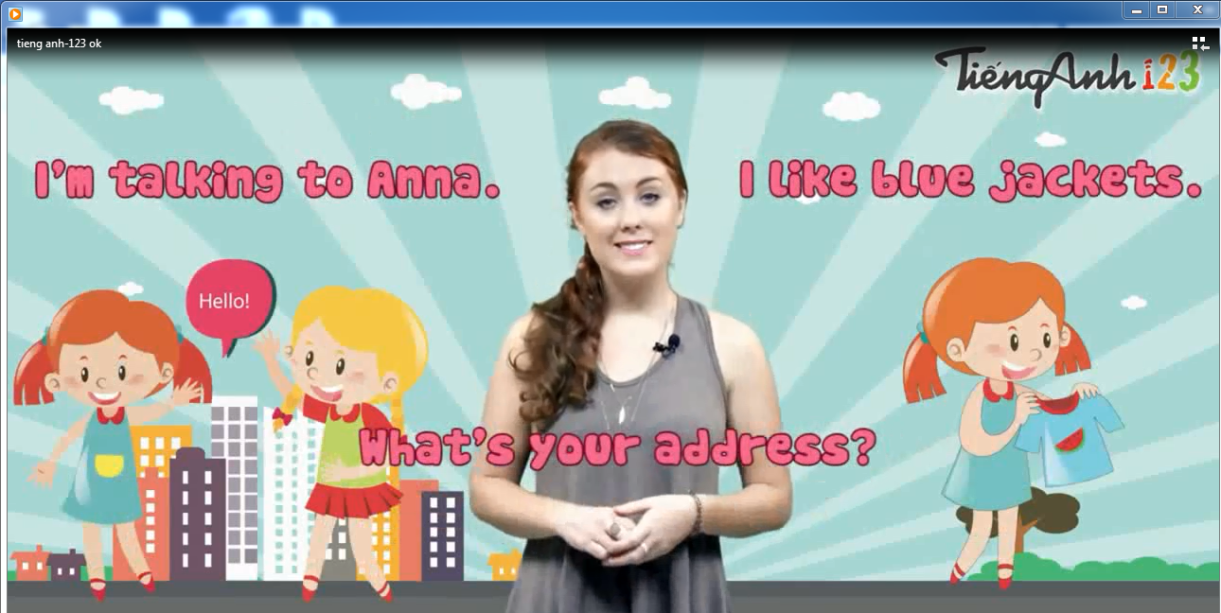

Slide 12
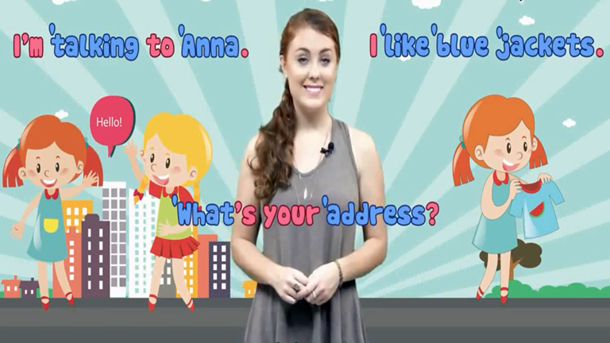

Slide 13
In lesson today, we learn about sentences stress.
1.What is the sentence stress?
- Sentence stress is the “Music” of spoken English.
2. Which words are stressed in a sentence?
- We must stress the following words:
- Nouns, Verbs, adjectives, Adverbs and Wh- words like: What, Which, How, Where, When. So, we read these words louder, longer and higher.

Slide 14
Example:
'
'
'
'
How many lessons do you have today?
Wh- word
Noun
Verb
Adverb
'
'
I have four.
Verb
Noun

Slide 15
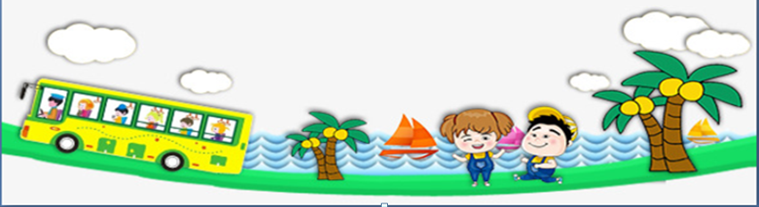
Wednesday, November 25th, 2020
Unit 6:
HOW MANY LESSONS DO YOU HAVE TODAY?
Lesson 3: Part 1, 2, 3

Slide 16


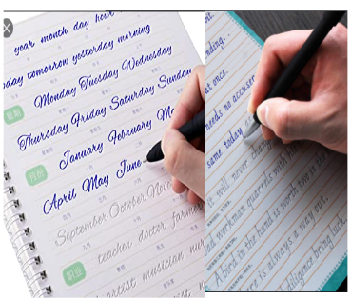
copybooks:
'
những quyển vở luyện viết.

Slide 17
Wednesday, November 25th, 2020
UNIT 6: HOW MANY LESSONS DO YOU HAVE TODAY?
Lesson 3: Part 1,2,3
1. Listen and repeat.

Slide 18
Wednesday, November 25th, 2020
UNIT 6: HOW MANY LESSONS DO YOU HAVE TODAY?
Lesson 3: Part 1,2,3
1. Listen and repeat.
'
'
'
'
'
'
How many lessons do you have today?
I have four .
'
'
'
'
'
How many crayons do you have ?
I have five .
'
'
'
'
'
How many books do you have ?
I have six .
'
'
'
'
'
How many copybooks do you have ?
I have seven.

Slide 19
Wednesday, November 25th, 2020
UNIT 6: HOW MANY LESSONS DO YOU HAVE TODAY?
Lesson 3: Part 1,2,3
1. Listen and repeat.
'
'
'
'
How many lessons do you have today?
'
'
I have four .

Slide 20
Wednesday, November 25th, 2020
UNIT 6: HOW MANY LESSONS DO YOU HAVE TODAY?
Lesson 3: Part 1,2,3
1. Listen and repeat.
'
'
'
How many crayons do you have ?
'
'
I have five .

Slide 21
Wednesday,November 25th, 2020
UNIT 6: HOW MANY LESSONS DO YOU HAVE TODAY?
Lesson 3: Part 1,2,3
1. Listen and repeat.
'
'
'
How many books do you have ?
'
'
I have six .

Slide 22
Wednesday, November 25th, 2020
UNIT 6: HOW MANY LESSONS DO YOU HAVE TODAY?
Lesson 3: Part 1,2,3
1. Listen and repeat.
'
'
'
How many copybooks do you have ?
'
'
I have seven .

Slide 23
Wednesday, November 25th, 2020
UNIT 6: HOW MANY LESSONS DO YOU HAVE TODAY?
Lesson 3: Part 1,2,3
1. Listen and repeat.
'
'
'
'
'
'
How many lessons do you have today?
I have four .
'
'
'
'
'
How many crayons do you have ?
I have five .
'
'
'
'
'
How many books do you have ?
I have six .
'
'
'
'
'
How many copybooks do you have ?
I have seven.

Slide 24

Wednesday, November 25th, 2020
UNIT 6: HOW MANY LESSONS DO YOU HAVE TODAY?
Lesson 3: Part 1,2,3
2. Listen and circle a or b. Then say the sentences aloud.

Slide 25
2. Listen and circle a or b. Then say the sentences.
1
2
1. How many ___________ do you have?
a. books
b. copybooks
I have___ .
a. two
b. six
2. How many ___________ do you have?
a. crayons
b. lessons
I have___ .
a. four
b. five

Slide 26
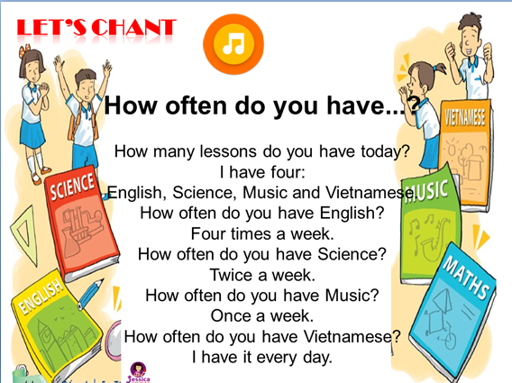


Slide 27
3. Let’s chant:
How often do you have...?
How many lessons do you have today?
I have four:
English, Science, Music and Vietnamese.
How often do you have English?
Four times a week.
How often do you have Science?
Twice a week.
How often do you have Music?
Once a week.
How often do you have Vietnamese?
I have it every day.

Slide 28
3.Let’s chant:
How often do you have...?
How many lessons do you have today?
I have four.
English, Science, Music and Vietnamese.

Slide 29
3.Let’s chant:
How often do you have...?
How often do you have Science?
Twice a week.

Slide 30
3.Let’s chant:
How often do you have...?
How often do you have Music?
Once a week.

Slide 31
3.Let’s chant:
How often do you have...?
How often do you have Vietnamese?
I have it every day.

Slide 33
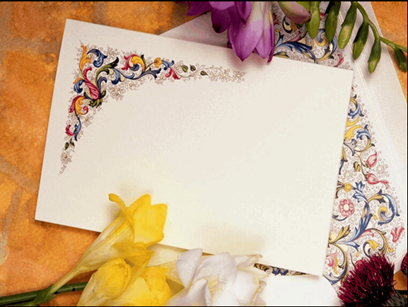
Game: Pass the ball !

Slide 34
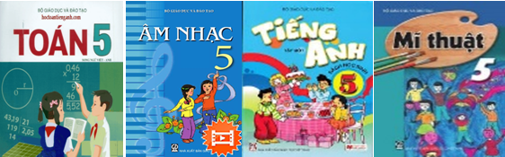

How many lessons do you have today?
I have four: Maths, Music, English and Art.

Slide 35
Which words are stressed in sentences?
'
'
'
'
How many lessons do you have today?
I have four.
'
'

Slide 36

Choose the correct order.
How/ you/ often/ Science/ do / have?
a. How often do you have Science?
b. How often you do Science?
c. How do you often have Science?

Slide 37
Choose the best answer.
'
'
'
a. How many books do you have?
'
'
'
'
b. How many books do you have?
'
'
'
'
c. How many books do you have?

Slide 38
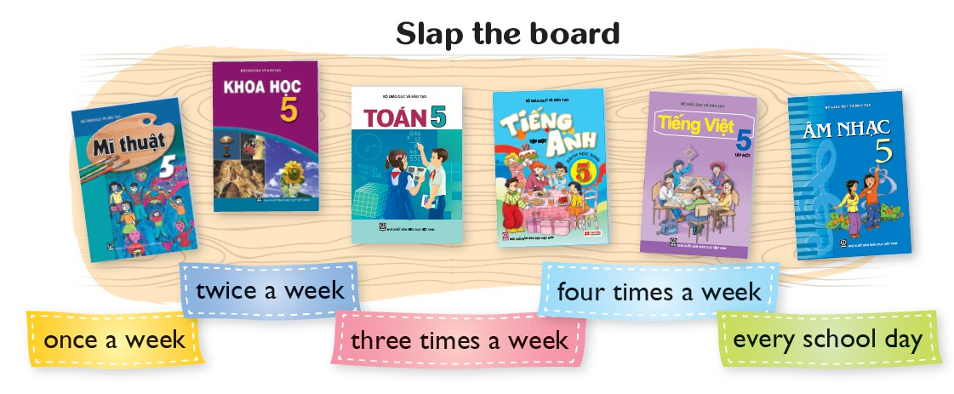


How many ........ do you have today?
a. books
b. copybooks
c. lessons

Slide 39
Wednesday, November 25th, 2020
UNIT 6: HOW MANY LESSONs DO YOU HAVE TODAY?
Lesson 1- Part 1,2,3
    1. Listen and repeat.
    - copybooks: những quyển vở luyện viết.
    2. Listen and circle a or a. Then say the sentences aloud.
    3. Let’s chant: How often do you have ...?
    * Homelink:
    Learn by heart the chant “How often do you have ...?
    Prepare lesson 3 part 4,5,6&7.

Slide 40
Thank you very much !!!

