Slide 1
Tuesday, January 25th 2022
Unit 16 Lesson 2

Slide 3
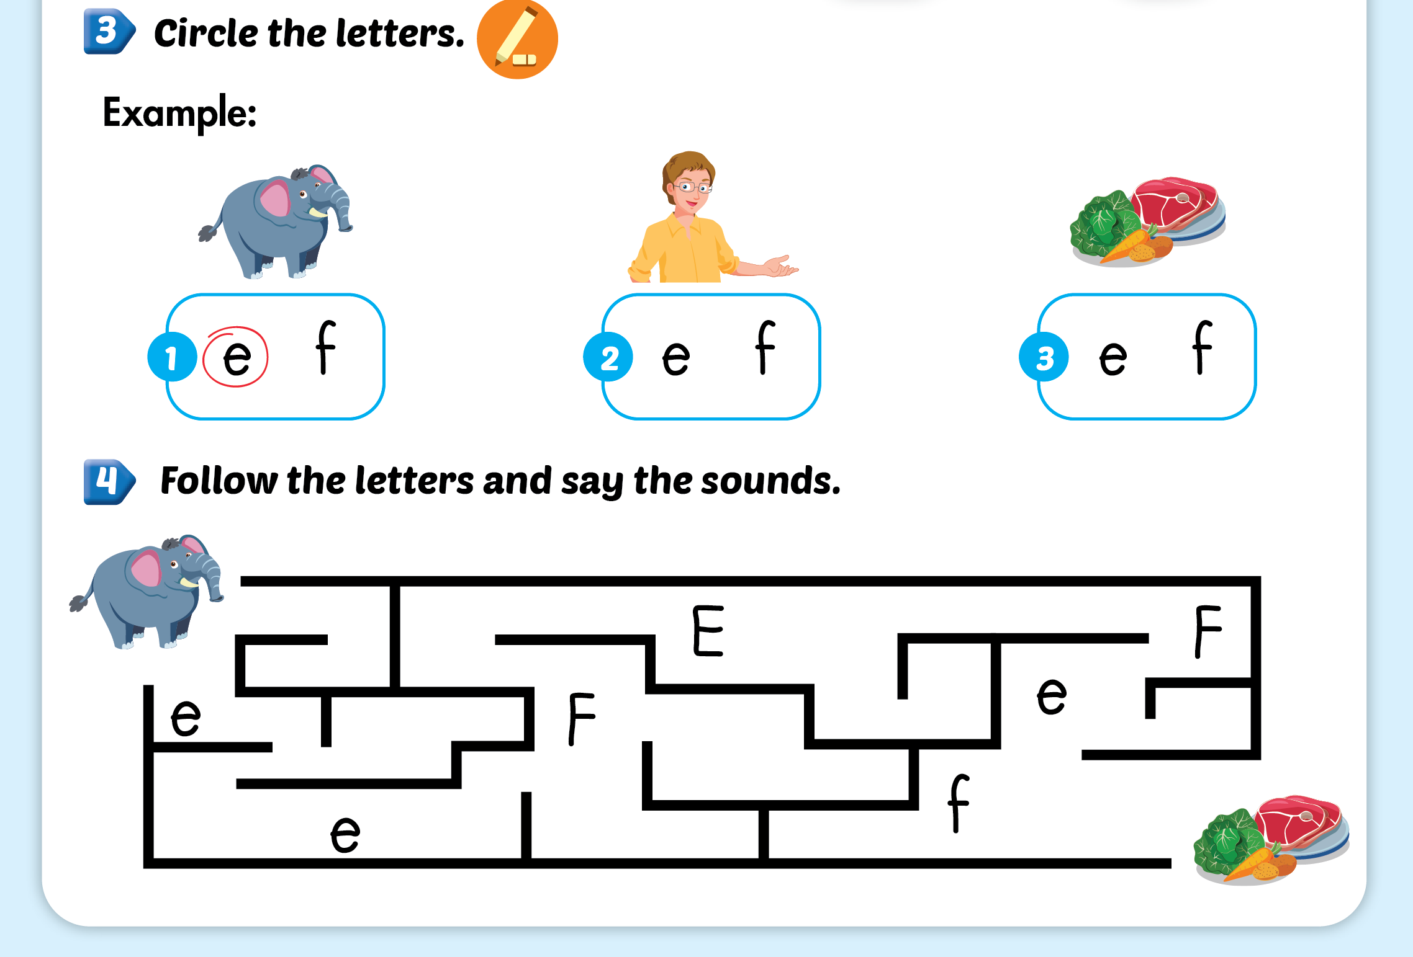
Lesson 2

Slide 4
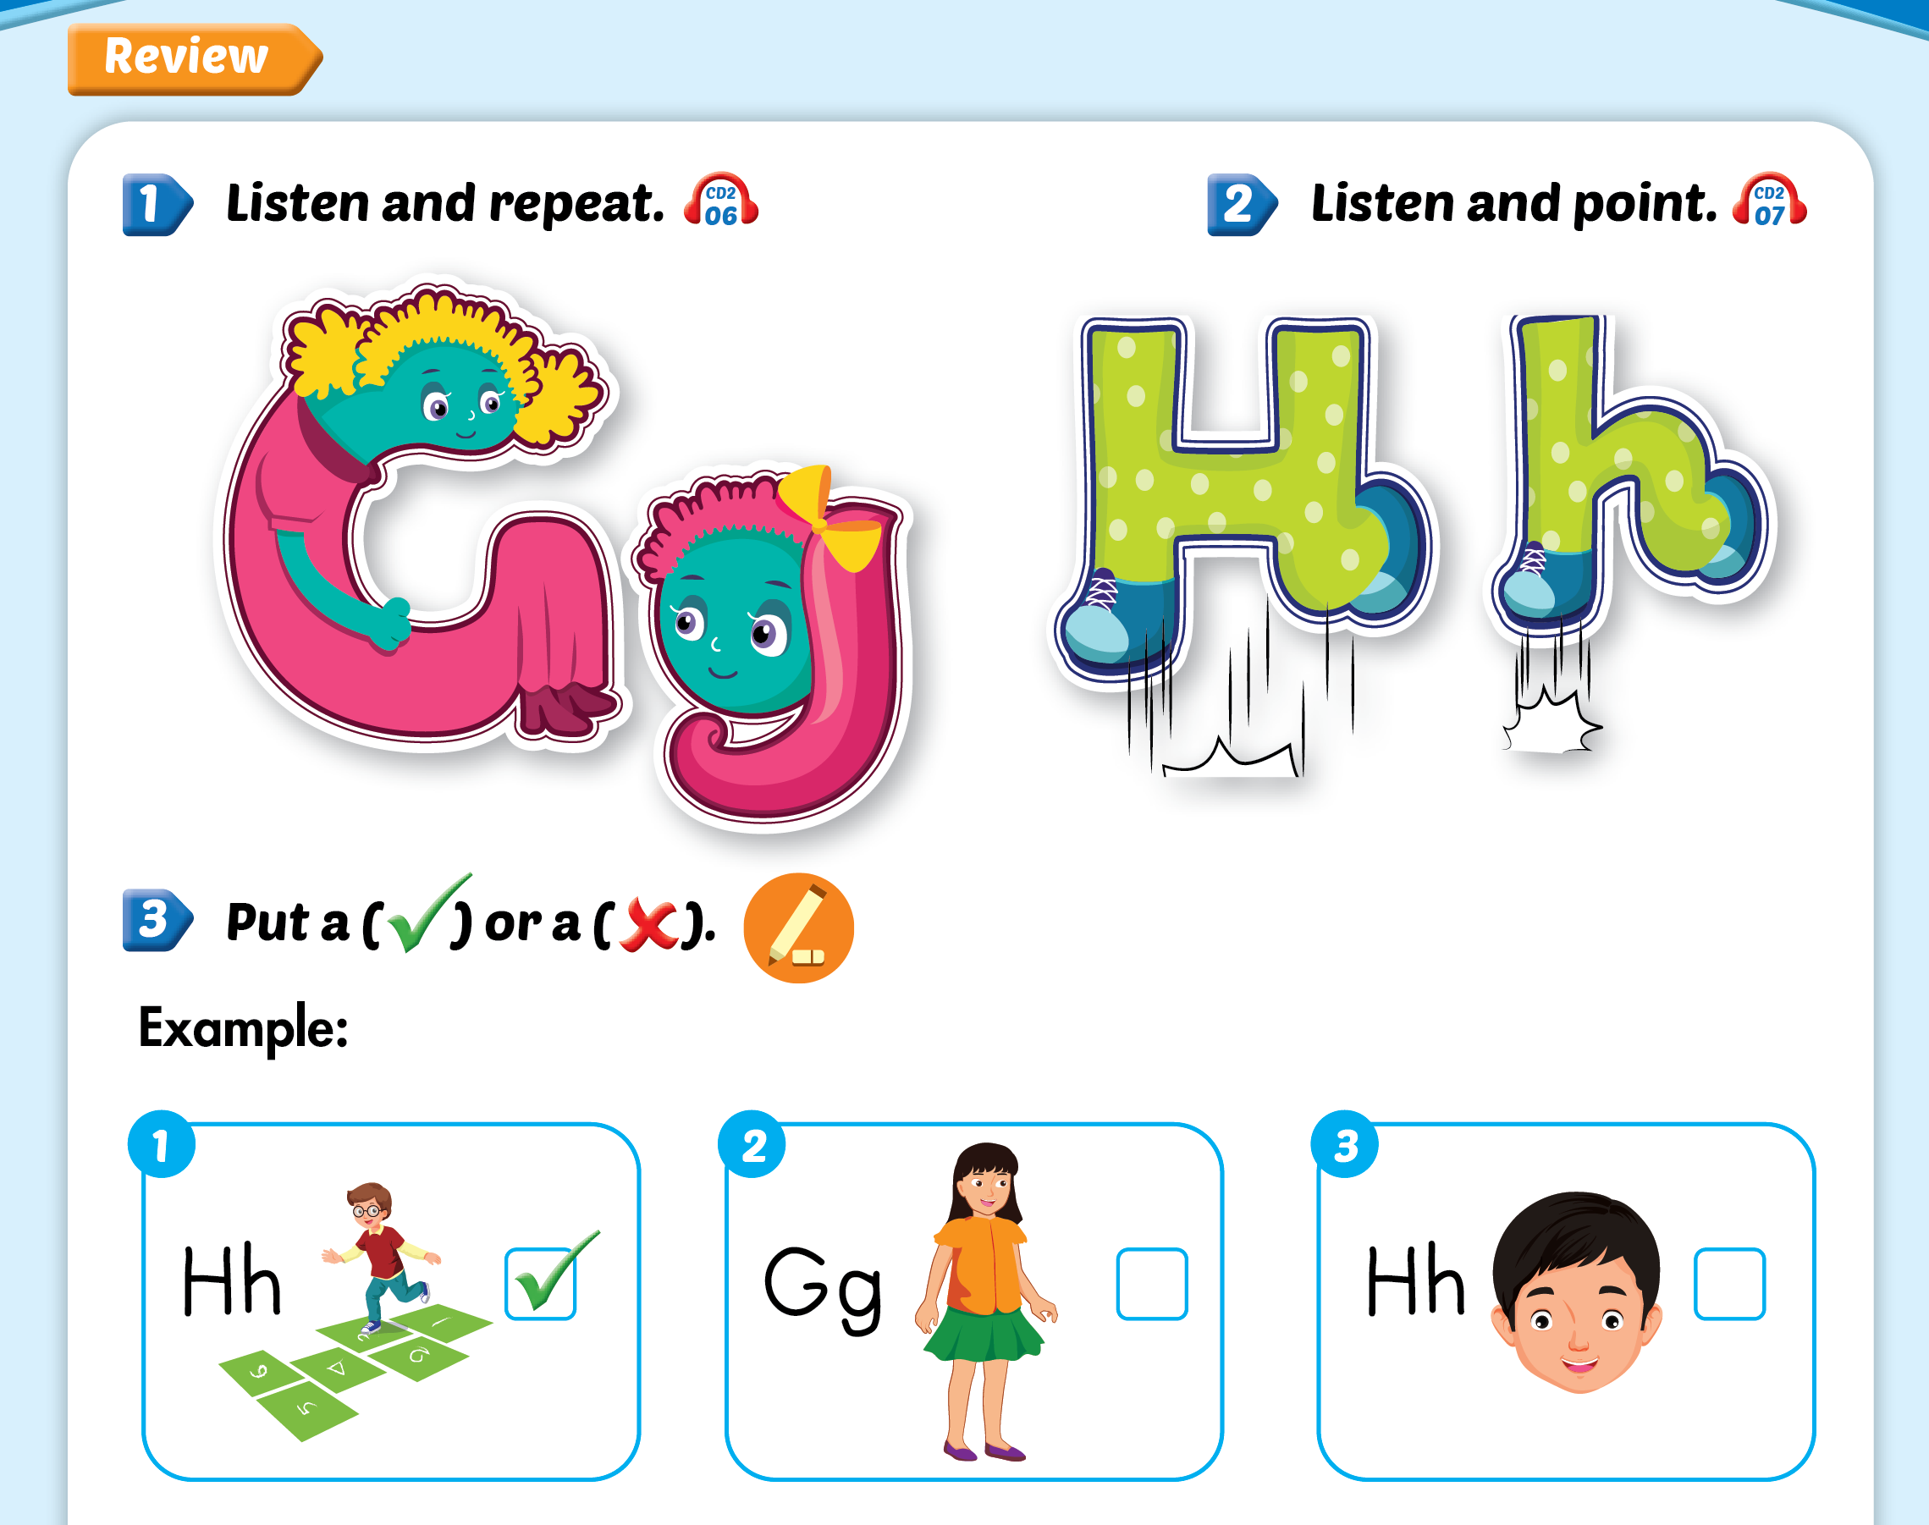
Lesson 2

Slide 5
Lesson 2

Slide 8
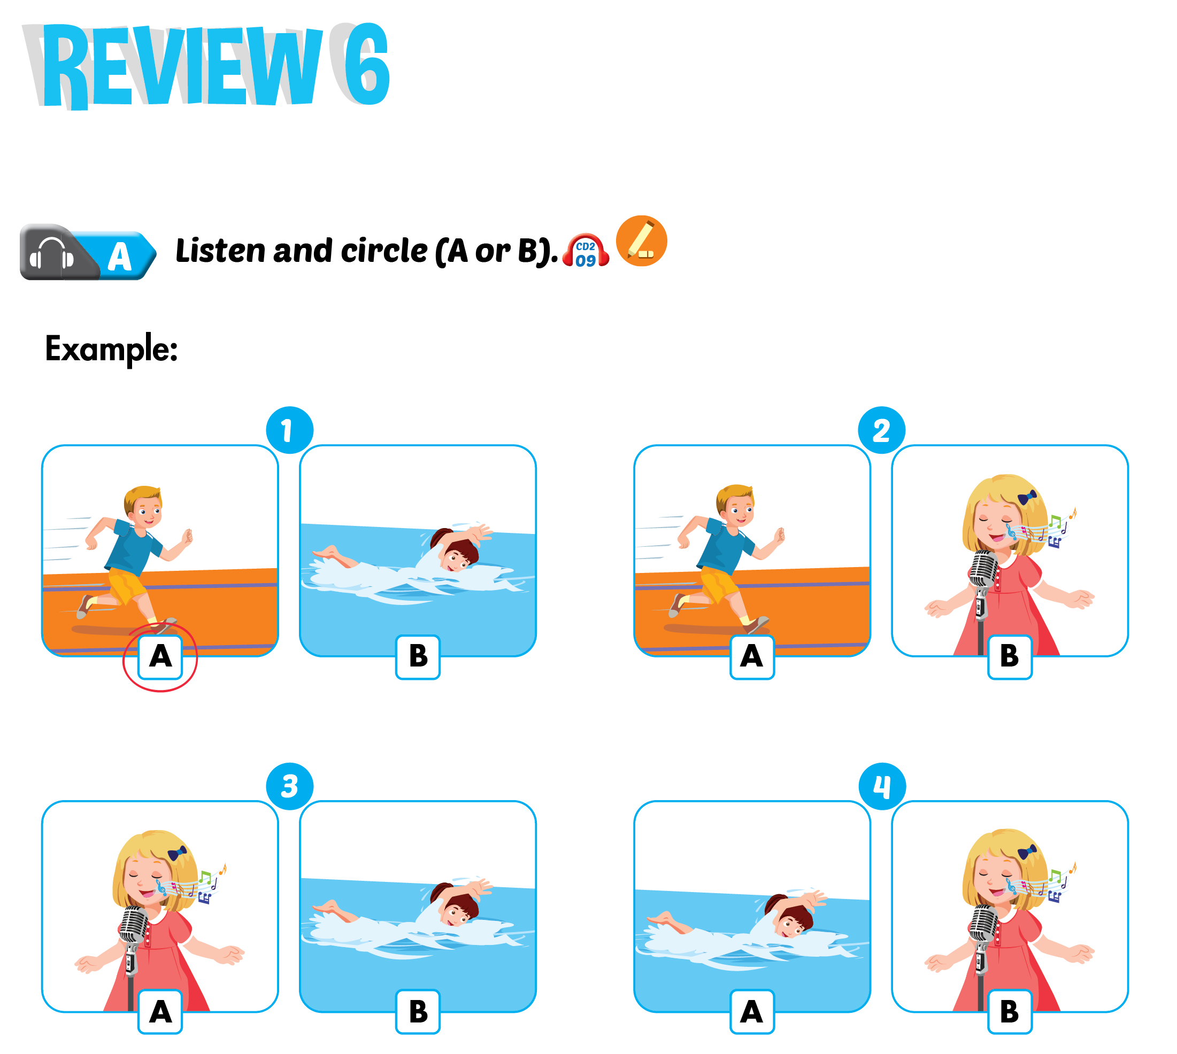

Slide 9
