Slide 1
Thursday, March 24th 2022
Unit 16
LET'S GO TO
THE BOOKSHOP
Lesson 1

Slide 2
VOCABULARY

Slide 3
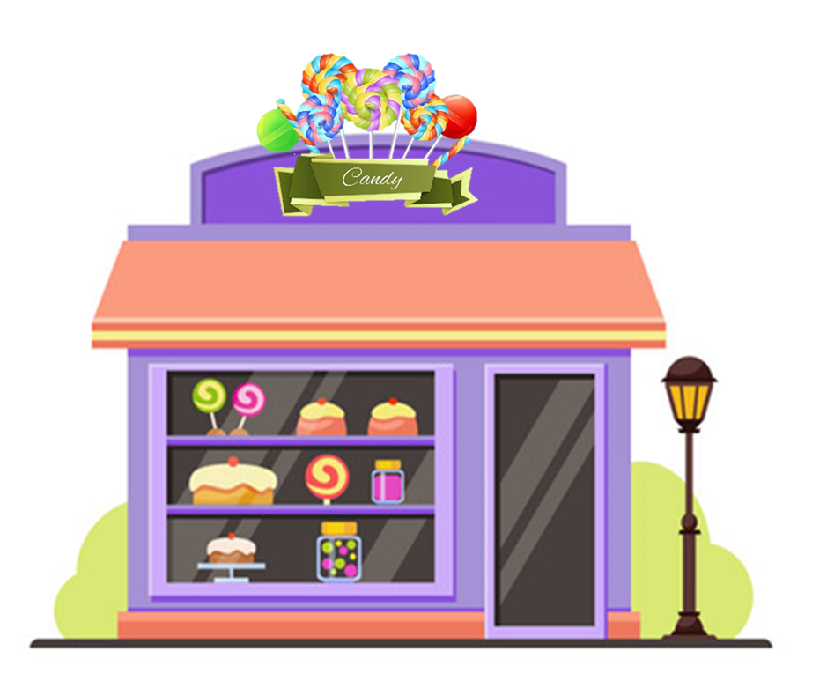
Vocabulary
sweet shop
/swiːt ʃɒp/

Slide 4
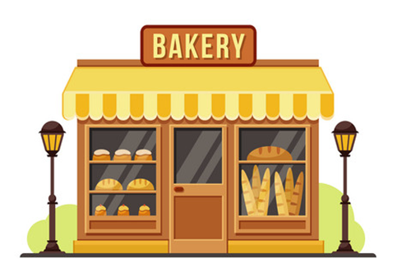
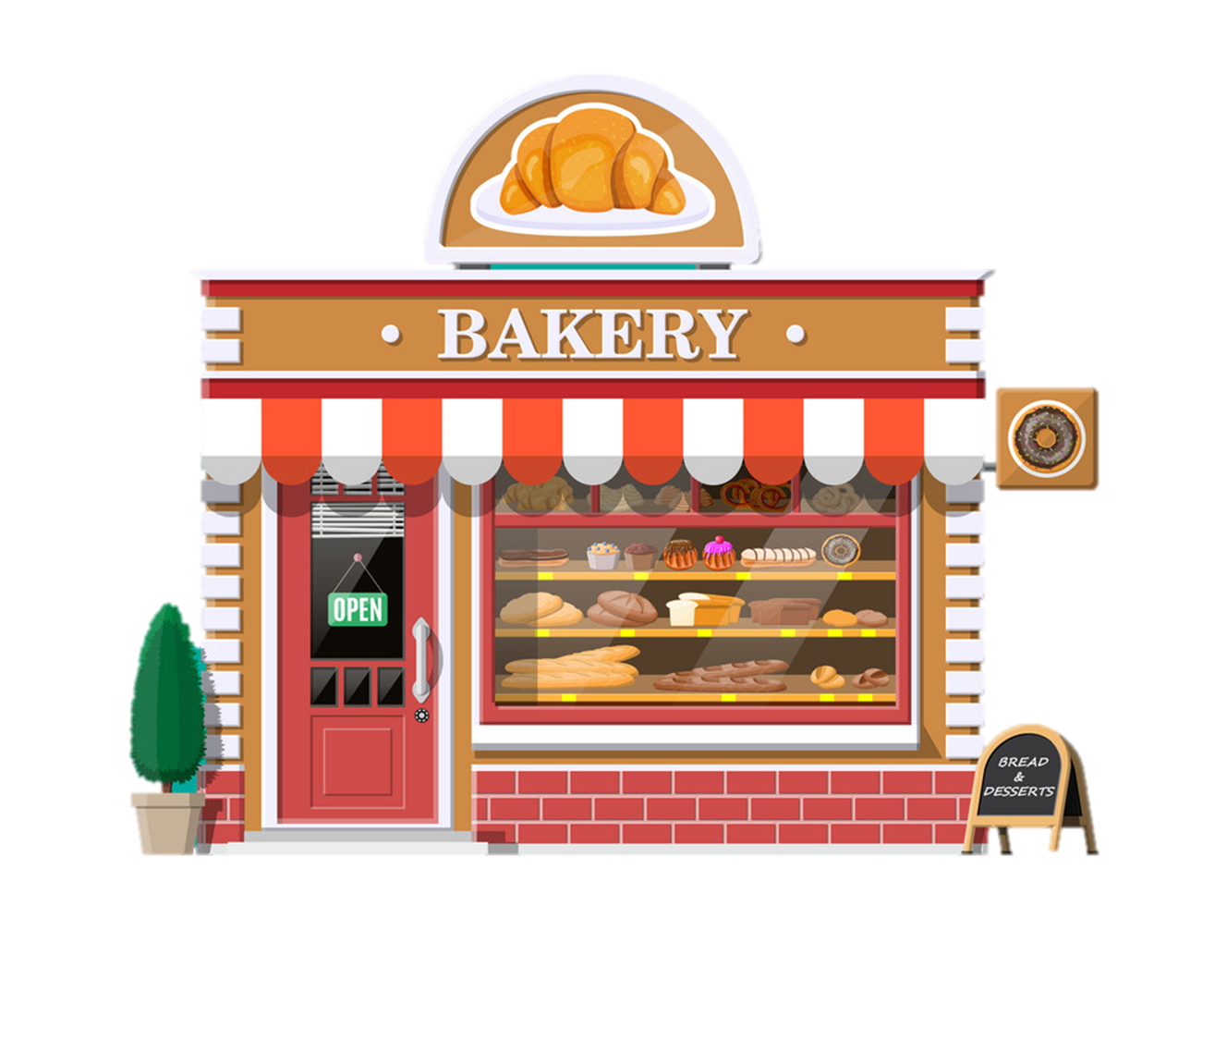
Vocabulary
bakery
/ˈbeɪkəri/

Slide 5
Vocabulary
pharmacy
/ˈfɑːməsi/

Slide 6
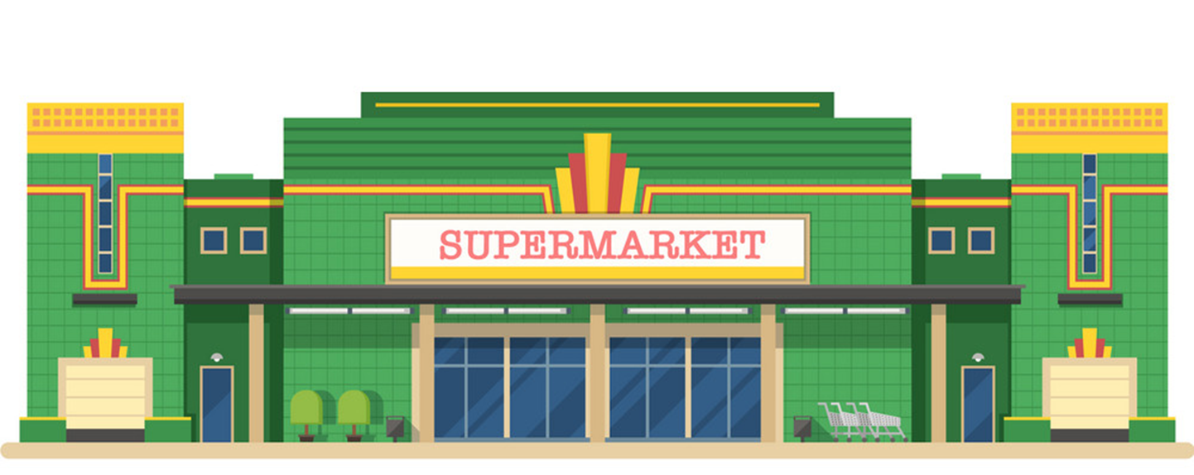
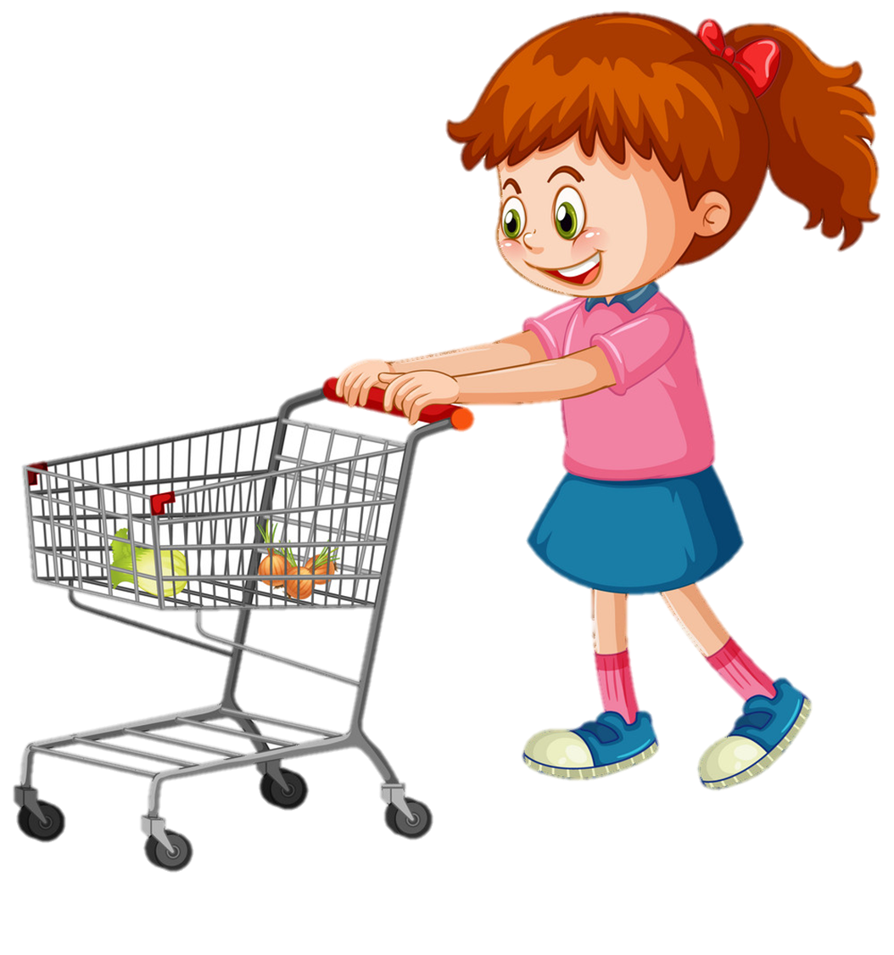
supermarket
/ˈsuːpəmɑːkɪt/

Slide 7
Vocabulary
bookshop
/ˈbu:ksop/

Slide 8
Vocabulary
1
2
3
sweet shop
bakery
bookshop
4
5
pharmacy
supermarket

Slide 9
Choose the correct picture.
a
b
c
d
supermarket

Slide 10
Choose the correct picture.
a
b
c
d
pharmacy

Slide 11
Choose the correct picture.
a
b
c
d
sweet shop

Slide 12
Choose the correct picture.
a
b
c
d
bookshop

Slide 13
Choose the correct picture.
a
b
c
d
bookshop

Slide 14
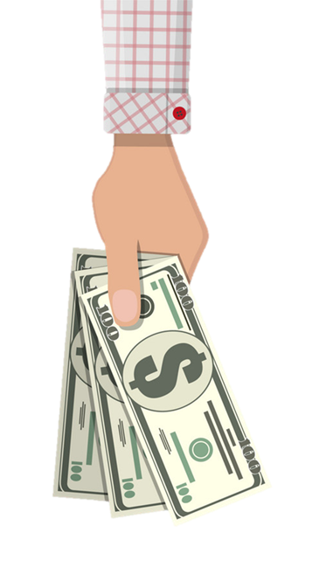
Vocabulary
buy some chocolate
/baɪ sʌm ˈtʃɒklət/

Slide 15
Vocabulary
buy some medicine
/baɪ sʌm ˈmedɪsn/

Slide 16
Vocabulary
buy some bread
/baɪ sʌm bred/

Slide 17
Vocabulary
buy some food
/baɪ sʌm fuːd/

Slide 18
Vocabulary
buy some books
/baɪ sʌm bʊks/

Slide 19
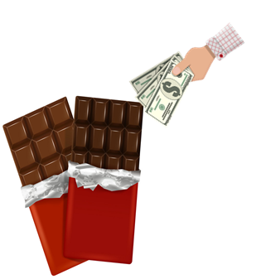
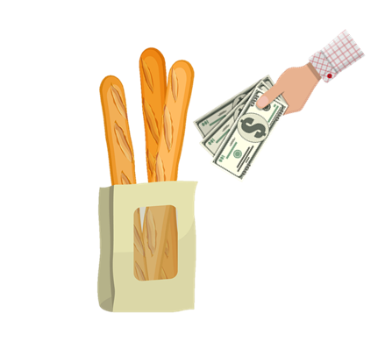
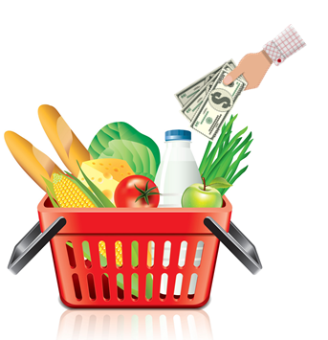
Vocabulary
1
2
3
buy some chocolate
buy some medicine
buy some books
4
5
buy some bread
buy some food

Slide 20
Choose the correct picture.
a
b
buy
some bread
c
d
buy some chocolate
buy some food
buy some books
buy some medicine

Slide 21
Choose the correct picture.
a
b
buy some chocolate
c
d

Slide 22
Choose the correct picture.
a
b
buy some books
c
d

Slide 23
Choose the correct picture.
a
b
buy some food
c
d

Slide 24
Choose the correct picture.
a
b
buy some medicine
c
d

Slide 25
GRAMMAR

Slide 26
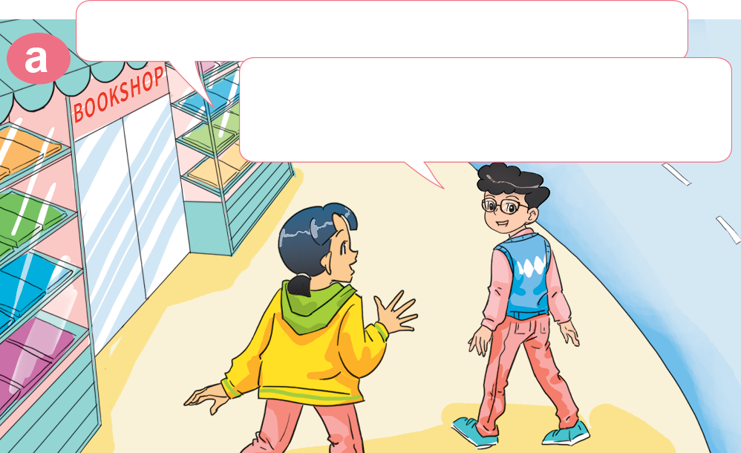
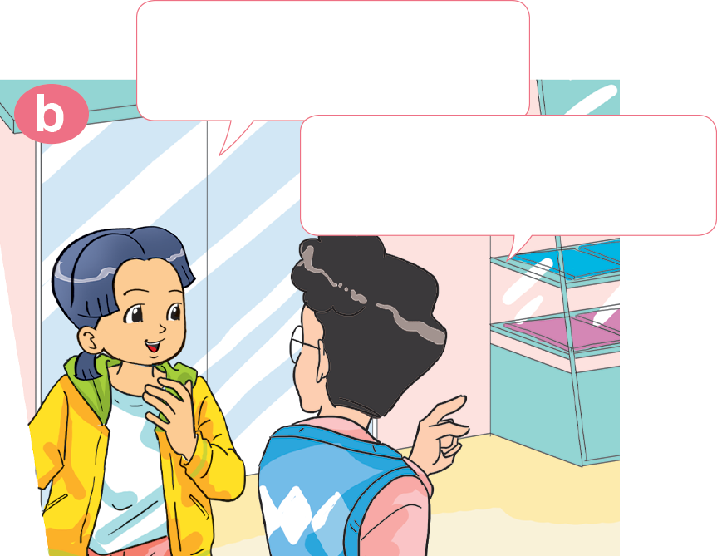
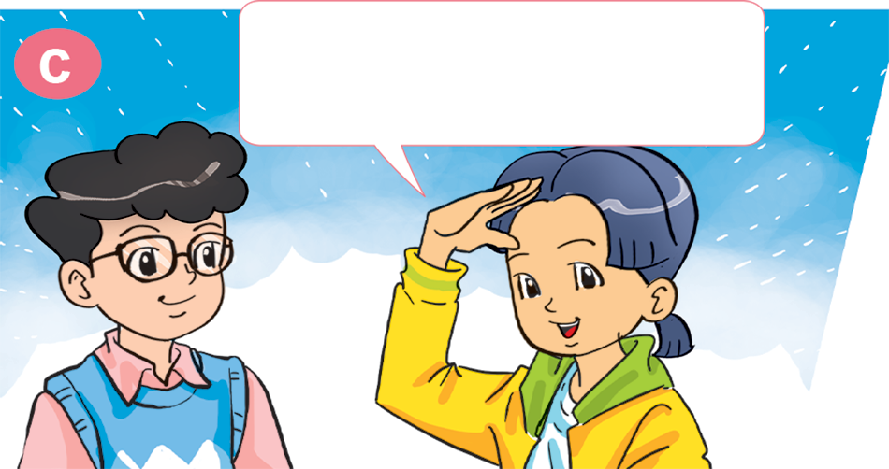
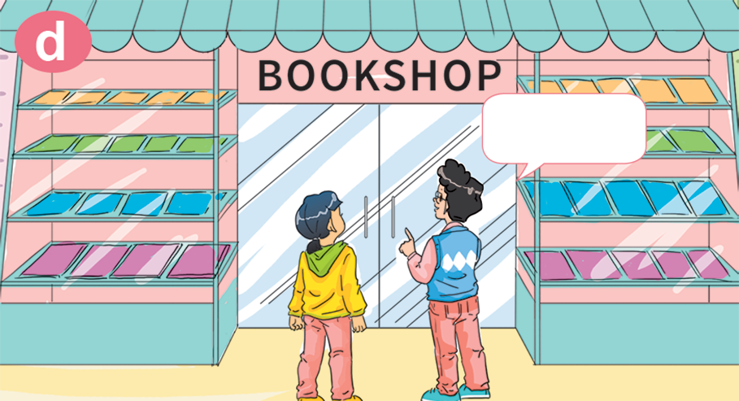
1. Look, listen and repeat.
Oh! I want to buy some books, too.
Hi, Phong. Where are you going?
I'm going to the bookshop. I want to buy some books.
OK. Let's go to the bookshop together.
Good idea! Where's the bookshop?
Here!

Slide 27
Let's go to the __________.
I want to ___________________.
pharmacy
buy some medicine
Great idea!

Slide 28
Let's go to the _____________.
I want to ___________________.
supermarket
buy some food
Great idea!

Slide 29
Let's go to the __________.
I want to ___________________.
bakery
buy some bread
Sorry. I'm busy.

Slide 30
Let's go to the ____________.
I want to ___________________.
sweet shop
buy some chocolate
Sorry. I'm busy.

Slide 31
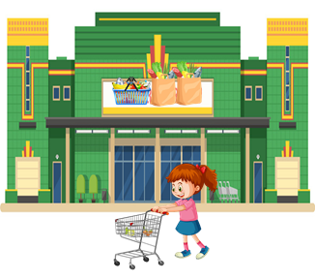
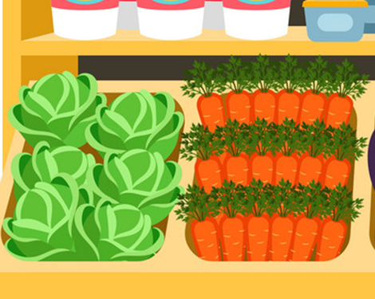
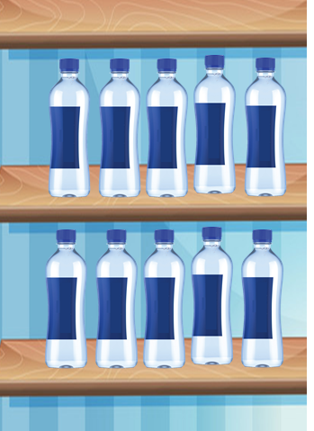
3. Listen and tick.
1. Where do Phong and Linda go?
2. What do they want?
a
b
a
b
3. Where do Mai and Tony go?
4. What do they want?
a
b
a
b

Slide 32
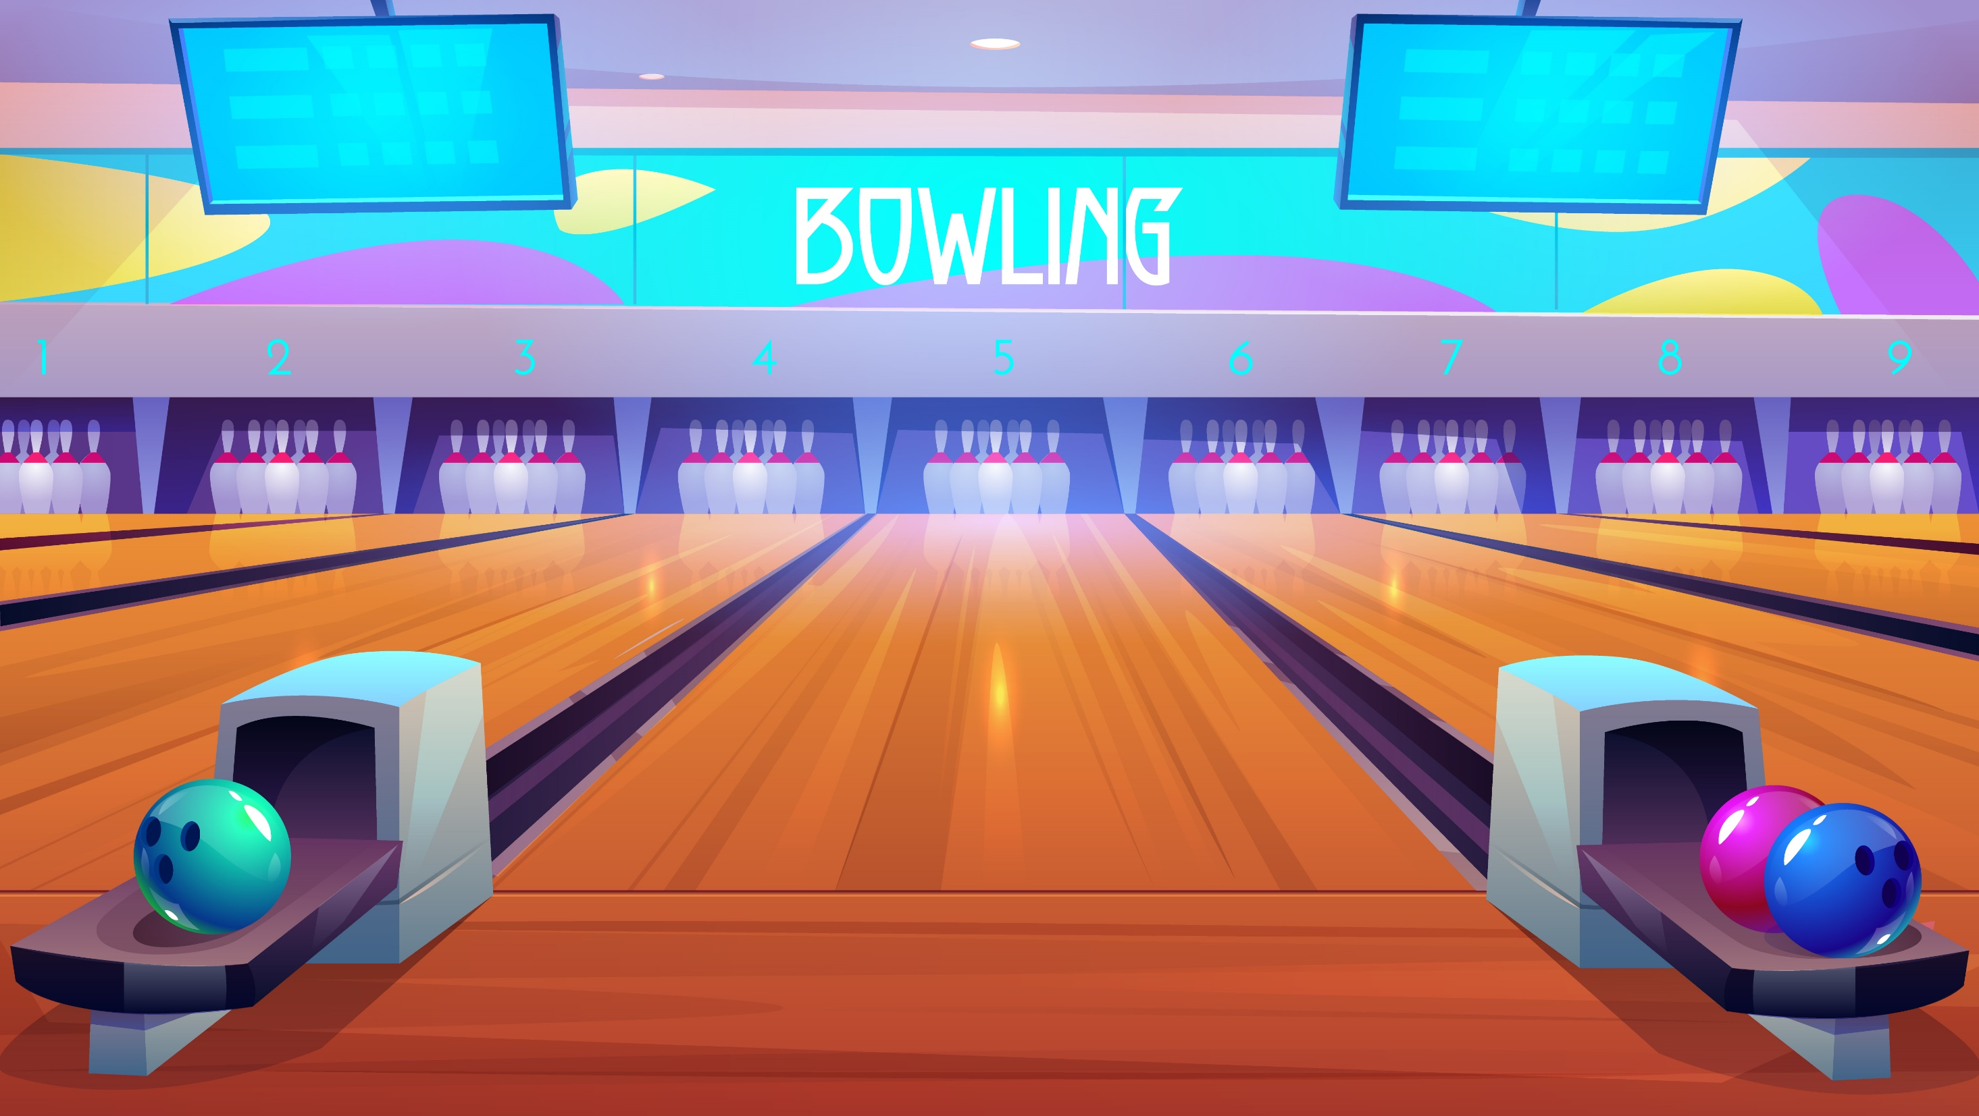
Notes:
Ms Huyền Phạm - 0936.082.789 – YOUTUBE: MsPham. Facebook: Dạy và học cùng công nghệ.

Slide 33
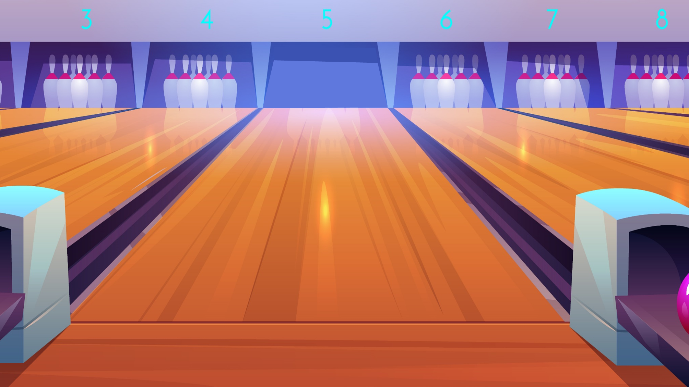
buy some food
buy some books
Let’s go to the bookshop.
I want to ______.
buy some chocolate
Next
Notes:
Ms Huyền Phạm - 0936.082.789 – YOUTUBE: MsPham. Facebook: Dạy và học cùng công nghệ.

Slide 34
buy some food
buy some medicine
Let’s go to the supermarket.
I want to ______.
buy some books
Next
Notes:
Ms Huyền Phạm - 0936.082.789 – YOUTUBE: MsPham. Facebook: Dạy và học cùng công nghệ.

Slide 35
buy some pens
buy some bread
Let’s go to the bakery. I want to ______.
buy some books
Next
Notes:
Ms Huyền Phạm - 0936.082.789 – YOUTUBE: MsPham. Facebook: Dạy và học cùng công nghệ.

Slide 36
buy some medicine
buy some vegetables
Let’s go to the sweet shop.
I want to ______.
buy some chocolate
Next
Notes:
Ms Huyền Phạm - 0936.082.789 – YOUTUBE: MsPham. Facebook: Dạy và học cùng công nghệ.

Slide 37
buy some medicine
buy some food
Let’s go to the pharmacy.
I want to ______.
buy some bread
Notes:
Ms Huyền Phạm - 0936.082.789 – YOUTUBE: MsPham. Facebook: Dạy và học cùng công nghệ.

Slide 38
b. am like
Great idea.
Sorry. I’m busy.
Let’s go to the bakery. I want to buy some bread.
Next
Notes:
Ms Huyền Phạm - 0936.082.789 – YOUTUBE: MsPham. Facebook: Dạy và học cùng công nghệ.

Slide 39
b. am like
Great idea.
Sorry. I’m busy.
Let’s go to the pharmacy.
I want to buy some medicine.
Next
Notes:
Ms Huyền Phạm - 0936.082.789 – YOUTUBE: MsPham. Facebook: Dạy và học cùng công nghệ.

Slide 40
Let’s go to the bookshop.
Let’s go to the supermaket.
________
I want to buy some food.
Let’s go to the pharmacy.
Next
Notes:
Ms Huyền Phạm - 0936.082.789 – YOUTUBE: MsPham. Facebook: Dạy và học cùng công nghệ.

Slide 41
Let’s go to the sweet shop.
Let’s go to the pharmacy.
________
I want to buy some chocolate.
Let’s go to the bookshop.
Notes:
Ms Huyền Phạm - 0936.082.789 – YOUTUBE: MsPham. Facebook: Dạy và học cùng công nghệ.

Slide 42
Let’s go to the bookshop.
Let’s go to the bakery.
________
I want to buy some books.
Let’s go to the sweetshop.
Next
Notes:
Ms Huyền Phạm - 0936.082.789 – YOUTUBE: MsPham. Facebook: Dạy và học cùng công nghệ.

Slide 43
TIME’S UP
Notes:
Ms Huyền Phạm - 0936.082.789 – YOUTUBE: MsPham. Facebook: Dạy và học cùng công nghệ.

Slide 44
4. Look and write.
to the bookshop
to the bakery
Let's go ________________. I want to ________________.
Let's go________________. I want to ________________.
buy some books
buy some cakes
to the sweet shop
to the pharmacy
Let's go ________________. I want to ________________.
Let's go ________________.
I want to __________________.
buy some sweets
buy some medicine

Slide 45
5. Let's sing.

