Slide 1
Friday, March 25th 2022
Unit 16
LET'S GO TO
THE BOOKSHOP
Lesson 2

Slide 2
VOCABULARY

Slide 3
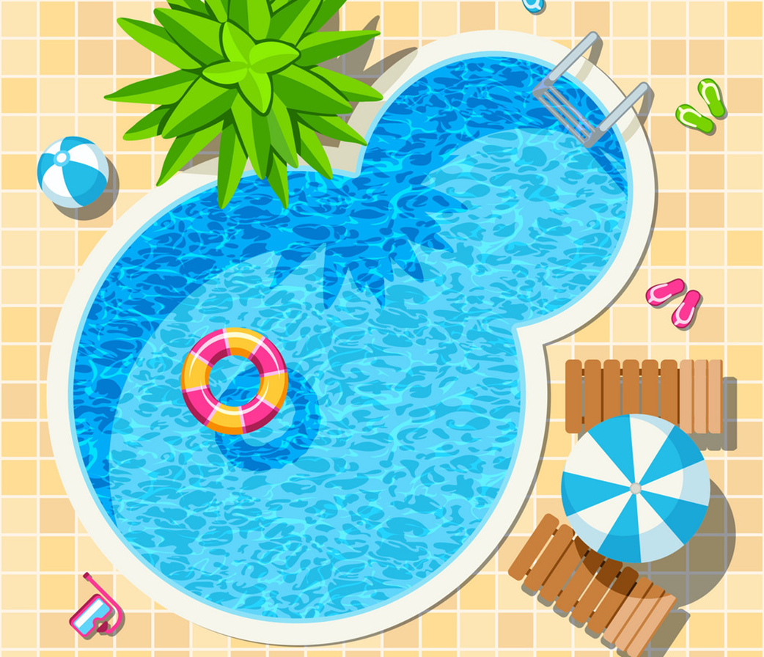
Vocabulary
swimming pool
/ˈswɪmɪŋ puːl/

Slide 4
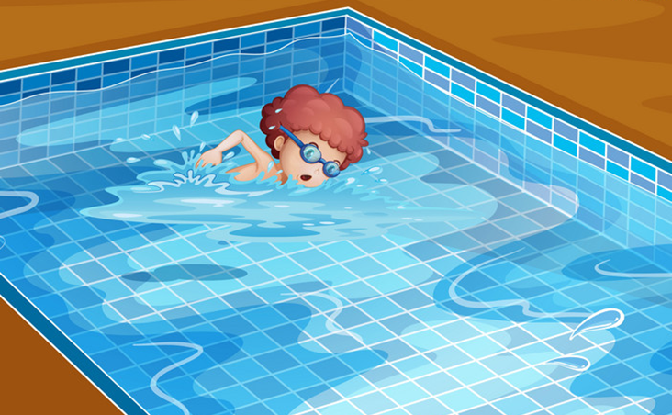
Vocabulary
swim
/swɪm/

Slide 5

Vocabulary
cinema
/ˈsɪnəmə/

Slide 6
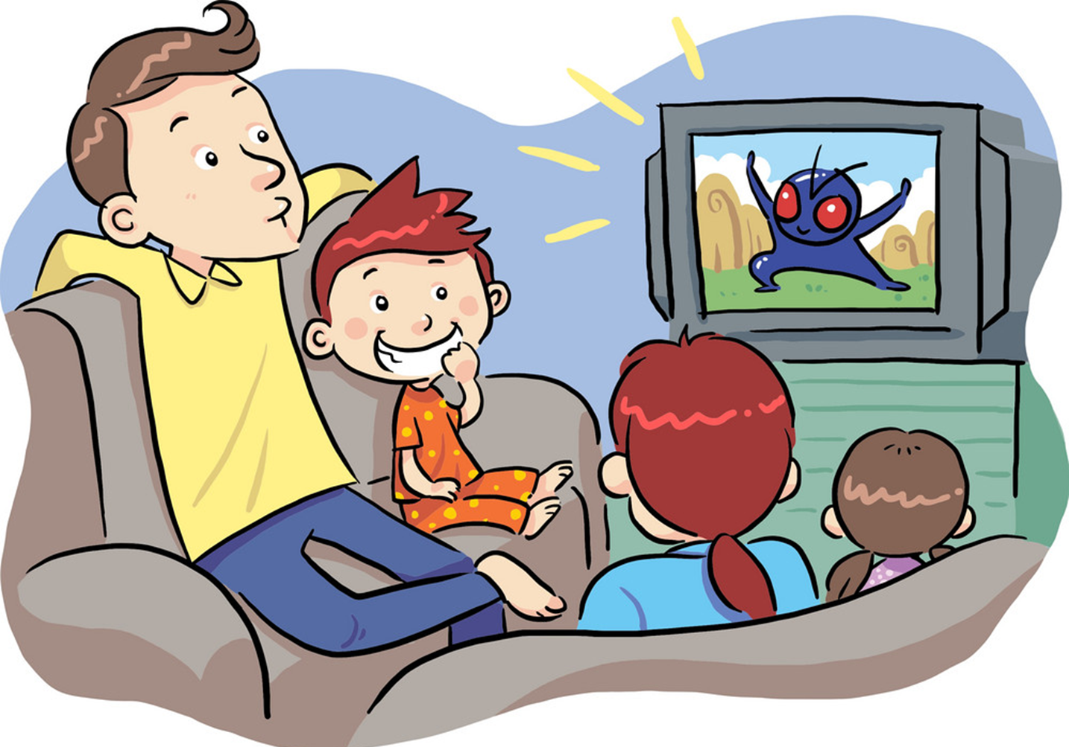
Vocabulary
see a film
/ siː ə fɪlm/

Slide 7
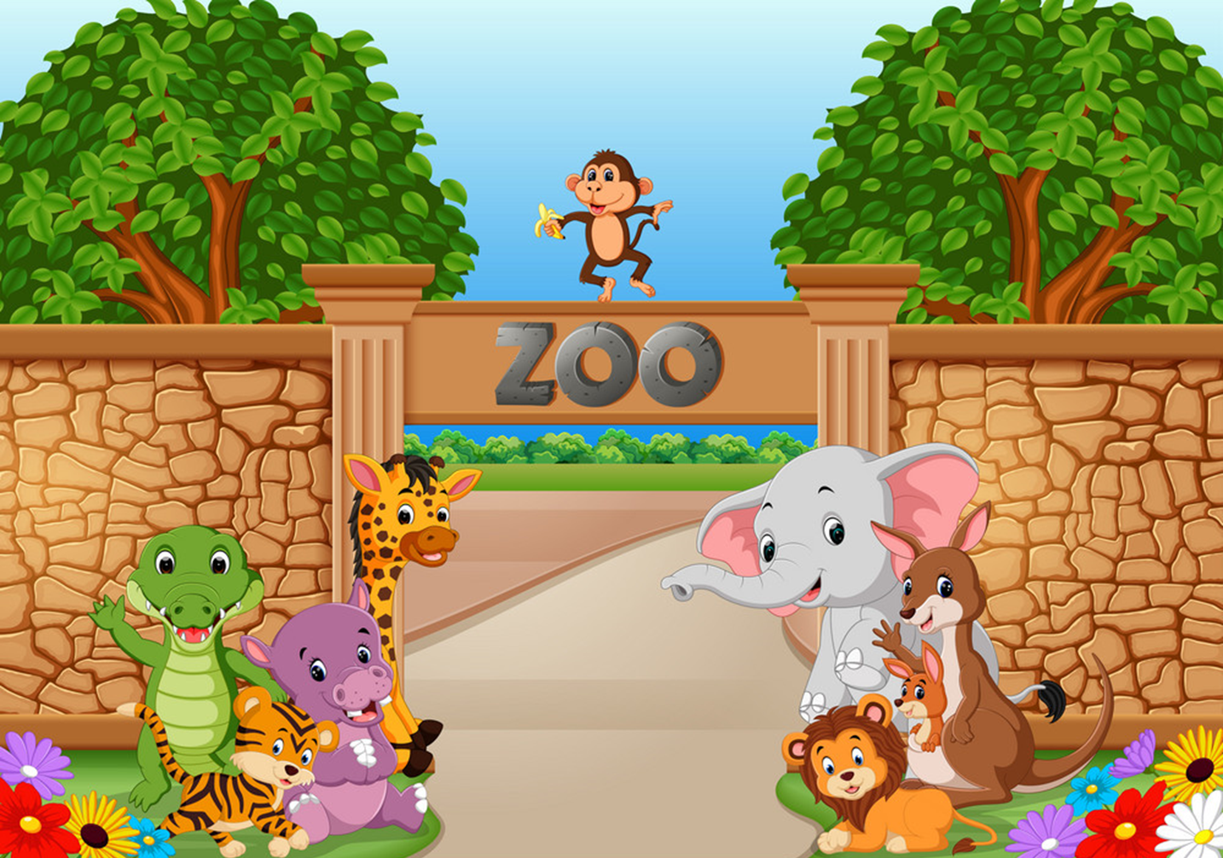
Vocabulary
zoo
/zuː/

Slide 8
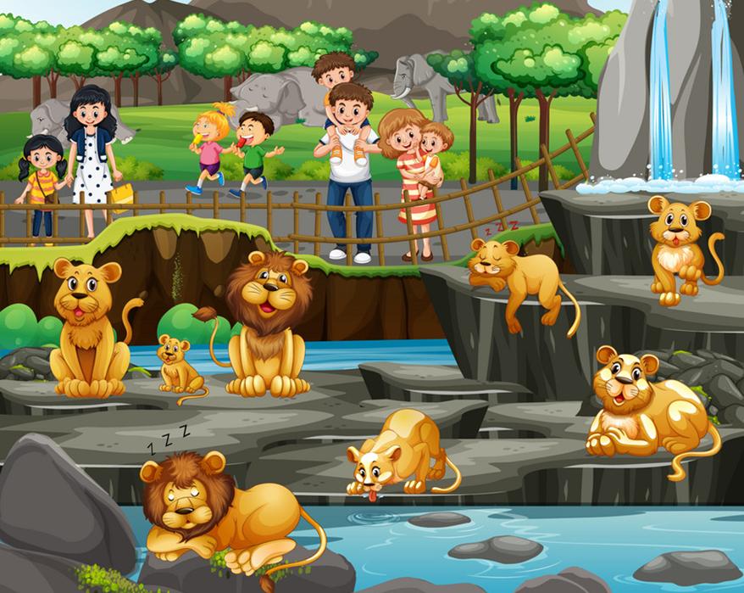
Vocabulary
see animals
/ siː ˈænɪmlz/

Slide 9
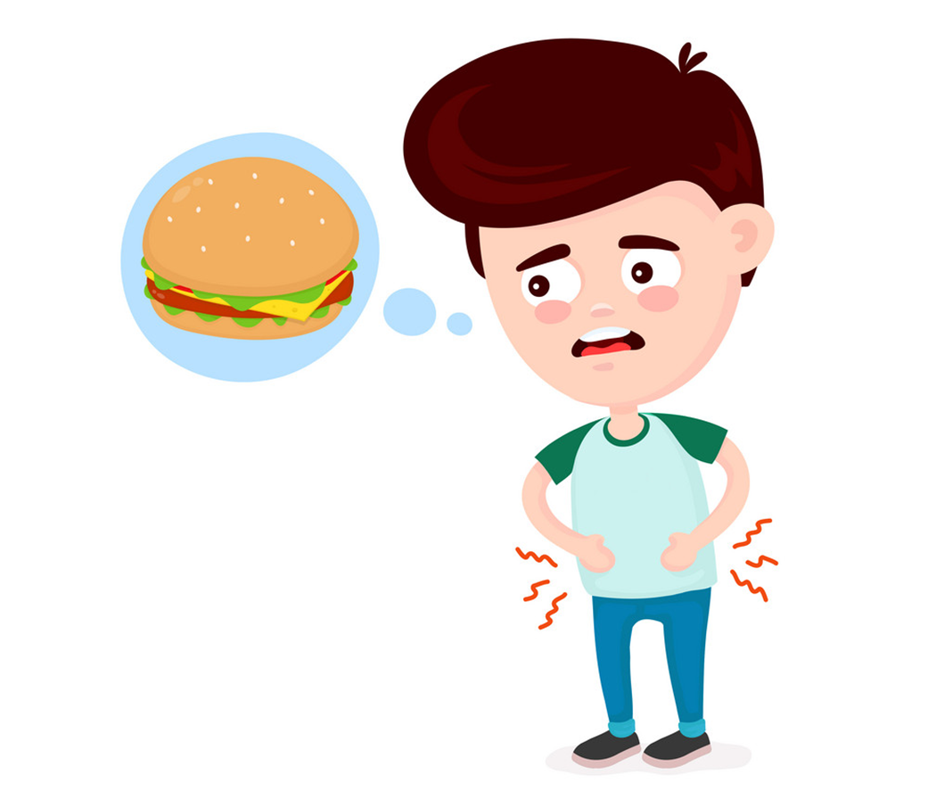
Vocabulary
hungry
/ˈhʌŋɡri/

Slide 10
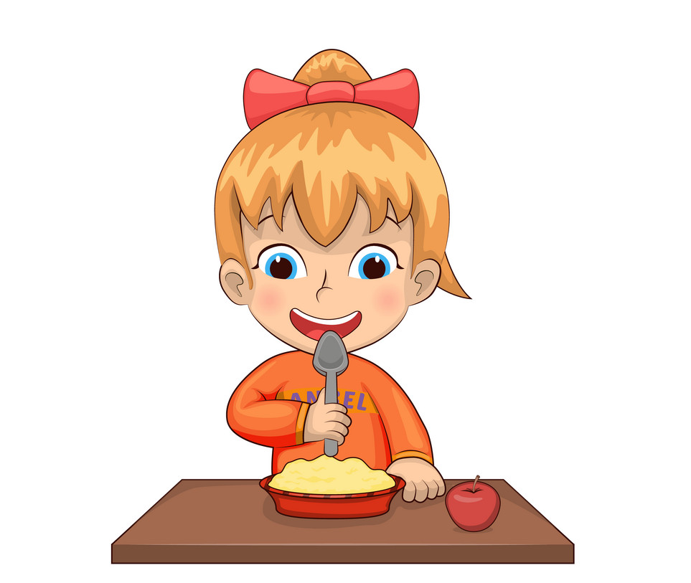
Vocabulary
eat
/iːt/

Slide 11

Vocabulary
1
2
3
4
swimming pool
swim
cinema
see a film
5
6
7
8
zoo
see animals
hungry
eat

Slide 12
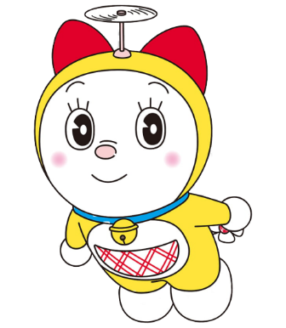


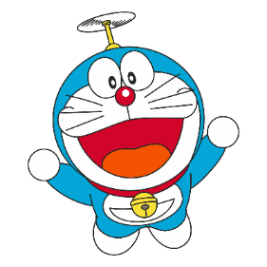
Find the correct picture.
1
2
3
4
5
6
7
8
swimming pool

Slide 13
Find the correct picture
1
2
3
4
5
6
7
8
swim

Slide 14
Find the correct picture.
1
2
3
4
5
6
7
8
cinema

Slide 15
Find the correct picture
1
2
3
4
5
6
7
8
zoo

Slide 16
Find the correct picture.
1
2
3
4
5
6
7
8
see a film

Slide 17
Find the correct picture.
1
2
3
4
5
6
7
8
see animals

Slide 18
Find the correct picture.
1
2
3
4
5
6
7
8
eat

Slide 19

Find the correct picture.
1
2
3
4
5
6
7
8
hungry

Slide 20
GRAMMAR

Slide 21

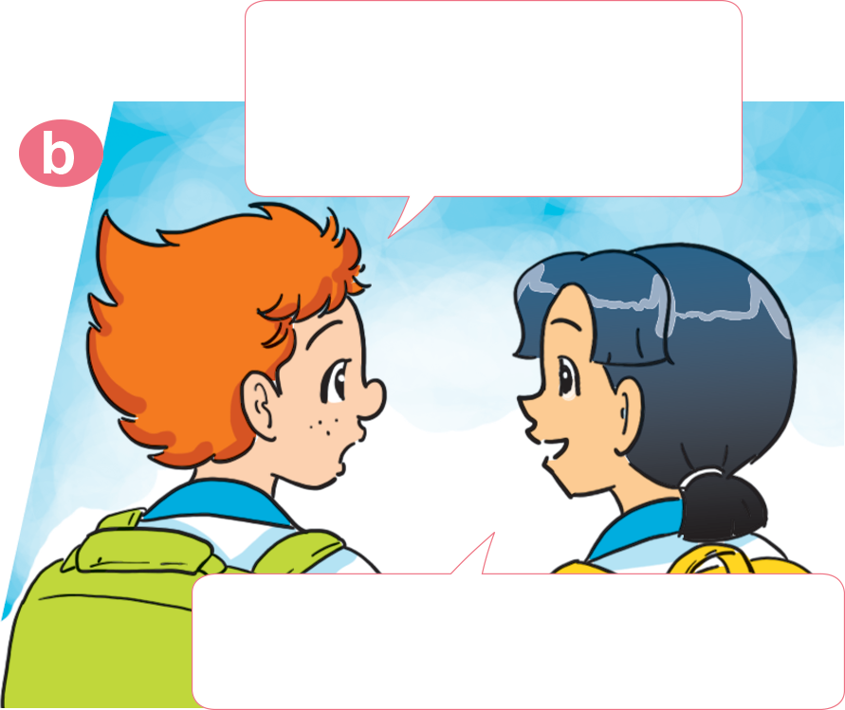
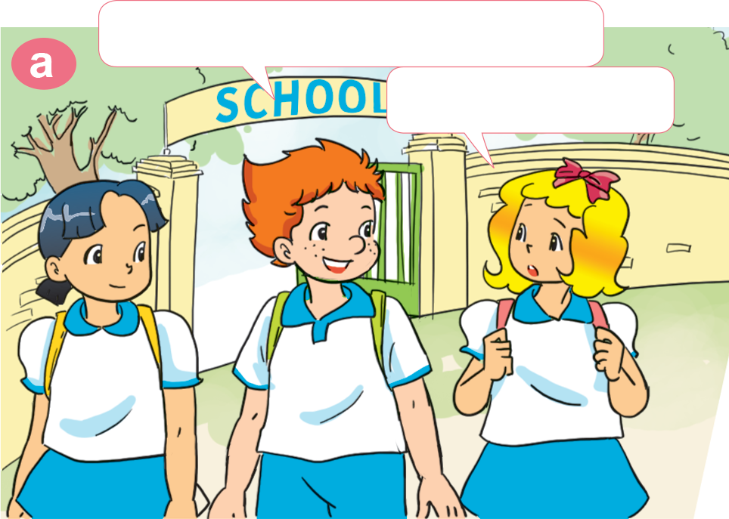
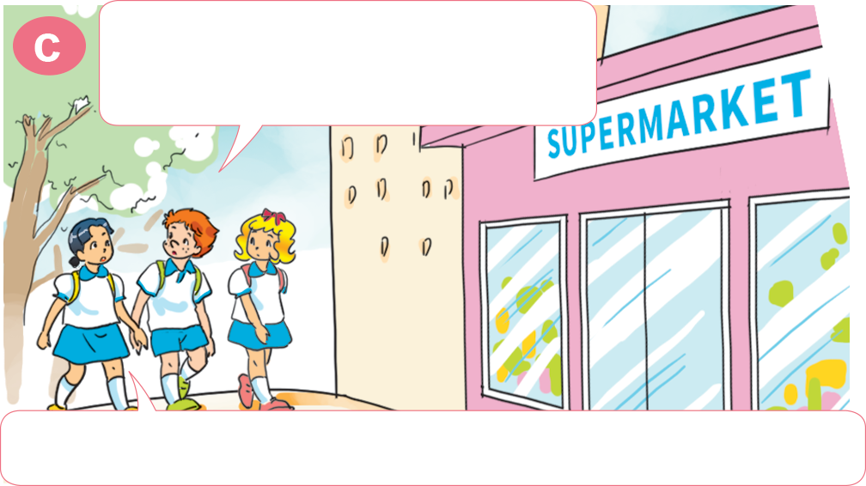
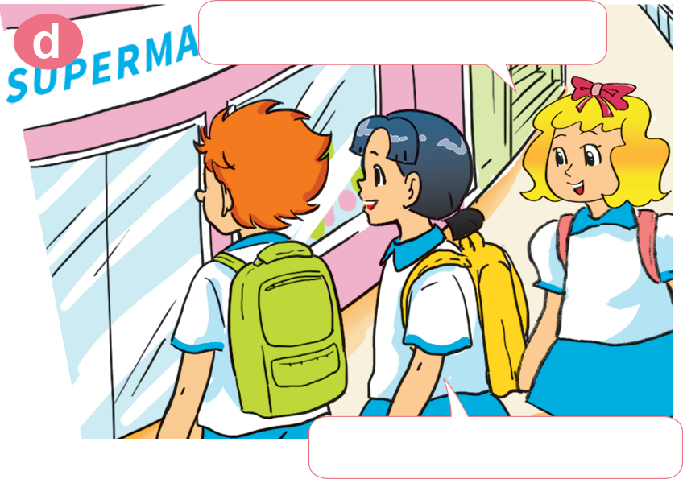
1. Look, listen and repeat.
How about you, Mai?
Would you like to go to the zoo?
Let's go to the zoo, Linda.
Sorry. I can't.
Yes, I'd like to. Can we go to the supermarket first?
Why do you want to go to the supermarket?
Me too! I'm hungry!
Because I want to buy something to eat.
Let's go together.

Slide 22
2. Point and say
Why do you want to go to the ________?
Because _______________________.
zoo
I want to see the animals

Slide 23
2. Point and say
Why do you want to go to the _______________?
Because _____________________.
swimming pool
I want to swim

Slide 24
2. Point and say
Why do you want to go to the ________?
Because _______________________.
cinema
I want to see a film

Slide 25
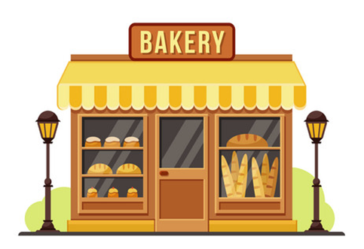
2. Point and say
Why do you want to go to the ________?
Because _______________________.
bakery
I want to buy some bread

Slide 26
3. Listen and circle.
1. Mai wants to go to the ______.
a. zoo b. sweet shop c. bookshop
2. Tony wants to go to the ______.
a. bakery b. pharmacy c. cinema
3. Phong wants to buy some ______.
a. books b. pens c. ruler
4. Tom wants to buy some ______.
a. sweets b. chocolate c. bread

Slide 27
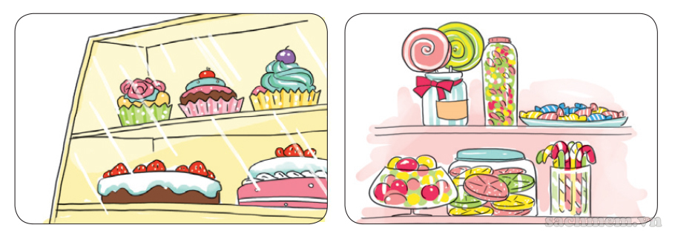
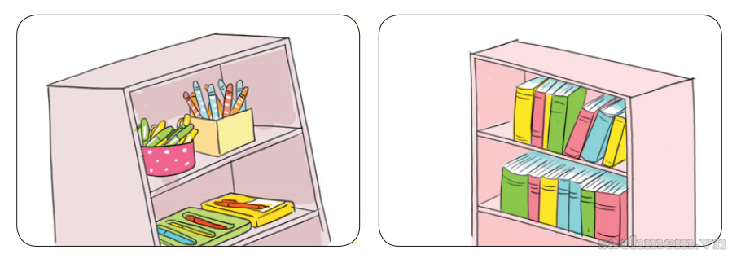
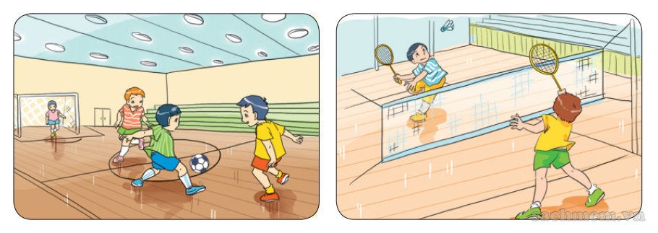
5. Look and write
A: Why does he want to go to the supermarket?
B: Because _____________________________
_____________________.
he wants to buy some cakes and
sweets
A: Why does she want to go to the bookshop?
B: Because _____________________________
_______________________.
she wants to buy some pens and
books
A: Why do they want to go to the gym?
B: Because _____________________________
____________________.
they want to play football and
badminton

Slide 28
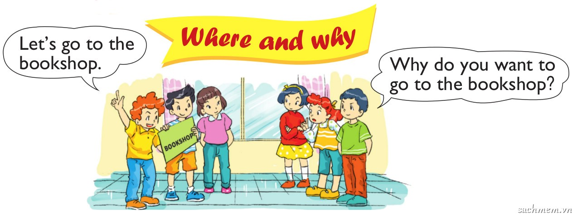
6. Let's play.

Slide 29
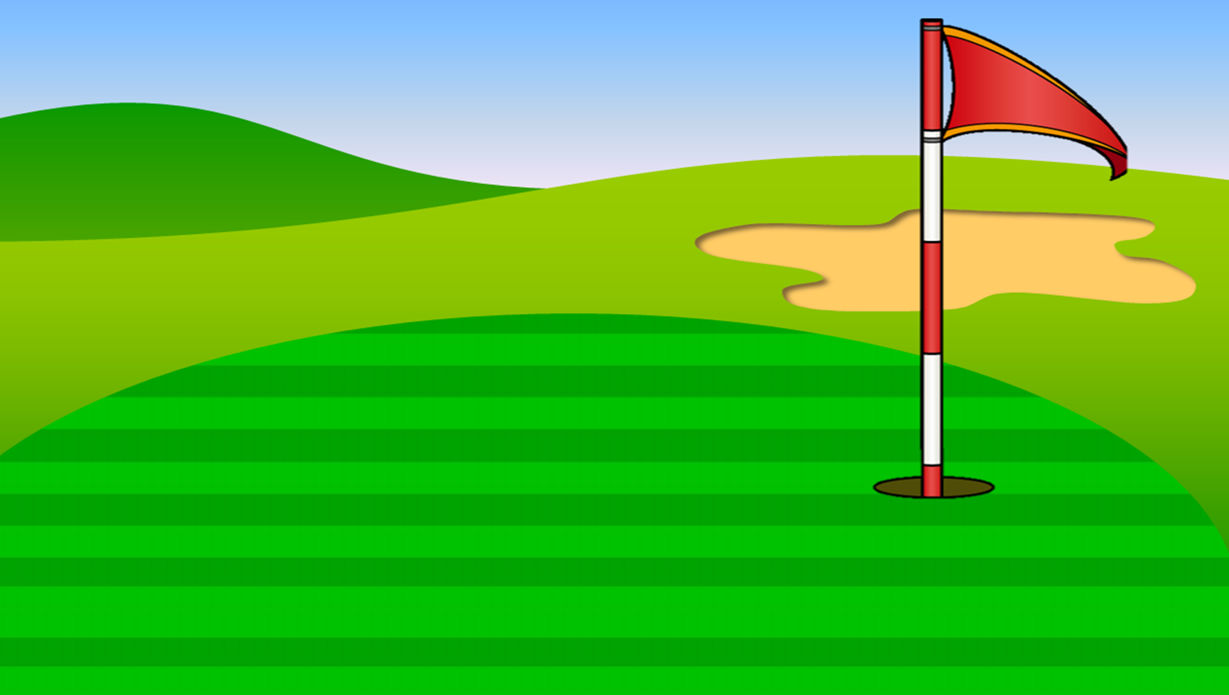
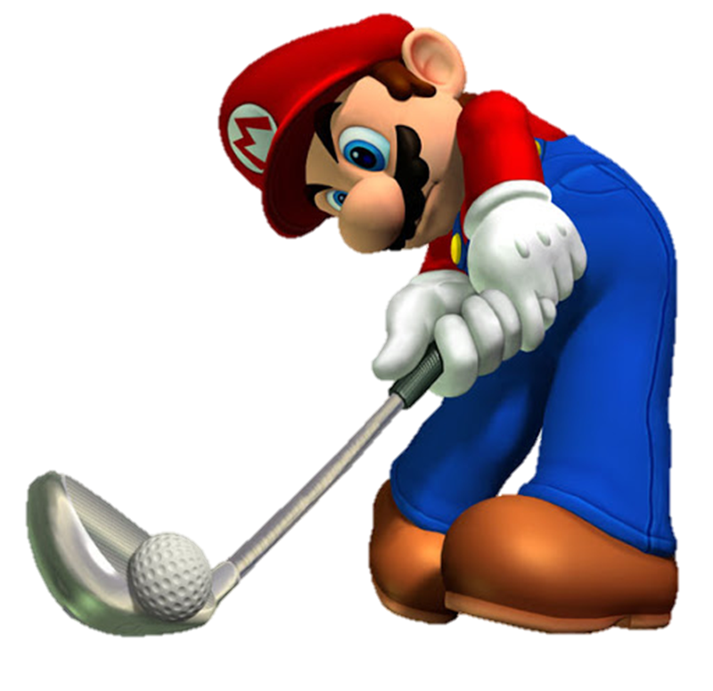
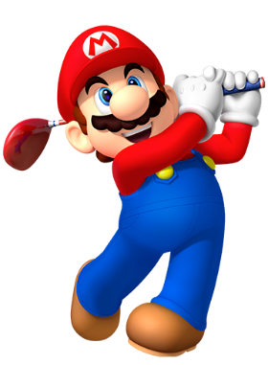

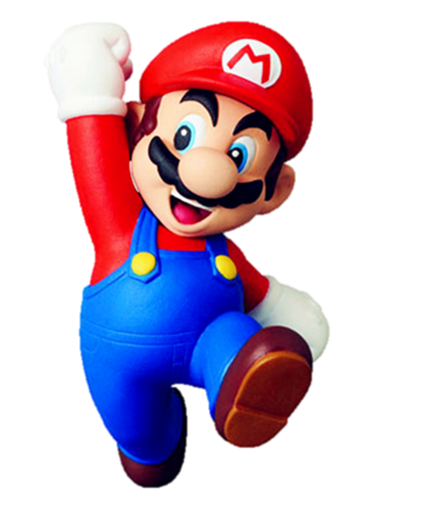


Slide 30






Why do you want to go to the supermarket?
________ I want to buy some food.
Yes
Because
No

Slide 31
______ do you want to go to the bakery?
Because I want to buy some bread.
What
Why
How

Slide 32
Why do you want to go to the cinema?
Because I want to _______.
see animals
buy some food
see a film

Slide 33
Why do you want to go to the _______?
Because I want to buy some books.
zoo
cinema
bookshop

Slide 34
Why do you want to go to the swimming pool?
Because I want to _______.
swim
eat
see a film

Slide 35
Why do you want to go to the zoo?
Because I want to _______.
see animals
see a film
play football

Slide 36
Why ____ you want to go to the sweetshop?
Because I want to buy some chocolate.
are
do
does

Slide 37
Why ____ she want to go to the pharmacy?
Because she wants to buy some medicine.
do
does
is

Slide 38
Why _____ your father want to go to the cinema?
Because he wants to see a film.
is
do
does

Slide 39
Why do you want to go to the supermarket?
Because I ______ to eat something.
wants
want
wantes

Slide 40
Why does he want to go to the cinema?
Because he ____ to see a film.
wants
want
play football

Slide 41
Why does she want to go to the cinema?
Because she ____ to see a film.
wants
want
play football

Slide 42


