Slide 2
Lesson 1
Look and match.
dog
bird
cat
Notes:
Click on the words, they will move and match up with the pictures.

Slide 3
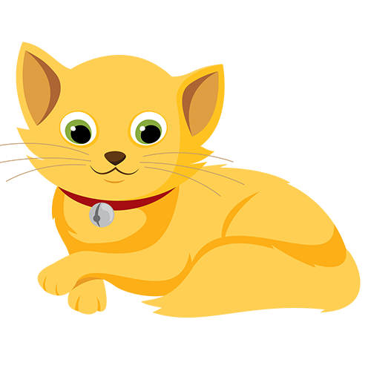
Lesson 1
Notes:
Click on the speaker to play the sounds, then click on the correct pictures.

Slide 4
Lesson 1
What is it?
dog
cat
dog
bird
dog
cat
bird
cat
bird
Notes:
Click on any shape to reveal the animal behind.

Slide 5
Lesson 1

Slide 6
Lesson 1
Notes:
Click on the screen, a bird will fly in over the cats/dogs, and students will say I like... accordingly.

Slide 7
Lesson 1

Slide 8
Lesson 1
Notes:
Click on the speaker to play the sounds, then click on the correct pictures.

Slide 9
Lesson 1
What is it?
dog
cat
dog
bird
dog
cat
bird
cat
bird
Notes:
Click on any shape to reveal the animal behind.

Slide 11
Lesson 2

Slide 12
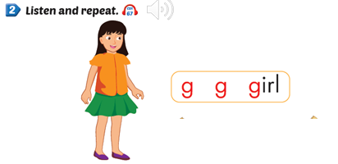

Slide 13
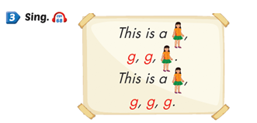

Slide 15
Lesson 2

Slide 16
Lesson 2

Slide 17
Play game: Clap your hand

Slide 19
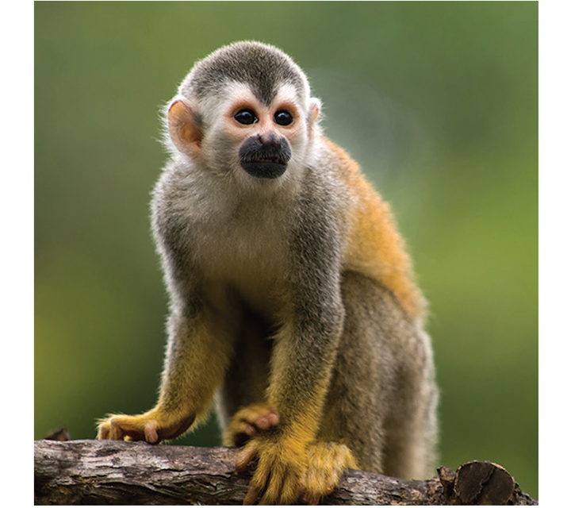
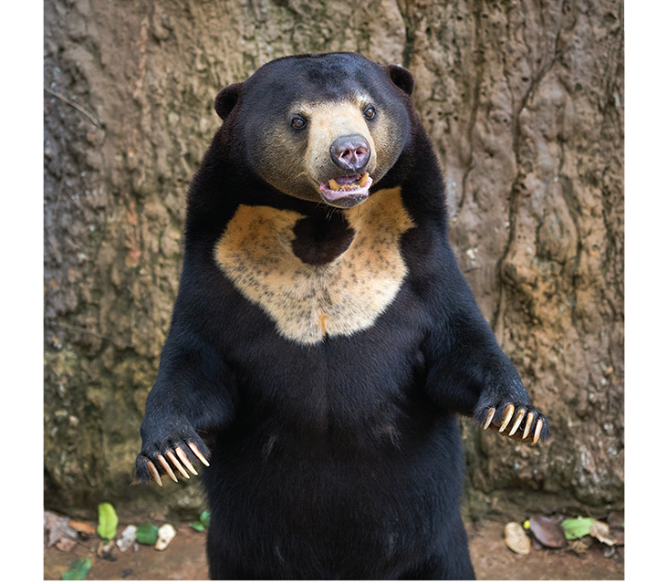
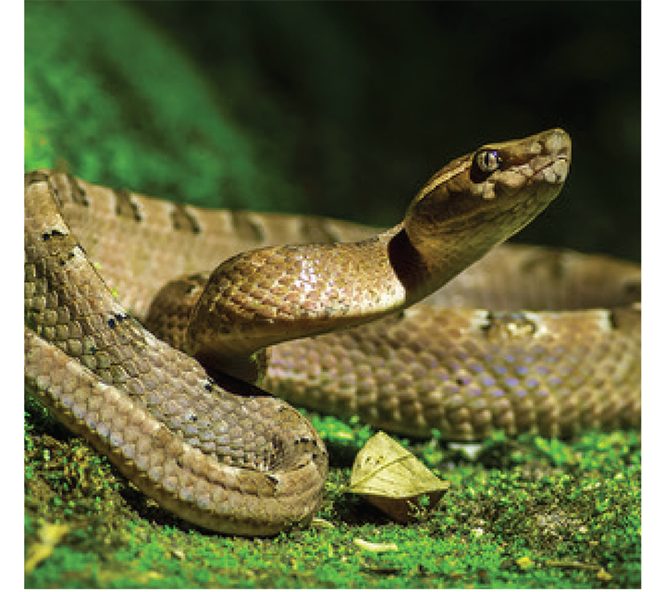
Lesson 3
What’s inside?
Notes:
Click on a gift box to show the animal behind.

Slide 20
Lesson 3

Slide 21
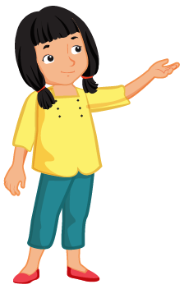
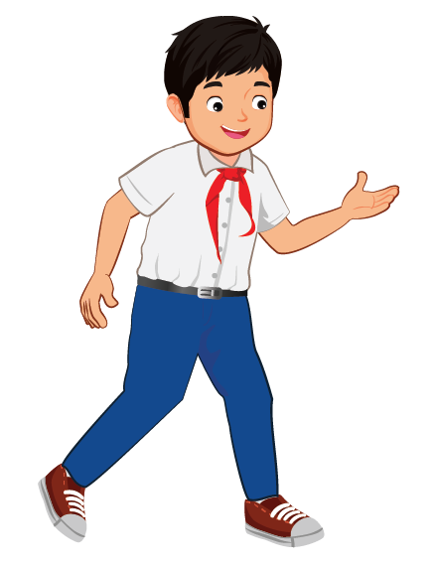
Lesson 3
Notes:
Click on a speaker, a boy/girl will move to the animal mentioned in the recording.

Slide 22
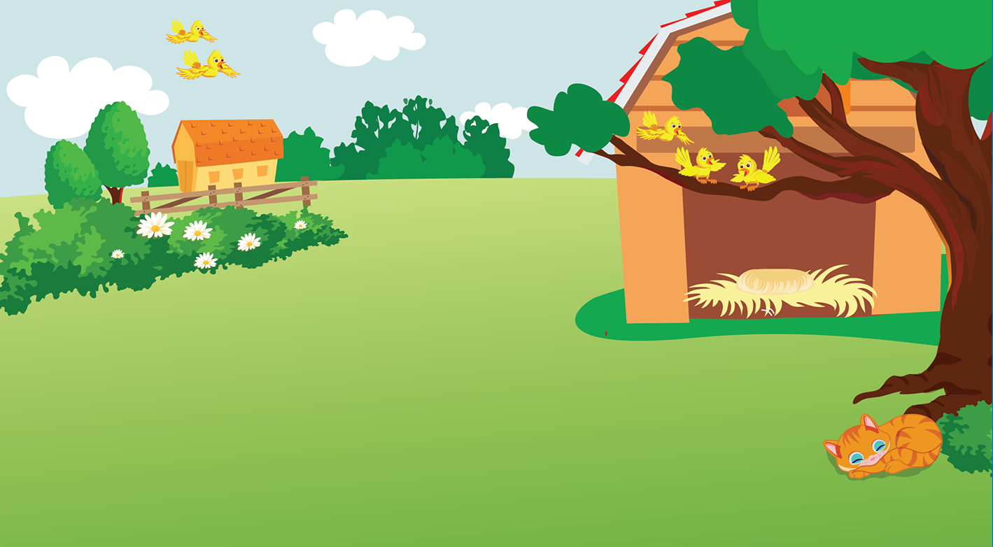
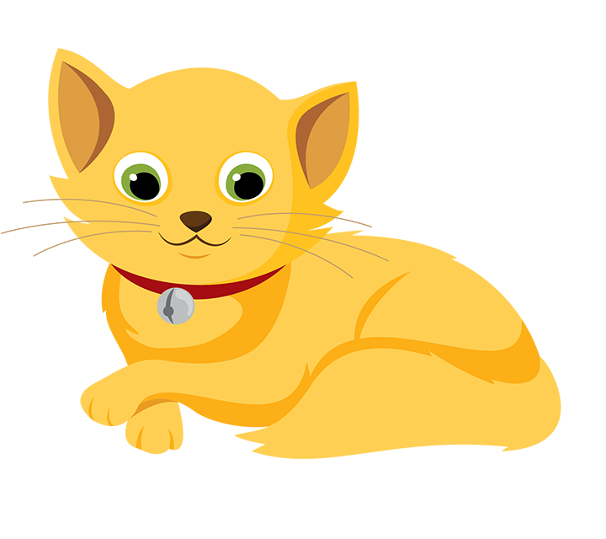
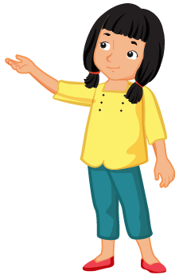
Lesson 3
This is a…
This is a…
Notes:
Click on either the boy or the girl to show an animal, and the students will say “this is a…” accordingly.

Slide 23
Lesson 3

Slide 24
Lesson 3

Slide 25
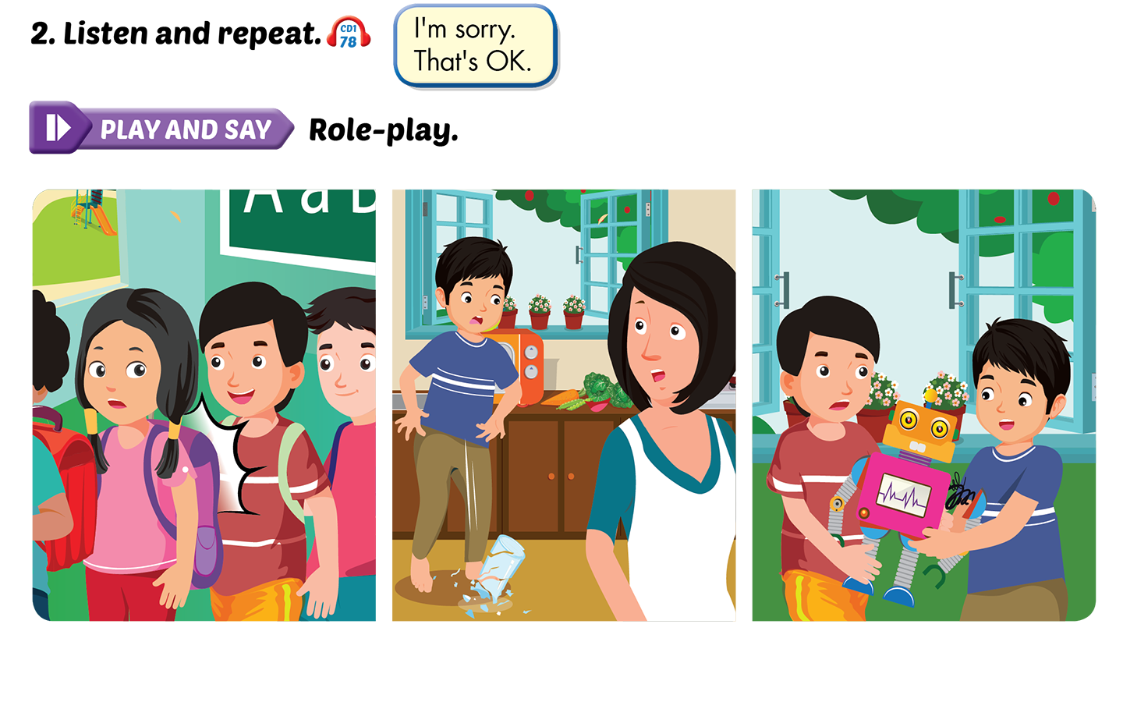
Lesson 3
Notes:
Click on the speech bubbles to play the audio.

