Slide 2
Lesson 1

Slide 3
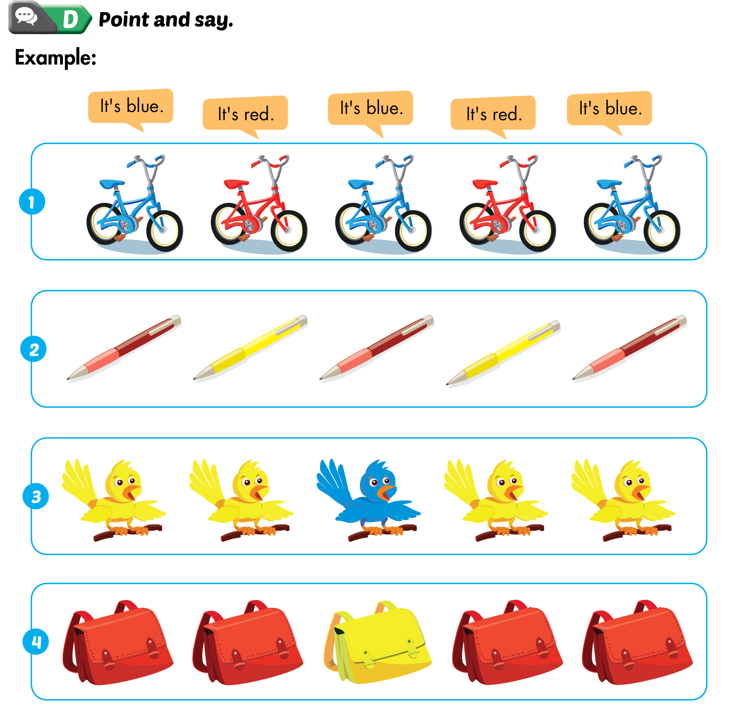
Lesson 1

Slide 4
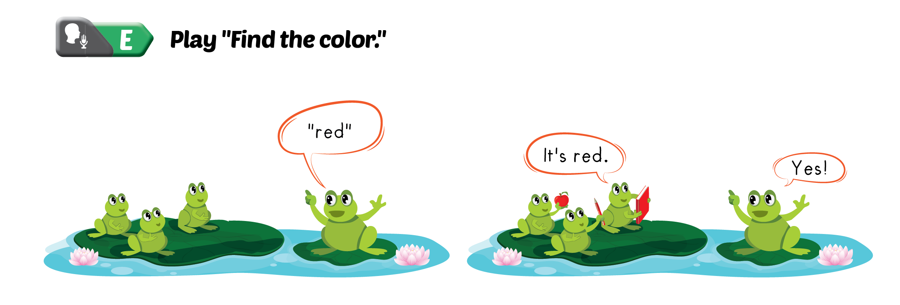
Lesson 1

Slide 6
Lesson 2

Slide 7
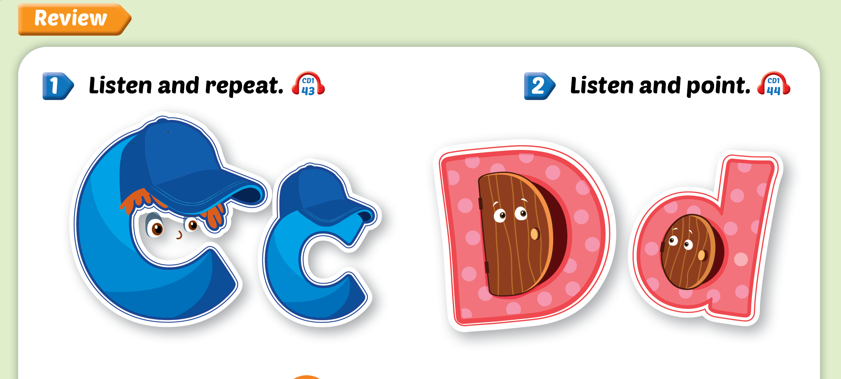
Lesson 2

Slide 8
Lesson 2
c
d

Slide 9
Lesson 2

Slide 11
Lesson 3

Slide 12
Lesson 3

Slide 13
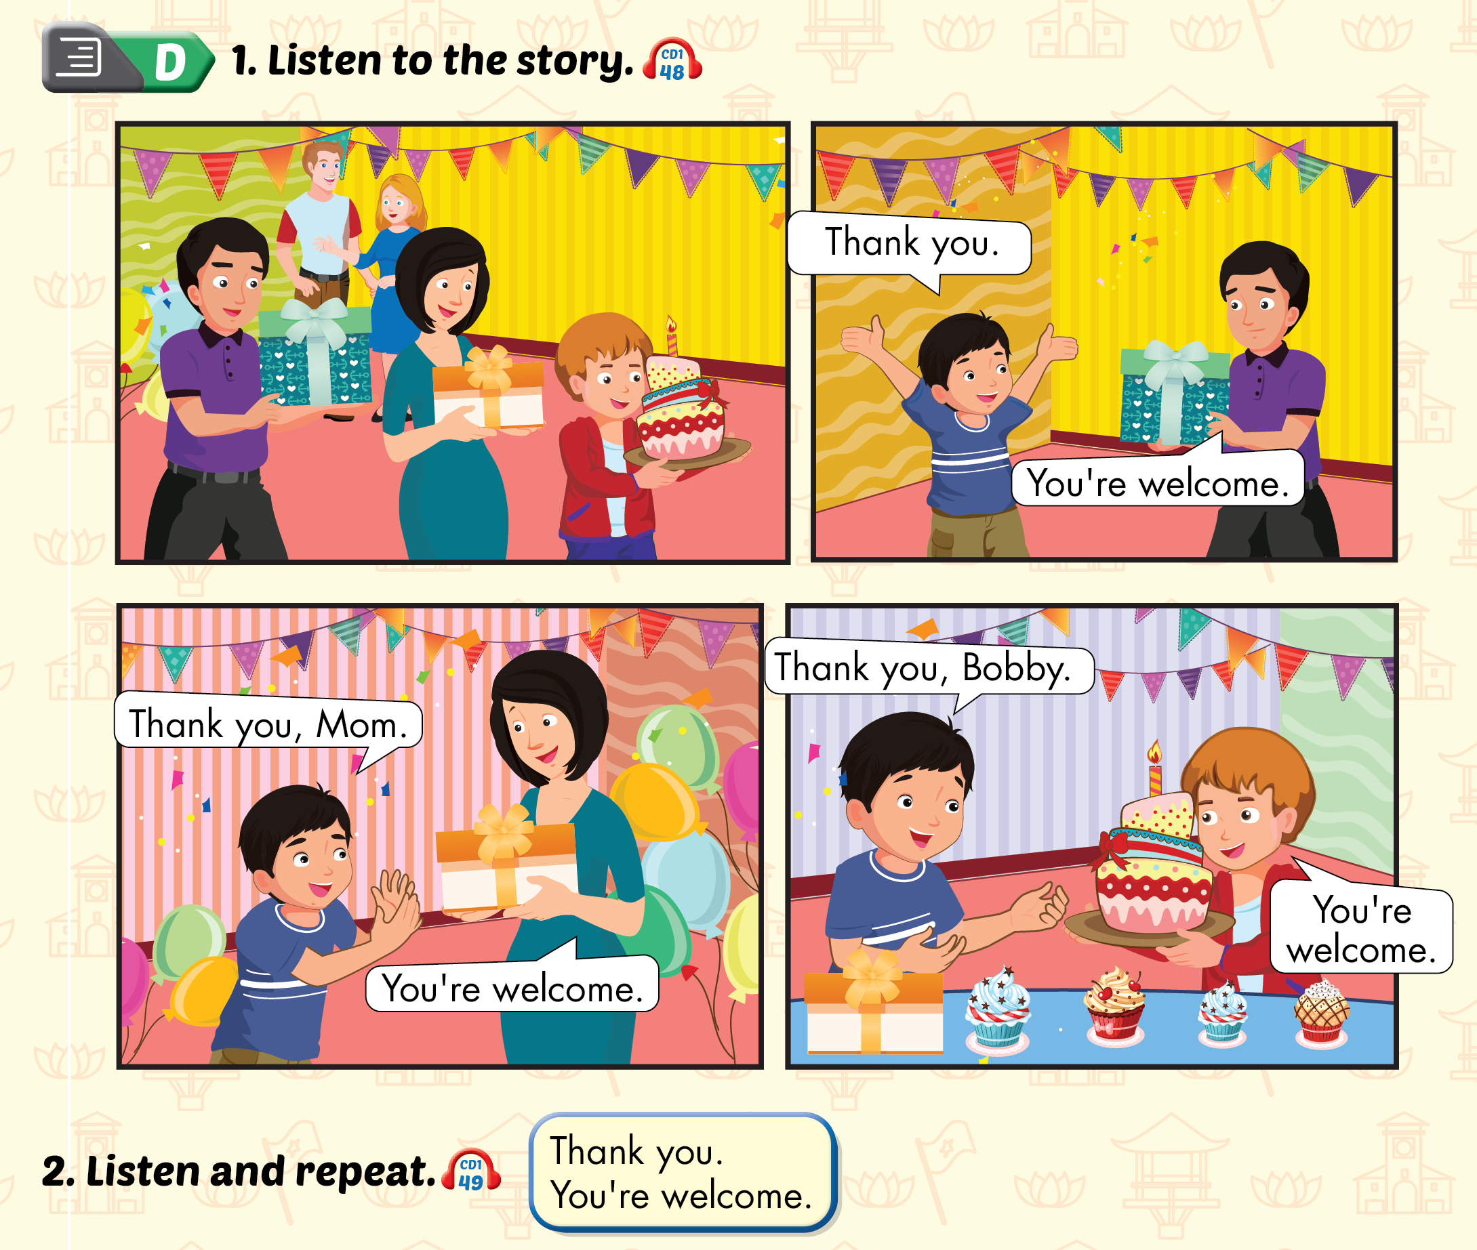
Lesson 3

Slide 14
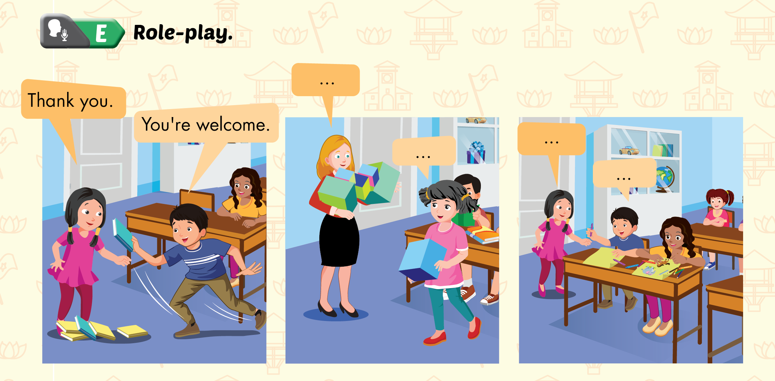
Lesson 3

