Slide 2
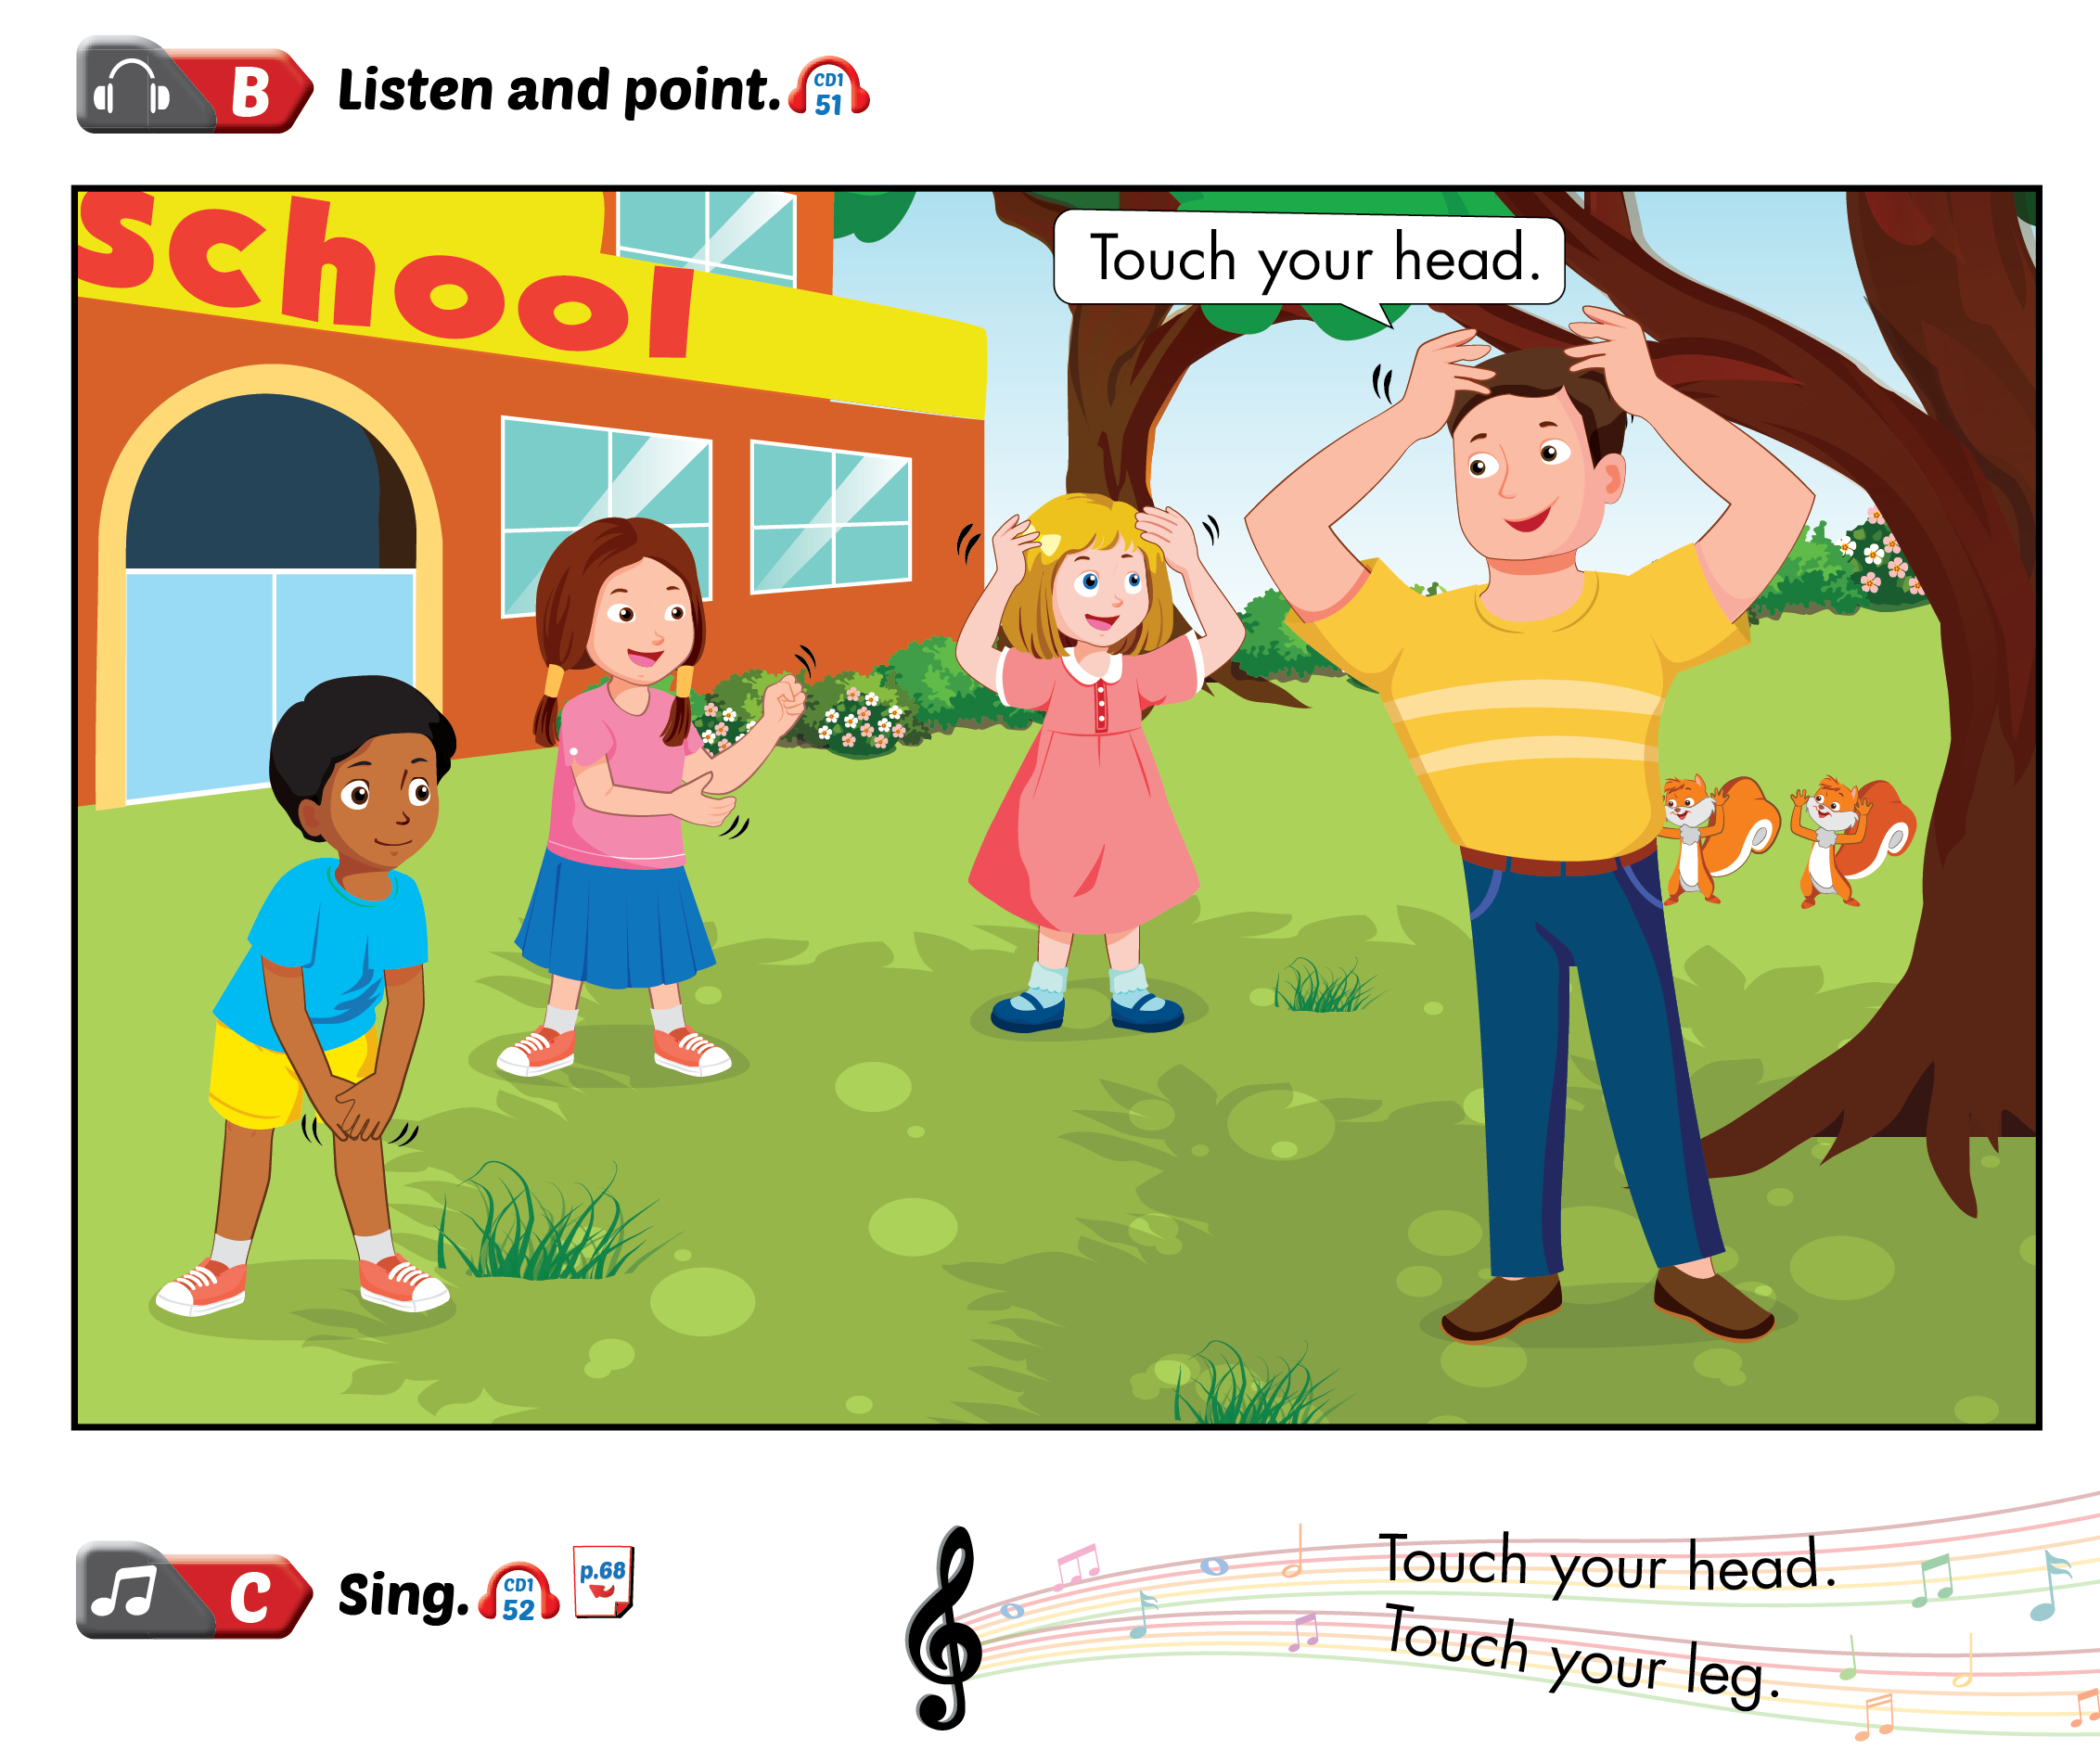
Lesson 1

Slide 3
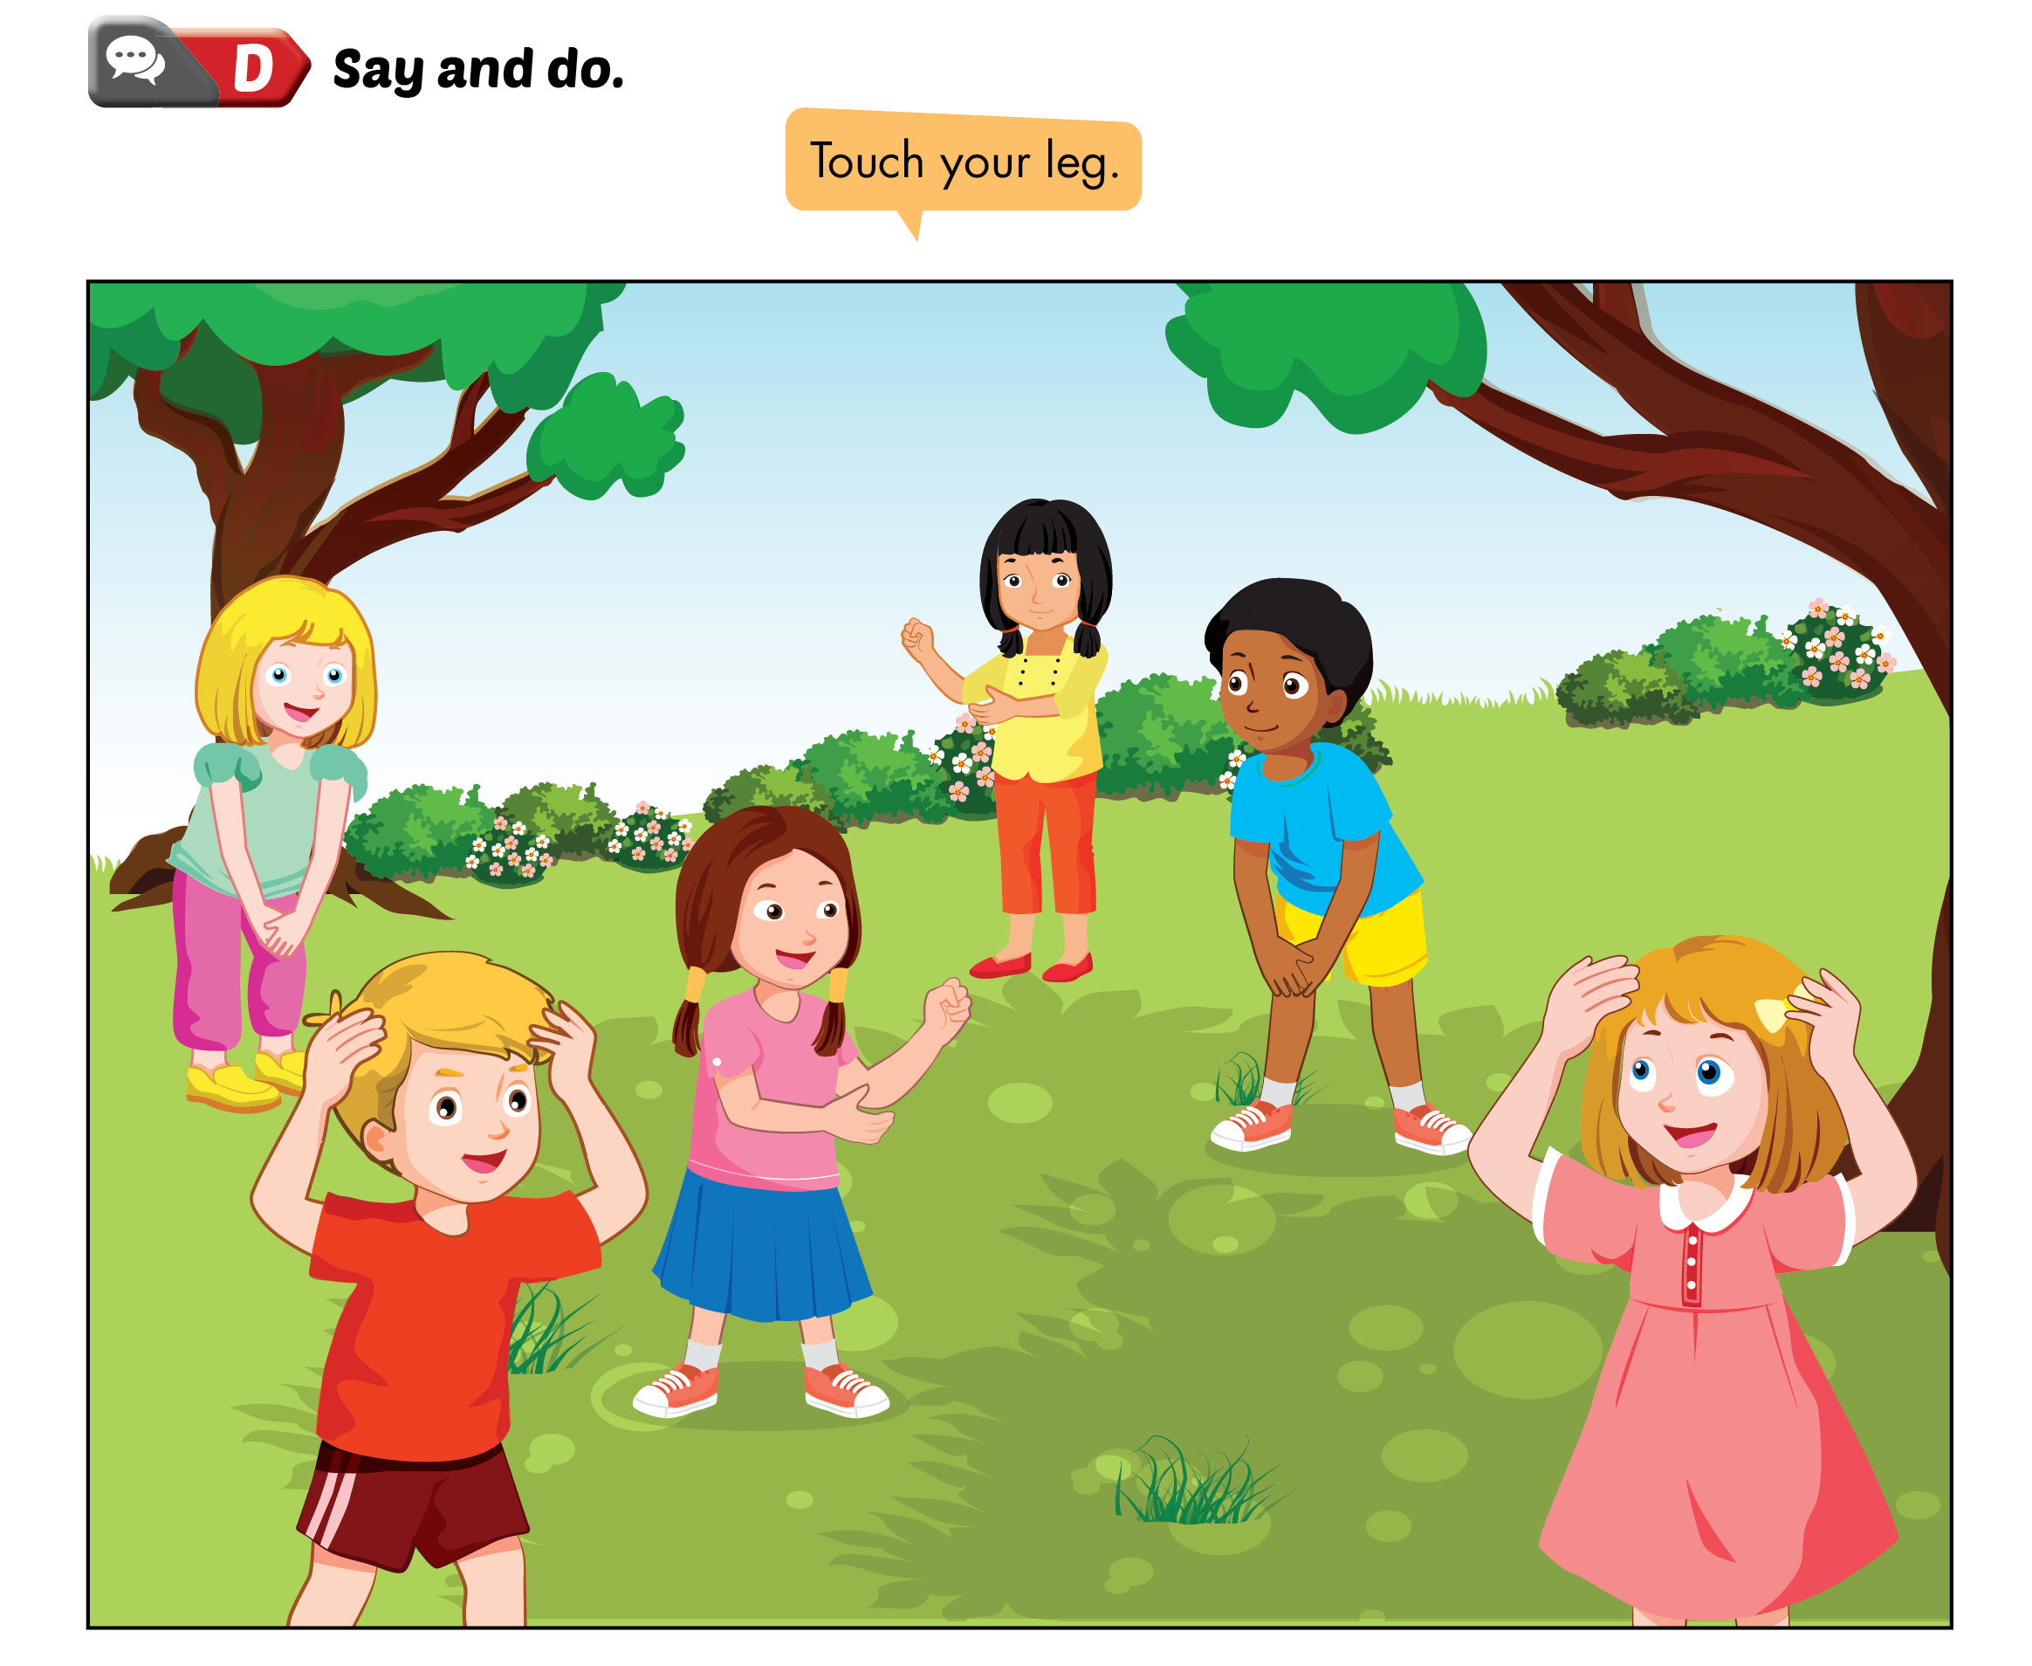
Lesson 1

Slide 4
Lesson 1

Slide 6
Lesson 2

Slide 7
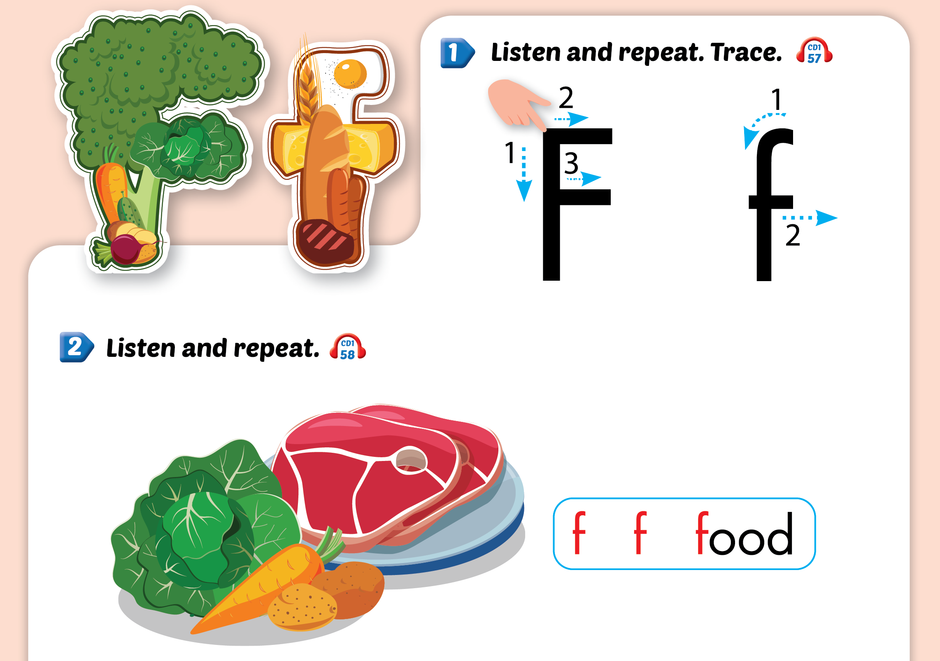
Lesson 2

Slide 8
Lesson 2

Slide 10
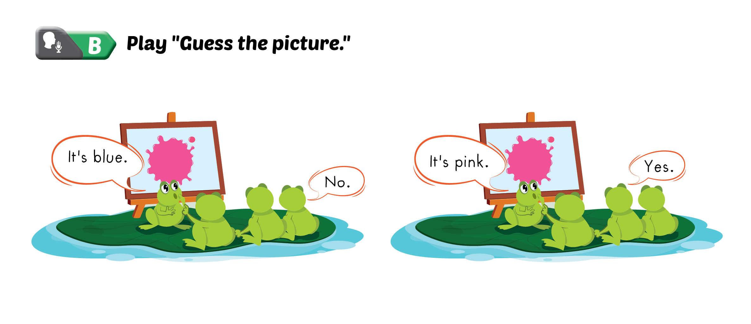

Slide 11
