Slide 1
Unit 15:
AT THE DINING TABLE
LESSON 1.1

Slide 2
WARM UP

Slide 3


Slide 4
1
Vocabulary

Slide 5


Slide 6
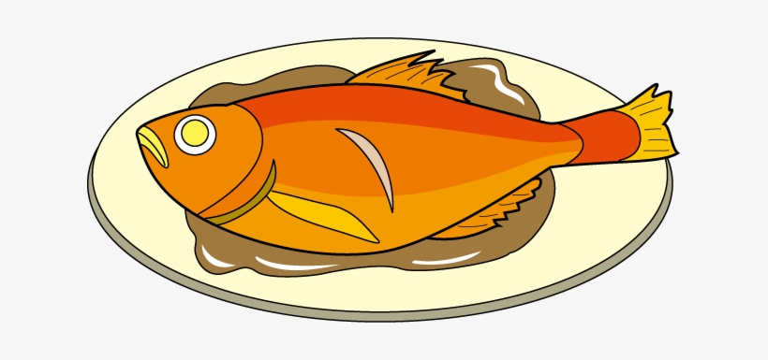

fish

Slide 7
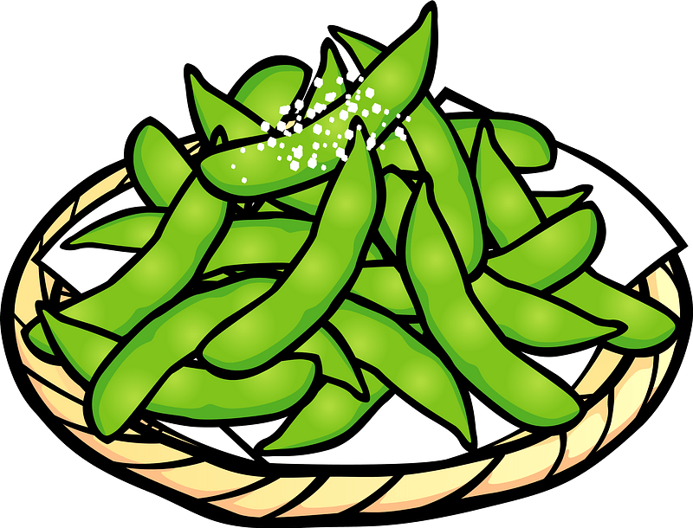
bean

Slide 8

juice

Slide 9

rice

Slide 10
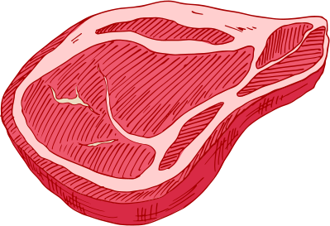
meat

Slide 11


Next
ROCKETS RACING
Start

Slide 12









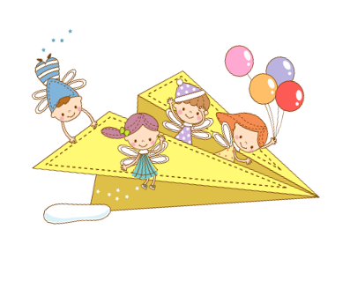
Next
Thử thách
QUYẾT ĐỊNH

Slide 13
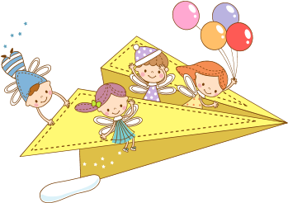
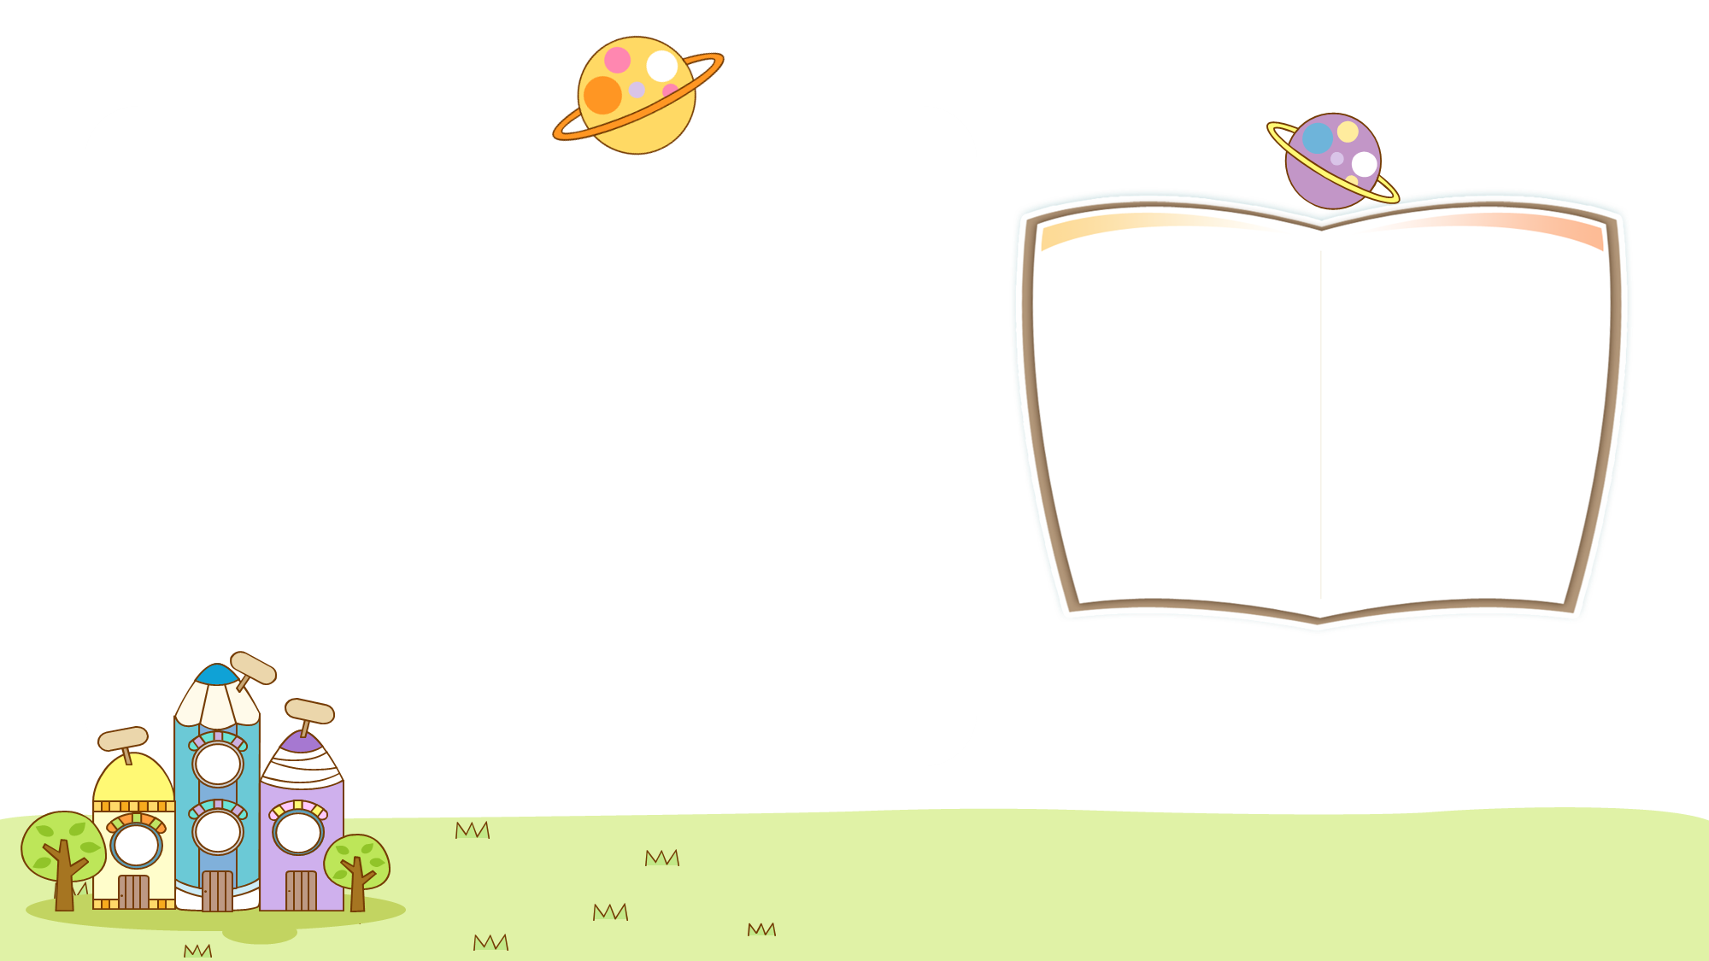


Back
What is it ?
juice
CHECK
Notes:
Thanh Yến Trần 0967 255 149 zalo/ FB https://www.facebook.com/thanhyentrananhngutaymy

Slide 14
Back
Listen and answer
rice
CHECK

Slide 15
Back
Uncreamble
a-n-e-b
bean
CHECK

Slide 16
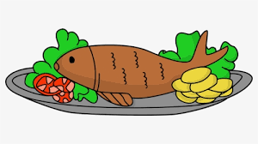
Back
What is it ?
fish
CHECK

Slide 17
Back
Find the missing letter
be…n
bean
CHECK

Slide 18
Back
Listen and answer
juice
CHECK

Slide 19



Back
Choose the odd one out
1
1
2
3
CHECK

Slide 20
SENTENCE

Slide 21



Would you like some+ Noun?
Ex: Would you like some meat?
- Yes, please.
Yes, please.
No, thanks.

Slide 22


Would you like some fish?
Yes, please.
No, thanks.

Slide 23

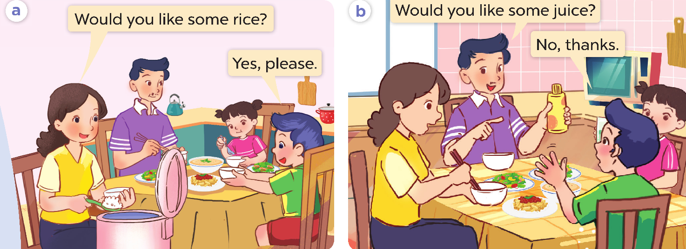

Slide 24









Next
THE HAPPY TOMATO TREE
Notes:
Click vào gốc cây để đi tới bài học

Slide 25


Look and choose
Would you like some...?
meat
bean
rice
Notes:
Thanh Yến Trần 0967 255 149 zalo/ FB https://www.facebook.com/thanhyentrananhngutaymy

Slide 26


Listen and choose
Notes:
Thanh Yến Trần 0967 255 149 zalo/ FB https://www.facebook.com/thanhyentrananhngutaymy

Slide 27

Reorder
you/ Would/ some/ fish?/like
Would you like some fish?
Some fish would you like?
Would some fish you like?

Slide 28
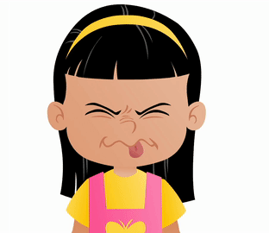
Look and choose
Would you like some juice?
No, thanks
Yes, please.
I'm fine.

Slide 29
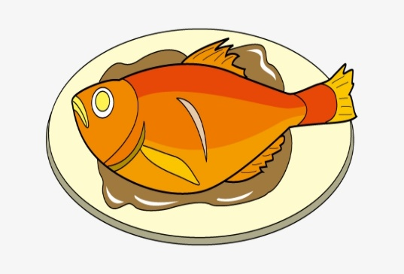

Look and choose
Would you like some bean?

Slide 30

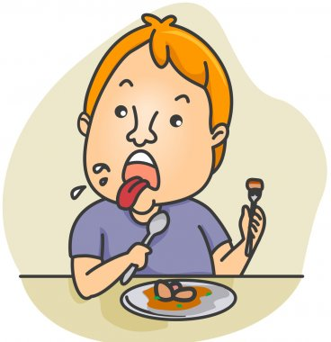

Listen and choose

Slide 31
Fill the missing word
.....you like some fish?
What
Would
Where

Slide 33
ACTIVITY

Slide 34

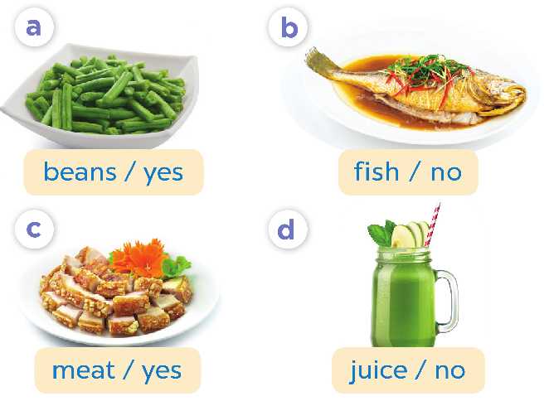
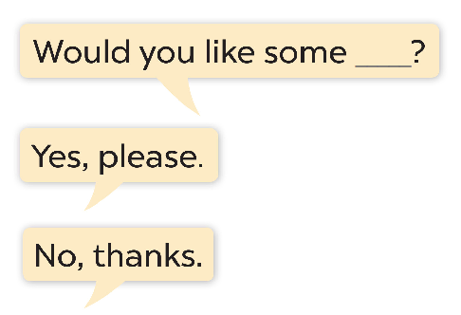

Slide 35

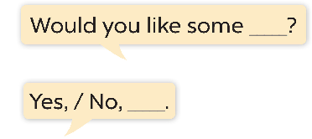
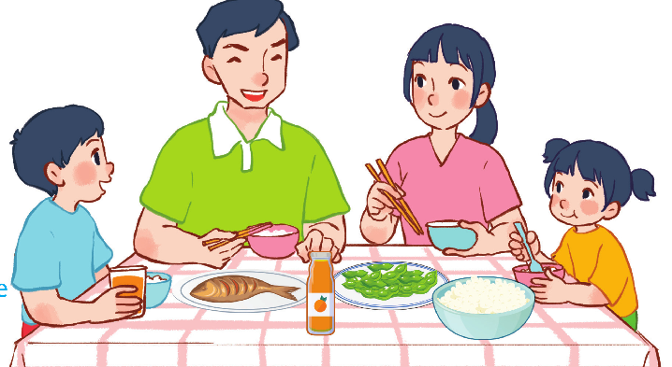

Slide 36
BYE BYE!!!

