Slide 1
Unit 15:
AT THE DINING TABLE
LESSON 1.2

Slide 2
WARM UP

Slide 3


Slide 4
REVIEW

Slide 5





DIRECTIONS
PLAY

Slide 6

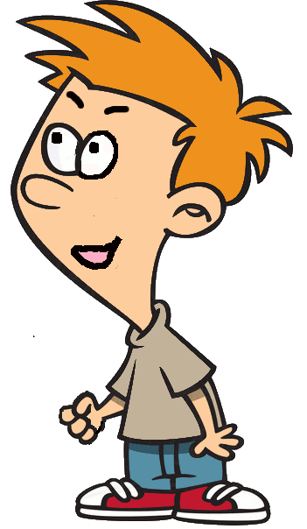
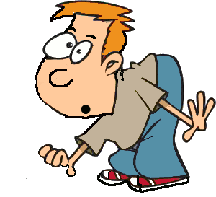











Would you like some.....?
juice
?
>
STOP

Slide 7

Listen and say
meat
?
>
STOP

Slide 8

Look and guess
bean
?
>
STOP

Slide 9

Look and guess
Yes, please.
?
>
STOP

Slide 10
Uncreamble : i-r-c-e
rice
?
>
STOP

Slide 11
Listen and choose?
Q:Would you like some fish?
A: ?
Yes, please.
?
>
STOP

Slide 12

Look and choose?
Q:Would you like some meat?
A: ?
No, thanks
?
>
STOP

Slide 13

Say the question?
Q: ?
A: No, thanks.
Would you like some rice?
?
>
STOP

Slide 14


Slide 15
ACTIVITY

Slide 16



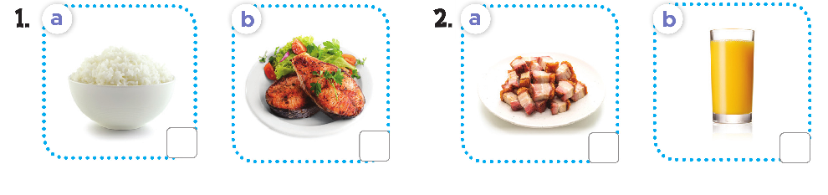



Slide 17

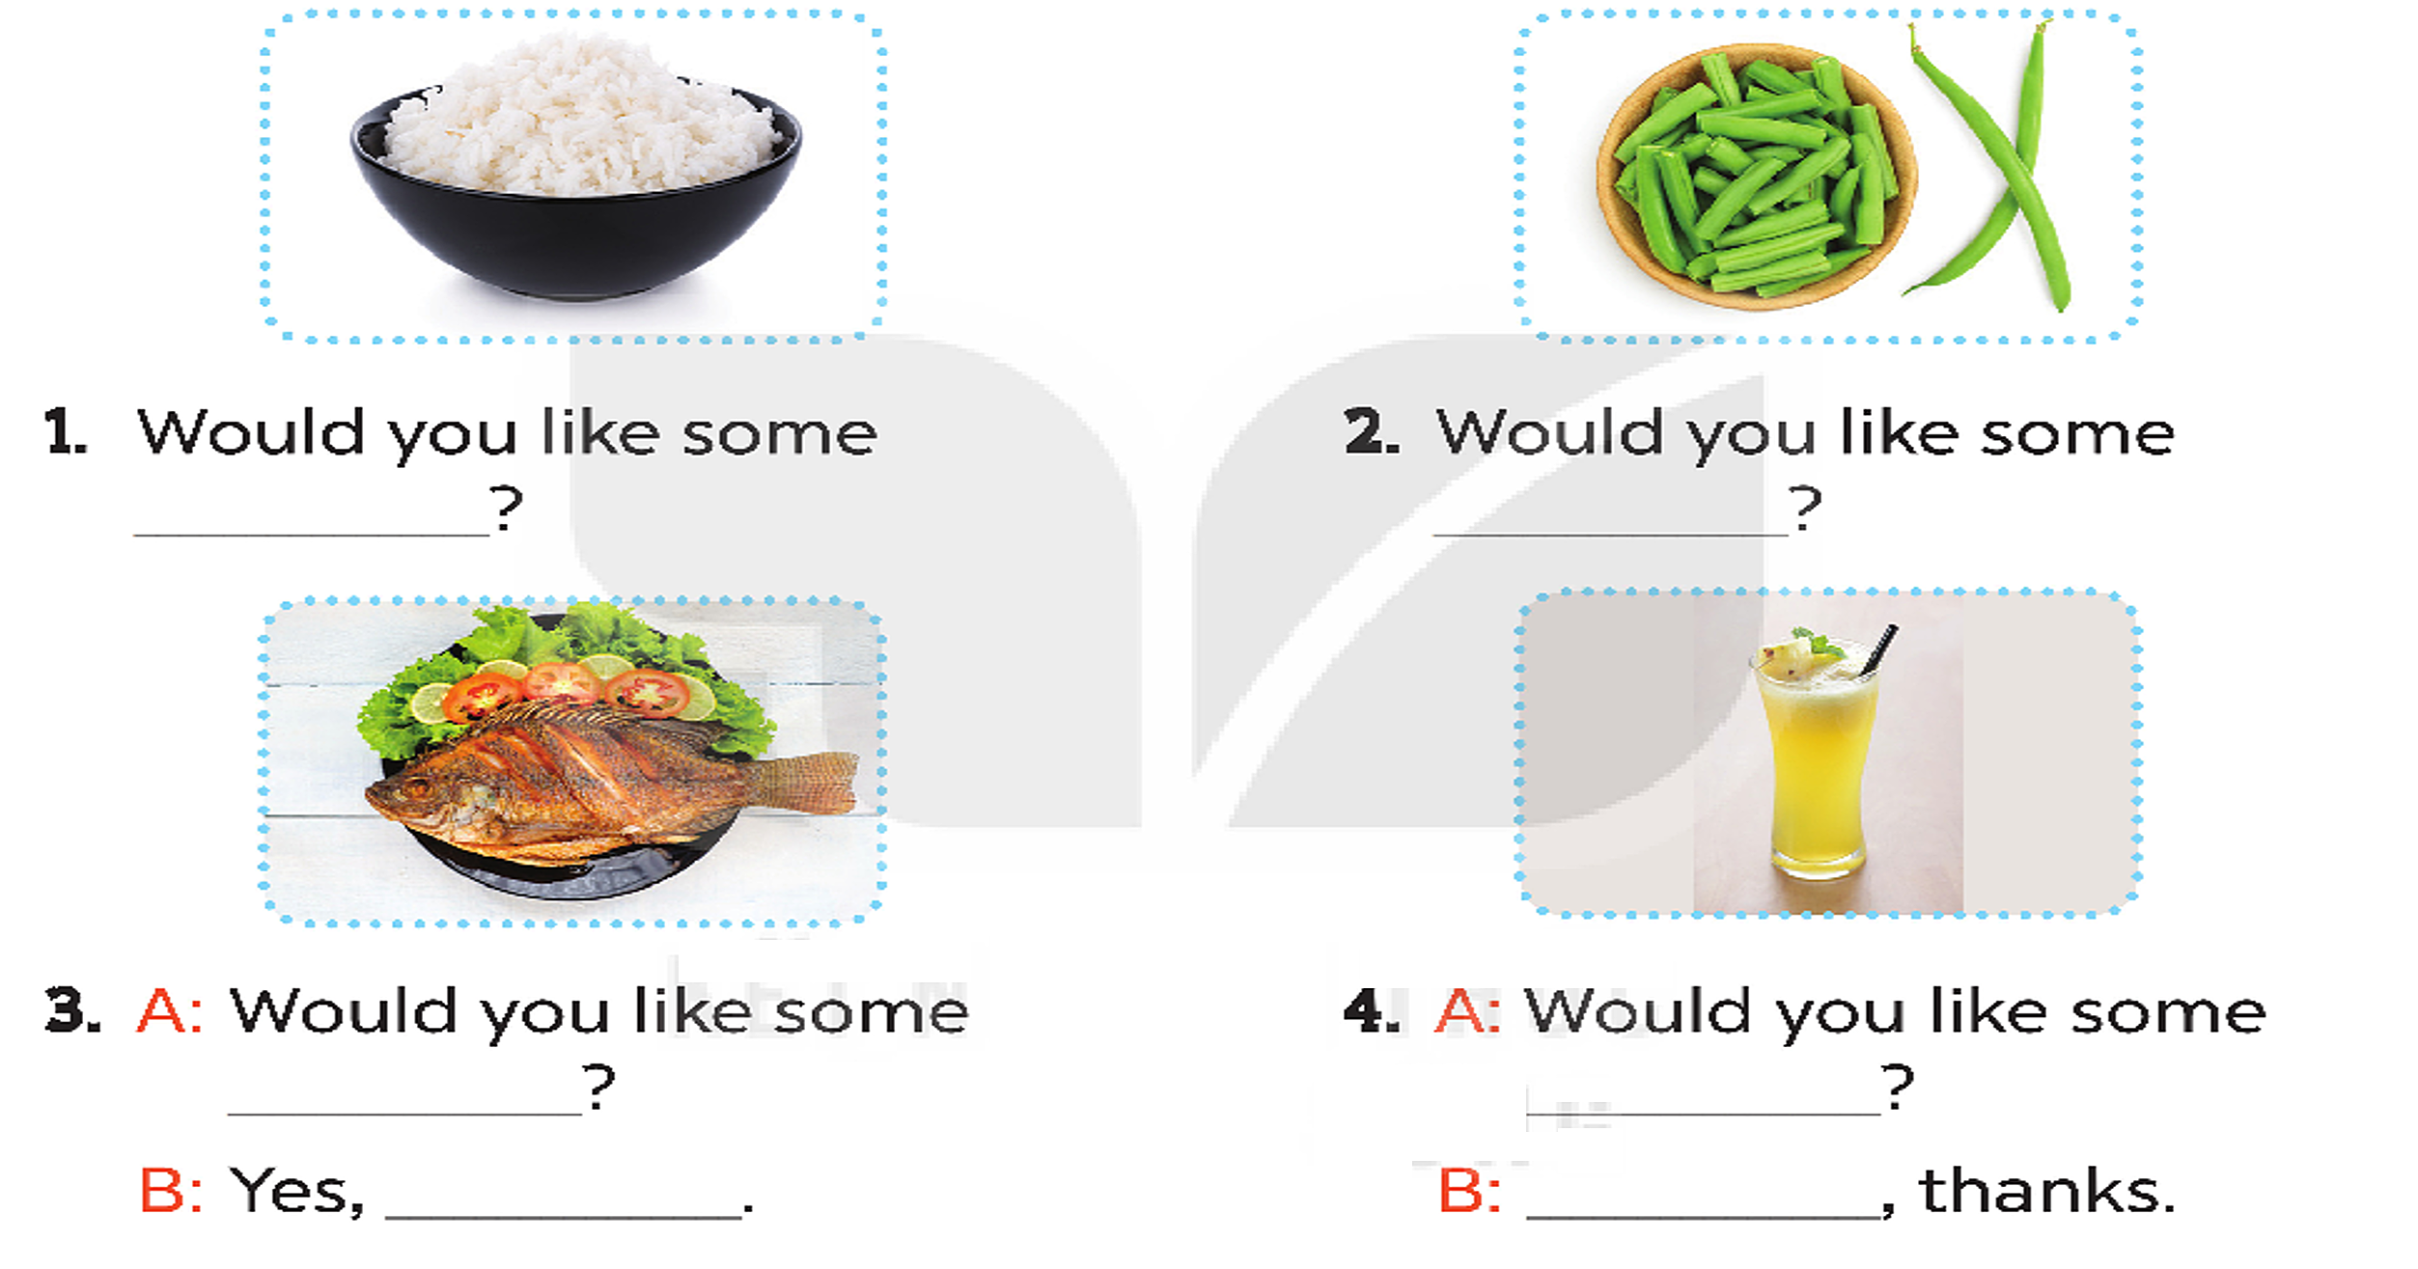
rice
bean
fish
juice
please
No

Slide 18

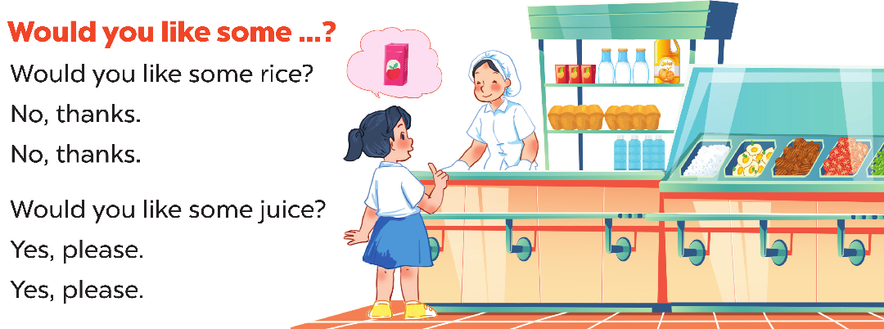

Slide 19
BYE BYE!!!

