Slide 1
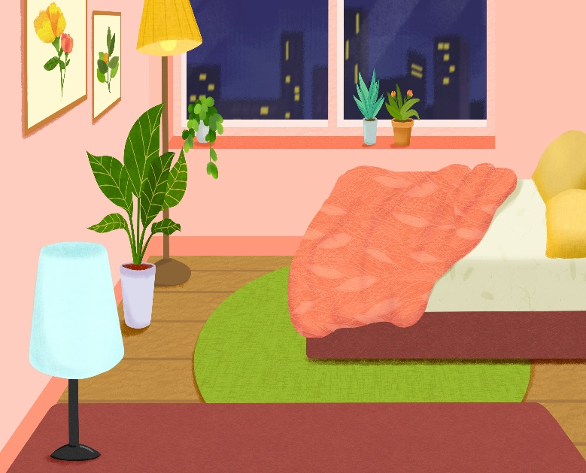
..................................
My bedroom
Unit
14
Lesson 1 (4+5+6

Slide 2

Warm-up

Slide 3
Well done!

Slide 4



Contents
Listen and tick.
Look, complete and read.
Let’s play.

Slide 5

Warm up

Slide 6
Let’s play!

Slide 7


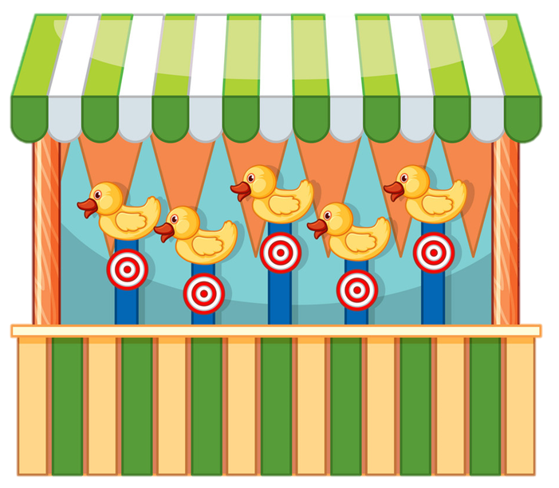


START

Slide 8




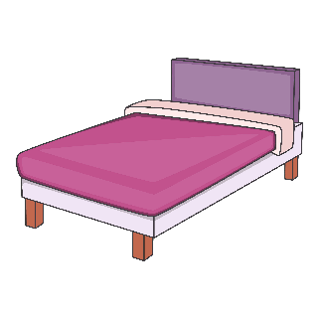
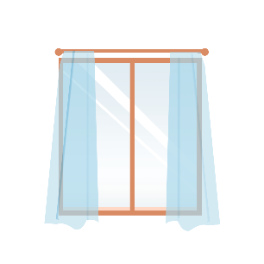
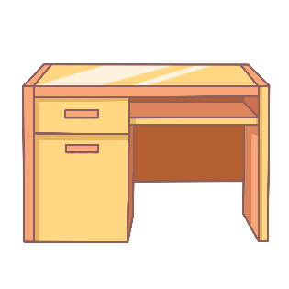

desk
A.
B.
C.

Slide 9

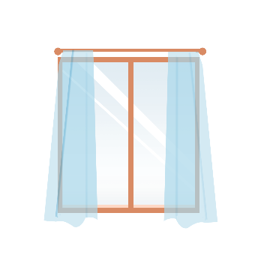

window
A.
B.
C.

Slide 10

b_d
A. a
B. e
C. o

Slide 11

doo_
A. d
B. s
C. r

Slide 12

w_ndow
A. a
B. e
C. i

Slide 13

A. bed
B. desk
C. door
Next

Slide 14
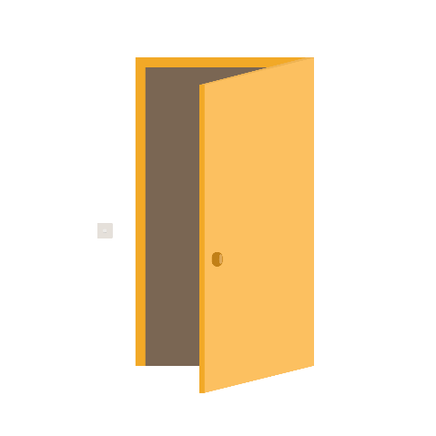
A. window
B. door
C. bed

Slide 15
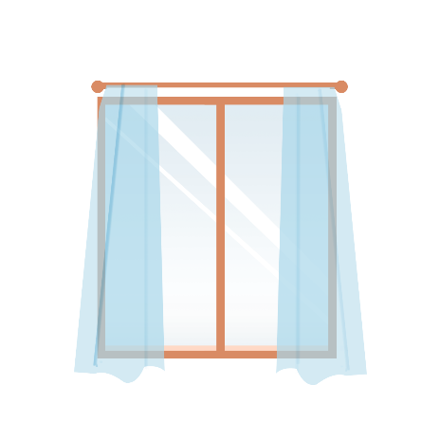
A. window
B. desk
C. door
Next

Slide 16
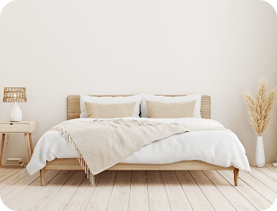
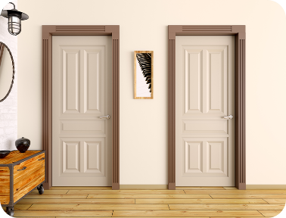
doors
A.
B.
C.

Slide 17


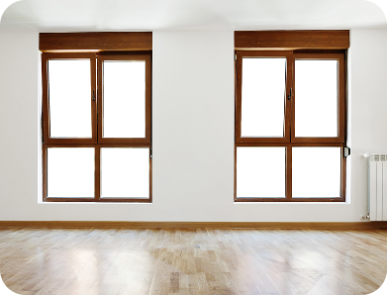

beds
A.
B.
C.

Slide 18



A.
B.
C.

Slide 19

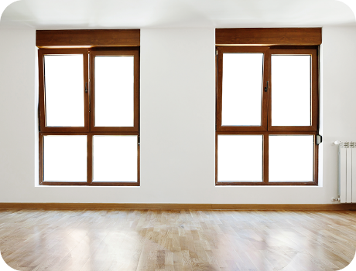
A.
B.
C.
Notes:
Facebook : Bùi Liễu 0968142780

Slide 20

_____ a desk.
A. There’s
B. There are

Slide 21

_____ a desk.
A. There is
B. There are

Slide 22
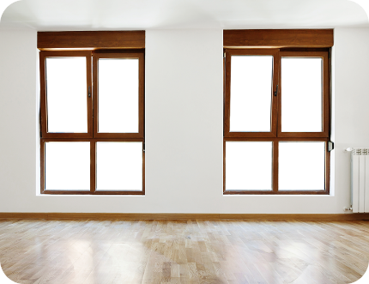
___ two windows.
A. There is
B. There are
Notes:
Facebook : Bùi Liễu 0968142780

Slide 23


Well done!
Notes:
Facebook : Bùi Liễu 0968142780

Slide 24
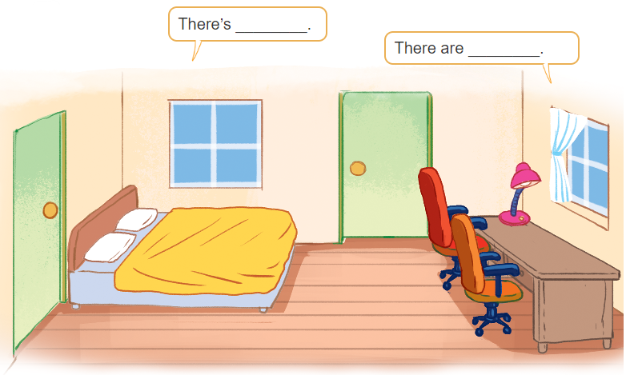
3. Let’s talk

Slide 25


3. Let’s talk
There are two windows
in the room.
There’s a bed
in the room

Slide 26
3. Let’s talk
There’s a lamp
in the room.
There are two chairs in the room.

Slide 27
3. Let’s talk
Bùi Liễu
There is a desk
in the room.
There are two doors
in the room.

Slide 28


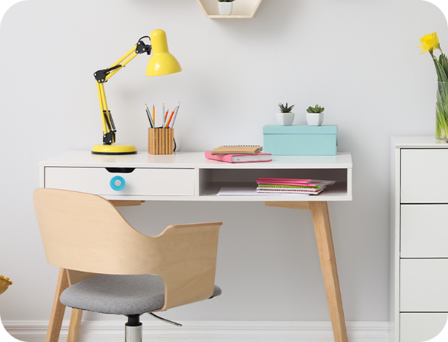
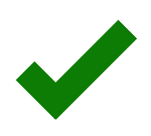
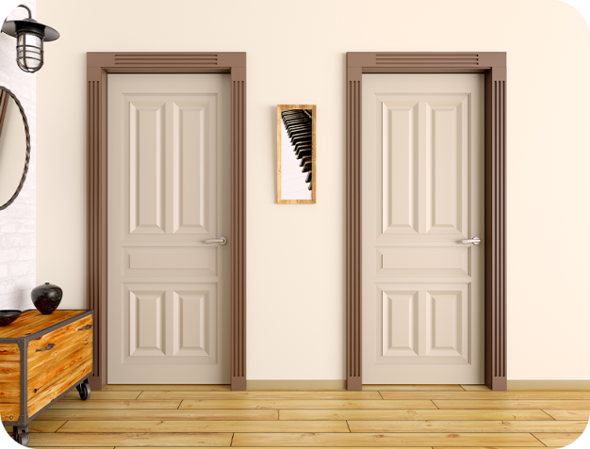

4. Listen and tick.
1
a
b
2
a
b

Slide 29
bed
a desk
lamps
two windows

Slide 30
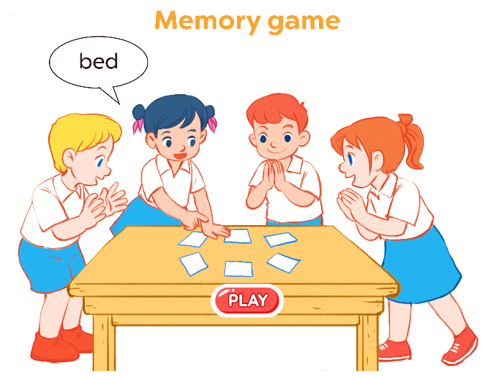
6. Let’s play.

Slide 31
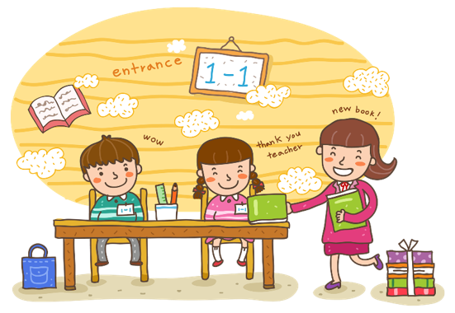
Wrap up

Slide 32
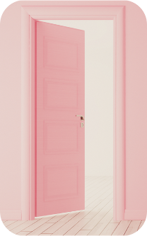
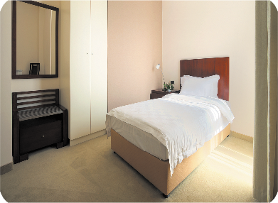

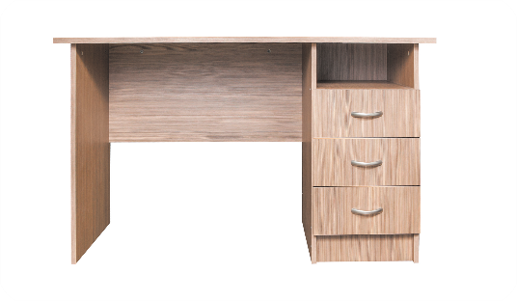
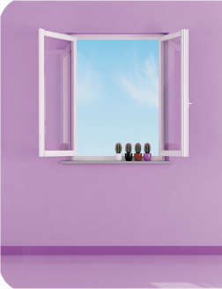
Vocabulary
door
bed
desk
window

Slide 33
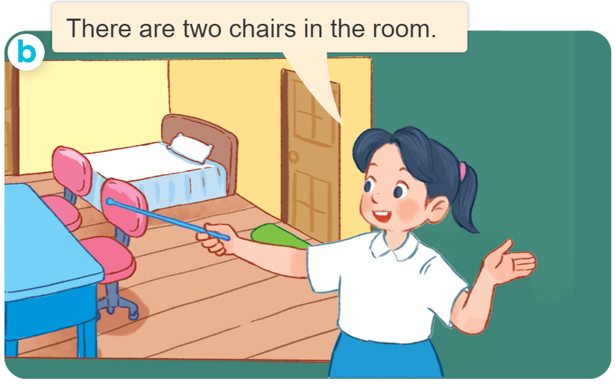
Structures
Cách nói về số lượng đồ vật ở trong phòng.
- There’s ____ in the room.
- There are ____ in the room.
( Có 1 ____ ở trong phòng)
(Có _______ ở trong phòng
there’s = there is

Slide 34
Homework
....................................................
....................................................

Slide 35

Thank you!

