Slide 1
Unit 4
My Birthday
Party
Lesson 1 - Period 2

Slide 2
MsPham
0936082789
Warm-up

Slide 3
BRICK WALL GAME
PLAY

Slide 4
When’s your birthday?
_______________
It’s in April.
Open
Next
Check

Slide 5
When’s your birthday?
_______________
It’s in March.
Open
Next
Check

Slide 6
When’s your birthday?
_______________
It’s in February.
Open
Next
Check

Slide 7
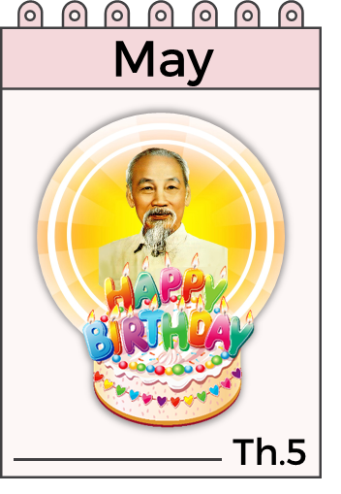
When’s your birthday?
_______________
It’s in May.
Open
Next
Check

Slide 8
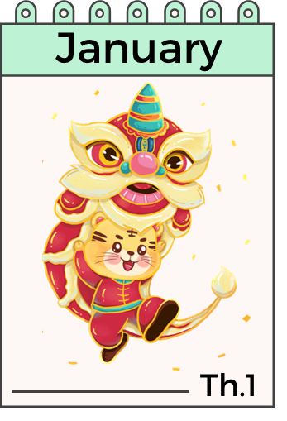
When’s your birthday?
___________
It’s in January.
Open
Next
Check

Slide 9
Next

Slide 10
MsPham
0936082789
Review

Slide 11
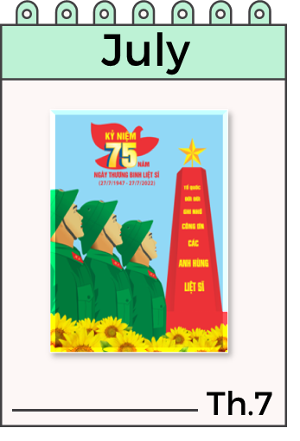
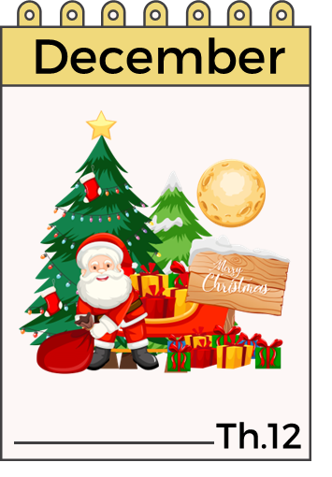
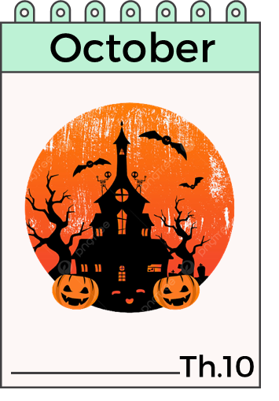
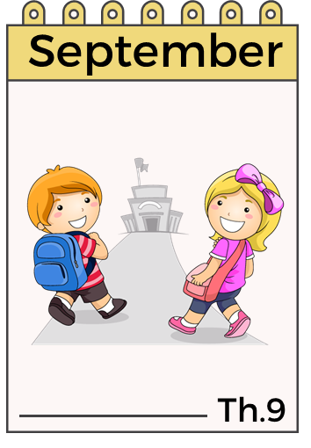
When’s your birthday?
It’s in ___________.
MsPham
0936082789

Slide 12
MsPham
0936082789
Practice

Slide 13
4
Listen and number.
MsPham
0936082789
2
1
4
3
1
2
3
4

Slide 14
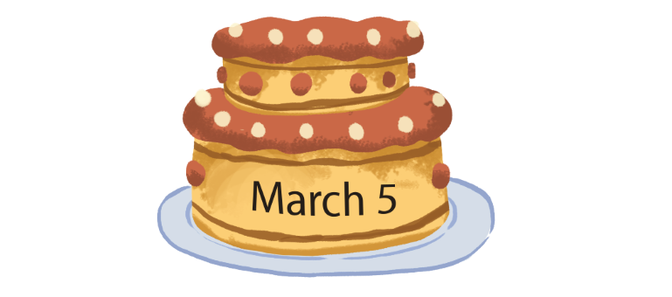
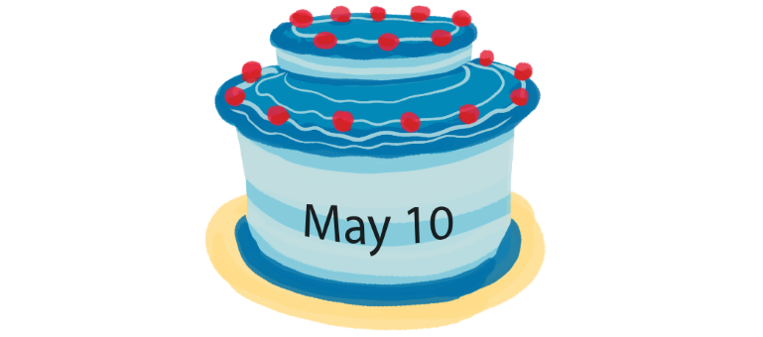
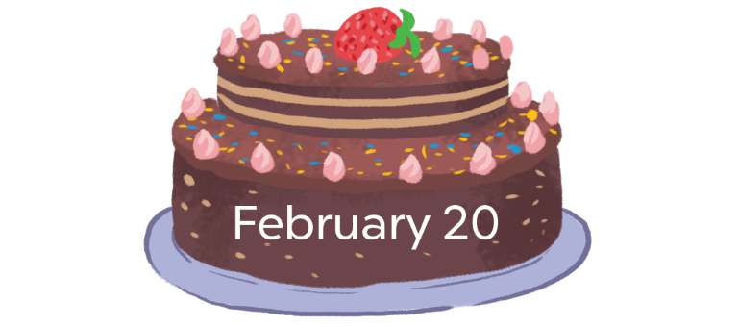
5
Look, complete and read.
1
2
MsPham
0936082789
A: When’s your birthday?
B: It’s in ___________.
A: When’s your birthday?
B: It’s in ___________.
March
May
3
4
birthday
When’s
A: When’s your _________?
B: It’s in ___________.
A: ________ your birthday?
B: It’s _______________.
February
in April

Slide 15
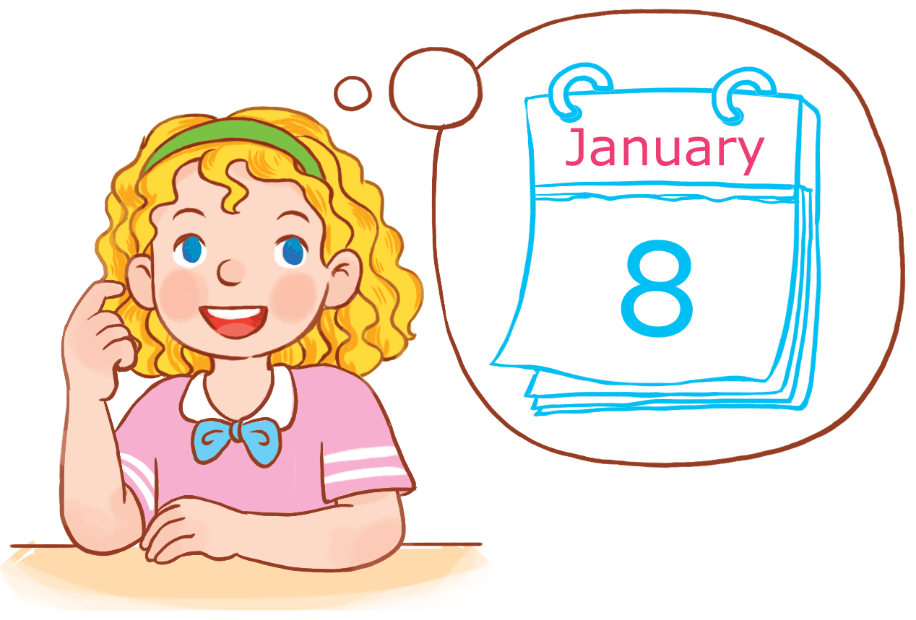
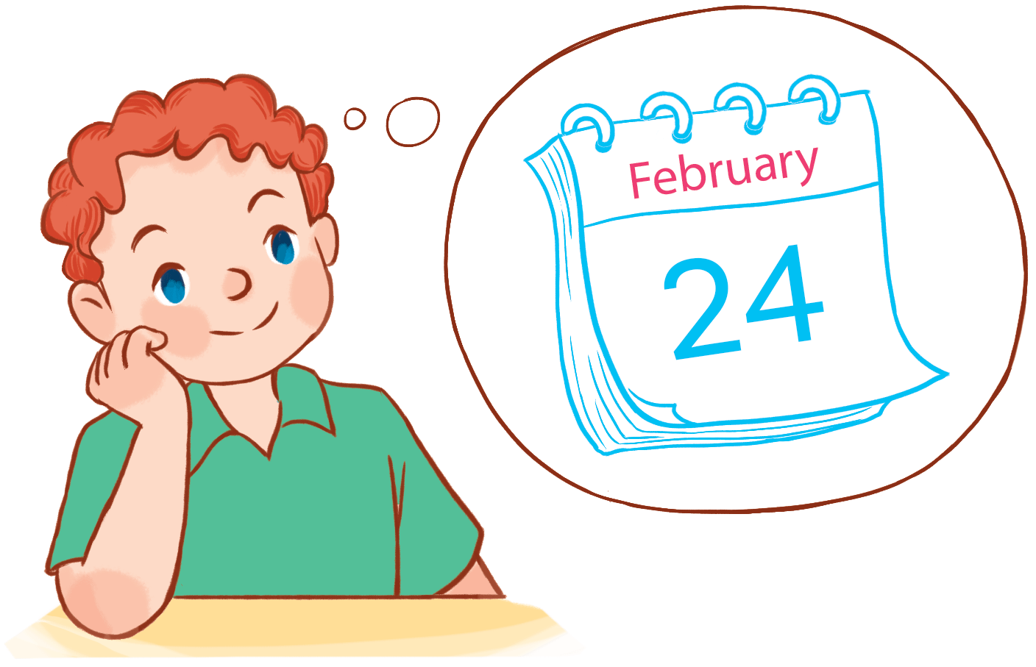
6
Let’s sing.
When's your birthday?
When's your birthday?
When's your birthday?
When's your birthday?
When's your birthday?
When's your birthday?
It's in January.
It's in January.
It's in January.
My birthday's in January.
My birthday's in January.
My birthday's in January.
When's your birthday?
When's your birthday?
When's your birthday?
When's your birthday?
When's your birthday?
When's your birthday?
It's in February.
It's in February.
It's in February.
MsPham
0936082789
My birthday's in February.
My birthday's in February.
My birthday's in February.
Hide

Slide 16
6
Let’s sing.
When's your birthday?
When's your birthday?
When's your birthday?
When's your birthday?
It's in January.
It's in January.
My birthday's in January.
My birthday's in January.
When's your birthday?
When's your birthday?
When's your birthday?
When's your birthday?
It's in February.
It's in February.
MsPham
0936082789
My birthday's in February.
My birthday's in February.

Slide 17
Thank you
for joining!

