Slide 1







Unit 4
My Birthday
Party
Lesson 2 – Period 2

Slide 2

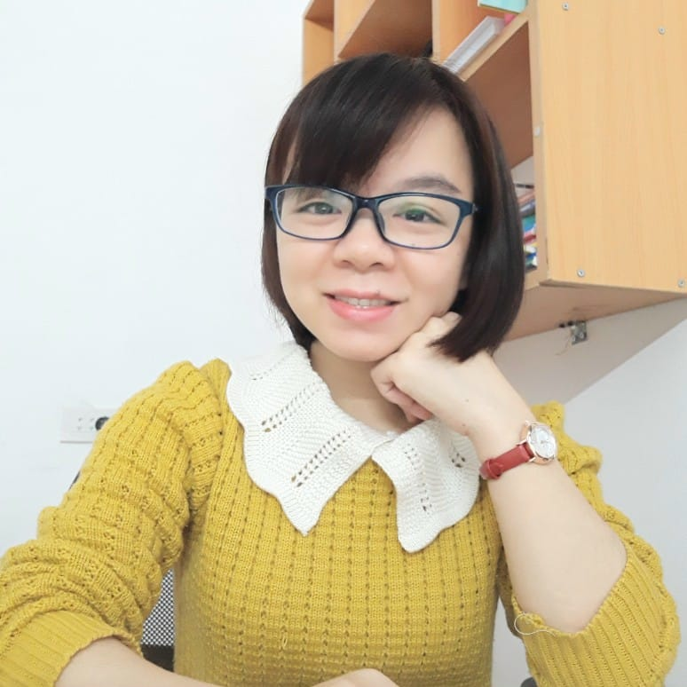
MsPham
0936082789
Warm-up

Slide 3


OWL’S PARTY
START

Slide 4

What do you want to _________?
I want some _____________.
drink
juice
OPEN
CHECK

Slide 5
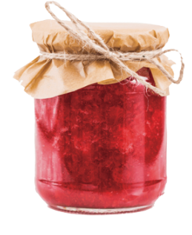
What do you want to _________?
I want some _____________.
eat
jam
OPEN
CHECK

Slide 6
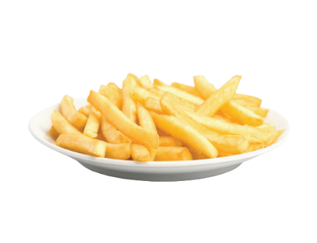
What do you want to _________?
I want some _____________.
eat
chips
OPEN
CHECK

Slide 7
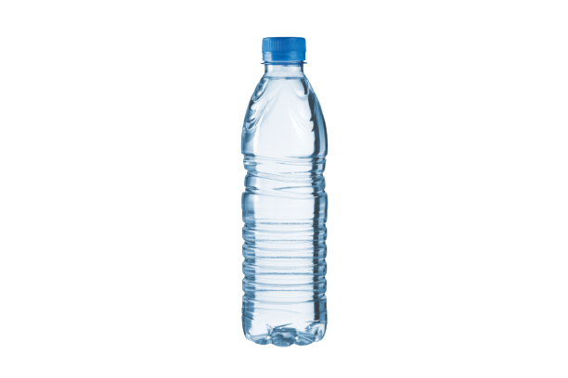
What do you want to _________?
I want some _____________.
drink
water
OPEN
CHECK

Slide 8
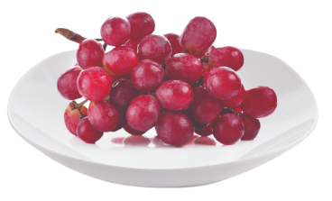
What do you want to _________?
I want some _____________.
eat
grapes
OPEN
CHECK

Slide 9

What do you want to _________?
I want some _____________.
drink
lemonade
OPEN
CHECK

Slide 10
Good job!
End

Slide 11
MsPham
0936082789
Review

Slide 12
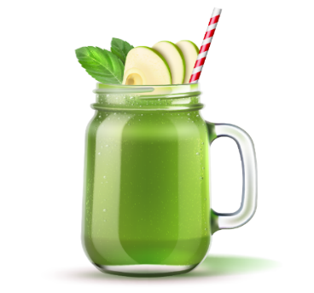
What do you want to eat/drink?
I want some _________.
MsPham
0936082789
chips
water
grapes
lemonade
jam
juice

Slide 13
MsPham
0936082789
Practice

Slide 14

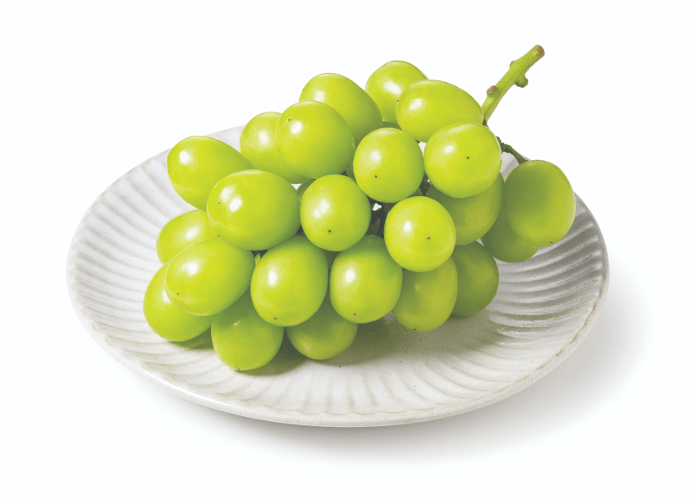
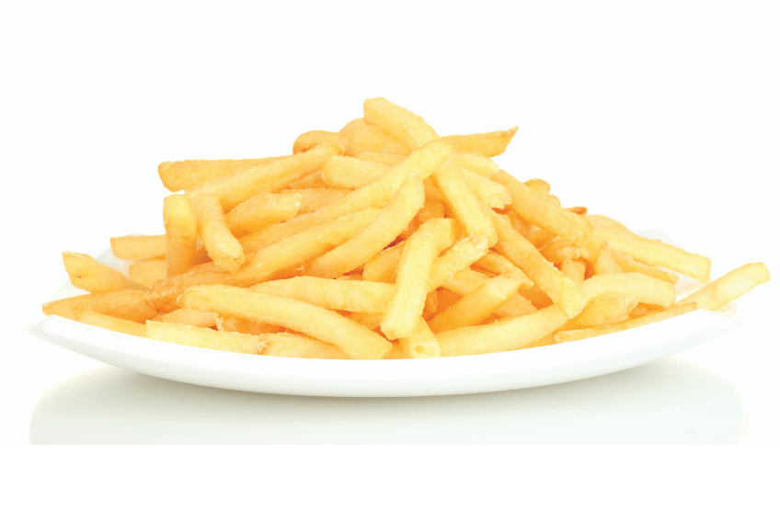
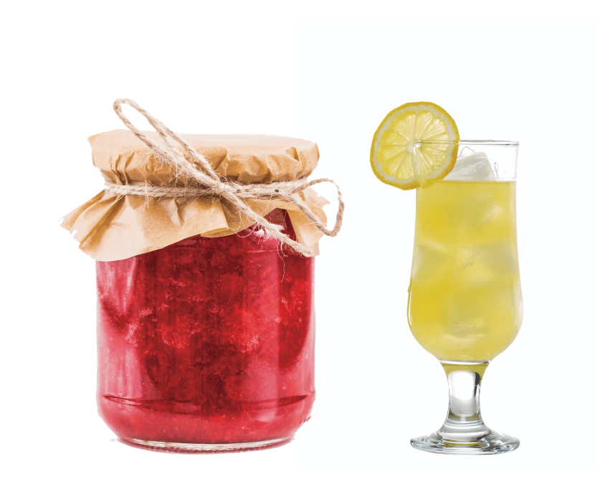
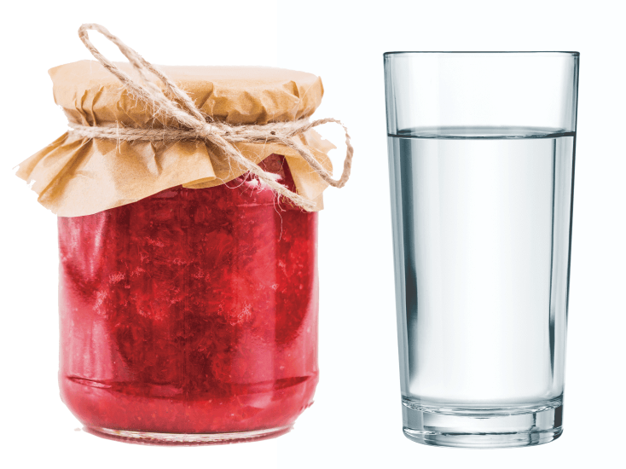
4
Listen and tick.
a
b
MsPham
0936082789
1
✓
a
b
2
✓

Slide 15
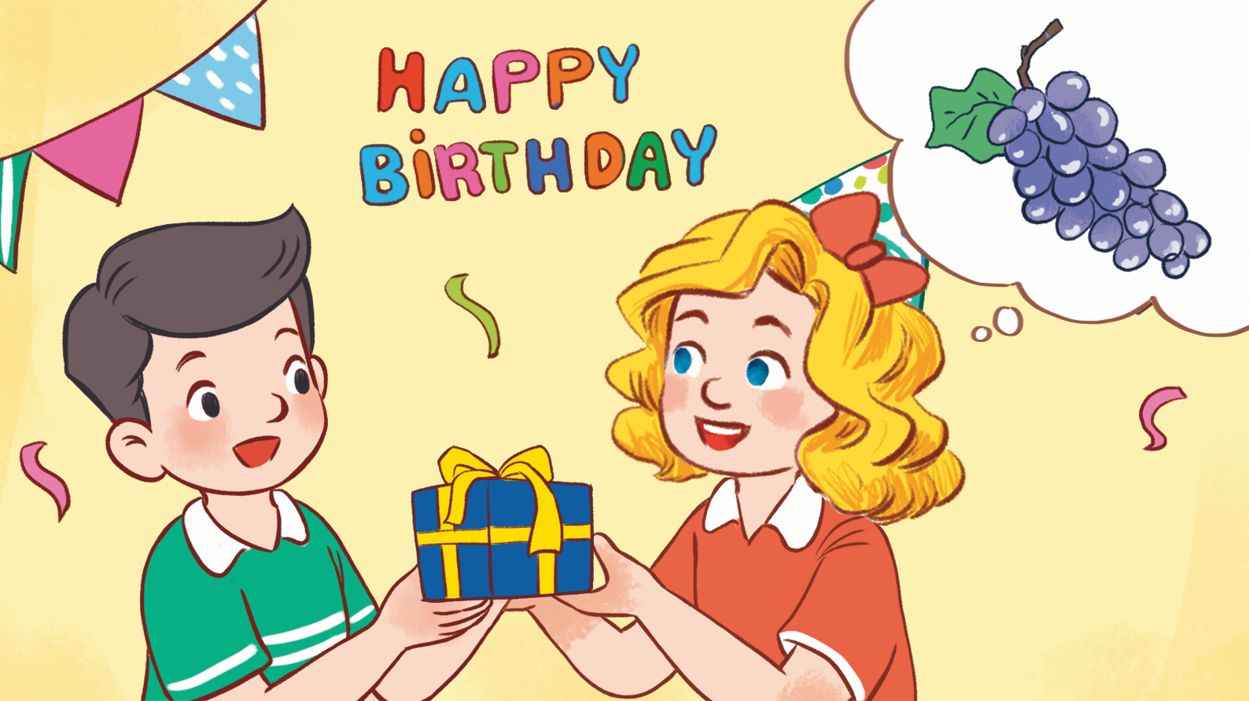
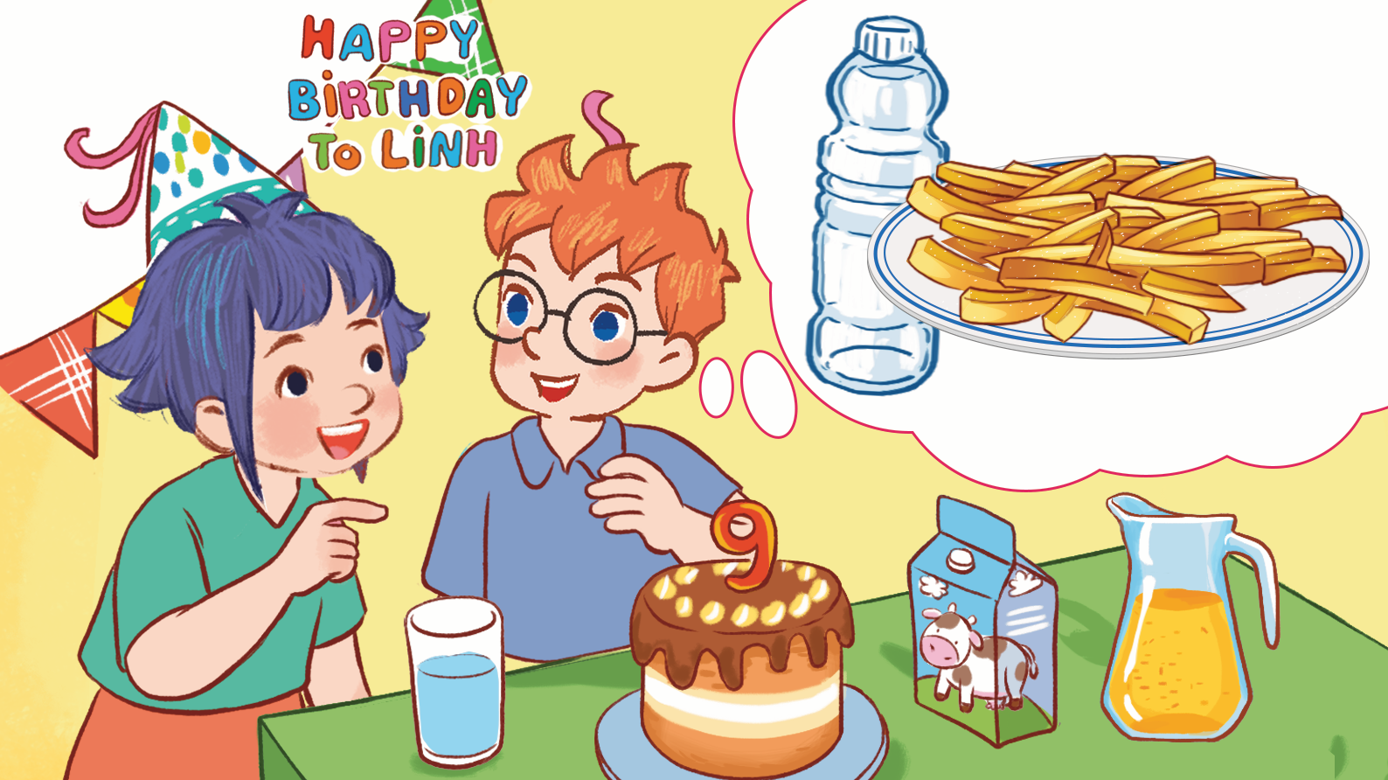
5
Look, complete and read.
1
2
MsPham
0936082789
A: What do you want to _______, Ben?
B: I want some water.
A: What do you want to eat?
B: I want some _______.
A: Happy birthday, Nam!
B: Thank you. _________ do you want to eat, Mary?
A: I want some _________.
drink
What
grapes
chips

Slide 16
6
Food or drink
Let’s play.
Check
Next
Food
Drink
jam

Slide 17
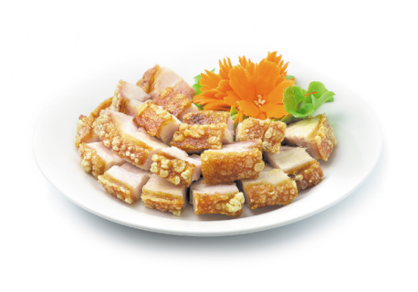
6
Food or drink
Let’s play.
Check
Next
Food
Drink
meat

Slide 18
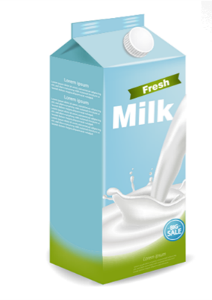
6
Food or drink
Let’s play.
Check
Next
Food
Drink
milk

Slide 19
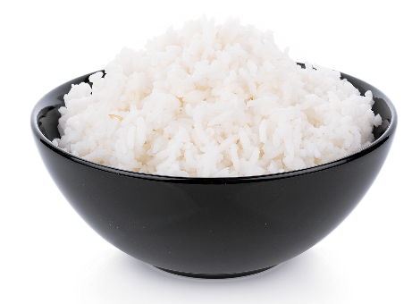
6
Food or drink
Let’s play.
Check
Next
Food
Drink
rice

Slide 20

6
Food or drink
Let’s play.
Check
Next
Food
Drink
juice

Slide 21
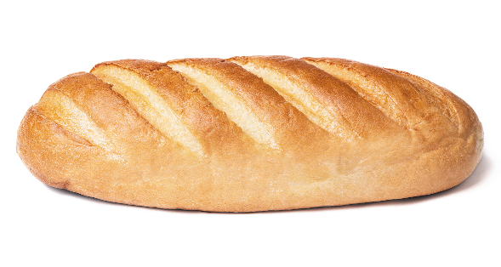
6
Food or drink
Let’s play.
Check
Next
Food
Drink
bread

Slide 22
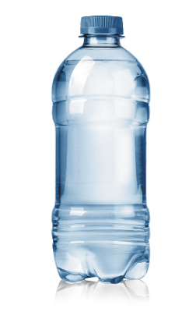
6
Food or drink
Let’s play.
Check
Next
Food
Drink
water

Slide 23
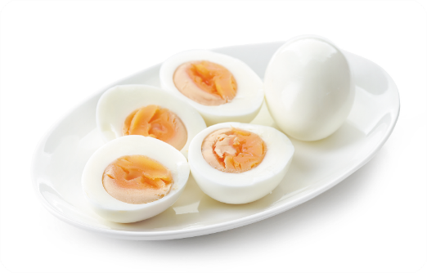
6
Food or drink
Let’s play.
Check
Next
Food
Drink
eggs

Slide 24
6
Food or drink
Let’s play.
Check
Next
Food
Drink
grapes

Slide 25
6
Food or drink
Let’s play.
Check
Next
Food
Drink
chips

Slide 26
6
Food or drink
Let’s play.
Check
Next
Food
Drink
lemonade

Slide 27

6
Let’s play.
End
Food
Drink

Slide 28
Thank you
for joining!

