Slide 1
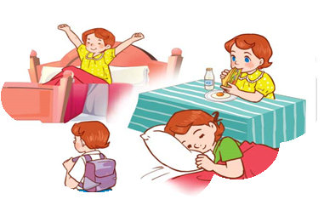
Monday, September 25th 2023
Unit
2
Time and daily routines
Facebook : Bùi Liễu
0968142780
Lesson 3

Slide 2
Warm-up

Slide 3
Facebook : Bùi Liễu
0968142780
Let’s play!

Slide 4
Sun Flower

Slide 5
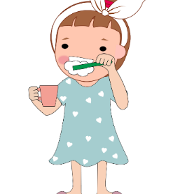
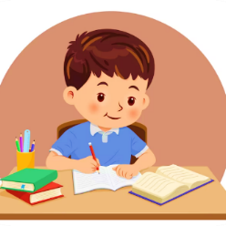
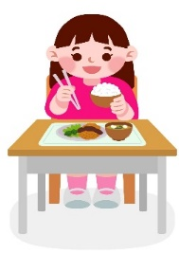
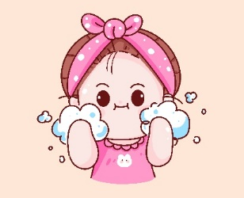
clean the teeth
Click the clock to start the timer.
A
B
C
D

Slide 6
have lunch
Click the clock to start the timer.
A
B
C
D
Sai
Sai
Đúng
Sai

Slide 7
do the homework
Click the clock to start the timer.
A
B
C
D
Sai
Đúng
Sai
Sai

Slide 8
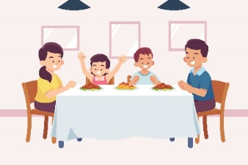
wash the face
Click the clock to start the timer.
A
B
C
D
Sai
Sai
Sai
Đúng

Slide 9
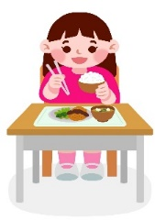
have dinner
Click the clock to start the timer.
A
B
C
D
Sai
Sai
Sai
Đúng

Slide 10
_____ the face
Click the clock to start the timer.
A
B
C
D
wash
clean
do
have

Slide 11
_____ the homework
Click the clock to start the timer.
A
B
C
D
clean
do
have
wash

Slide 12
_____ the teeth
Click the clock to start the timer.
A
B
C
D
do
clean
wash
have

Slide 13
have _____
Click the clock to start the timer.
A
B
C
D
the face
dinner
breakfast
lunch

Slide 14
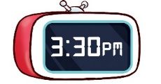
Click the clock to start the timer.
A
B
C
D
I have dinner at six thirty.
I go to bed at three thirty.
I do my homework at three thirty.
I do my homework at three forty five.

Slide 15
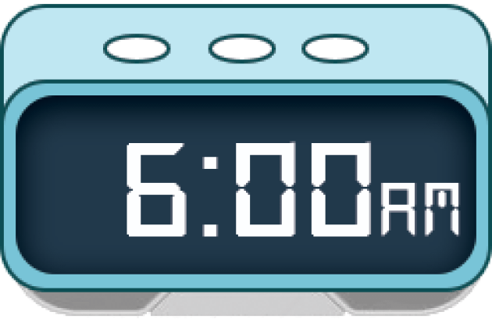
I have breakfast at home at six o’clock.
Click the clock to start the timer.
A
B
C
D

Slide 16
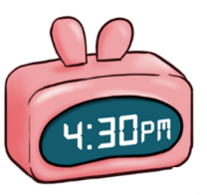
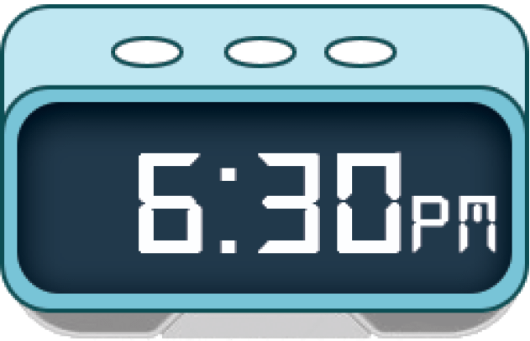
I have dinner at home at seven thirty.
Click the clock to start the timer.
A
B
C
D

Slide 18
Contents
1
2
Listen and repeat.
Listen and circle
3
4
Let’s chant.
Read and match.
5
6
Let’s write.
Project.

Slide 19
clean the teeth
/kliːn ðə tiːθ/
làm sạch răng

Slide 20
wash the face
/wɒʃ ðə feɪs/
rửa mặt

Slide 21
have lunch
/hæv ˈlʌnʧ/
ăn trưa

Slide 22
have dinner
/hæv ˈdɪnə/
ăn tối

Slide 23
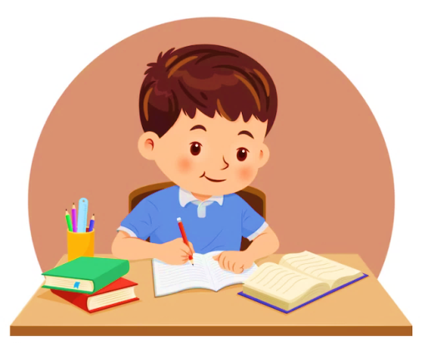
do homework
/dʊ ˈhəʊmˌwɜ:k/
làm bài tập

Slide 24
Review
clean the teeth
wash the face
have lunch
have dinner
do homework

Slide 25
Look and complete.
1
2
3
4
5
________
_______
_______
have dinner
_______
_____
have lunch
wash
the face
clean
the teeth
do homework
a
do homework
d
wash the face
b
have lunch
e
clean the teeth
c
have dinner
Notes:
Facebook : Bùi Liễu 0968142780

Slide 26
1. Look and repeat.
t
get
What time do you get up?
d
bed
What time do you go to bed?

Slide 27
2. Listen and circle.
1.
I _______ at six thirty.
a.
get up
b.
chat with my friends
c.
read a book
2.
I _______ at five forty-five.
a.
go out
b.
watch TV with my dad
c.
go to bed

Slide 28
3. Let’s chant.
Get up, get up
I get up at six o’clock.
I get up at six o’clock.
Go to bed, go to bed.
I go to bed at nine fifteen.
I go to bed at nine fifteen.

Slide 29
3. Let’s chant.
Get up, get up
I get up at six o’clock.
I get up at six o’clock.
Go to bed, go to bed.
I go to bed at nine fifteen.
I go to bed at nine fifteen.

Slide 30
4. Read and match.
1
I am a pupil at Hoa Lan Primary School. I get up at six o’clock. I wash my face and clean my teeth. Then I have breakfast at six fifteen. I go to school at seven o’clock. I have lunch at school. I have dinner at home at seven thirty. I do my homework and go to bed at nine forty-five.
2
3
4
1.
I get up.
a
b
2.
I go to school.
3.
I have dinner.
c
d
4.
I go to bed.

Slide 31
5. Let’s write.
I get up at _________________. I have breakfast at ____________. I go to school at _____________. What about you? What time do you go to school?
six fifteen
six thirty five
seven o’clock

Slide 32
6. Project

Slide 33
Let’s play!

Slide 34
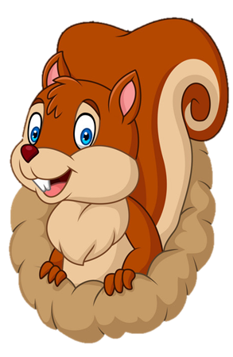
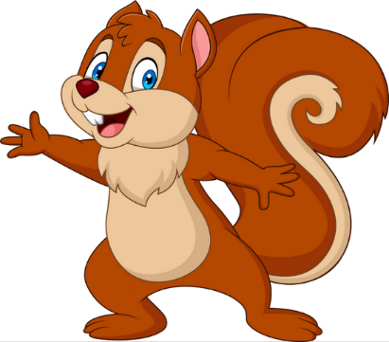
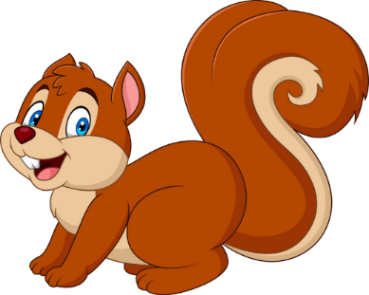
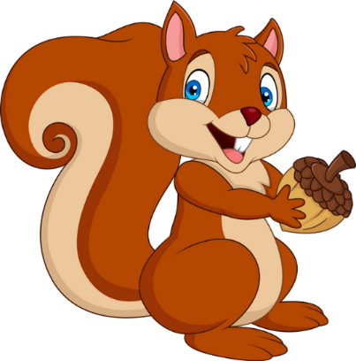

Slide 35
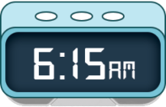
A. I wash the face at six o’clock.
B. I clean the teeth at six fifteen.

Slide 36
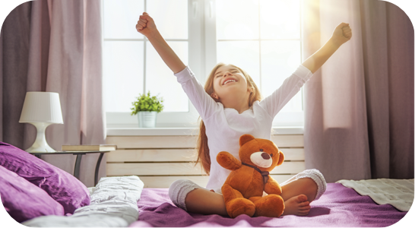
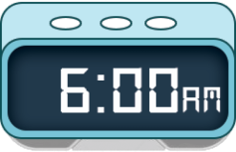
A. I get up at six o’clock.
B. I go to school at six o’clock.

Slide 37
A. six fifty
B. six fifteen

Slide 38
go to _______
A. school
B. bed

Slide 39
w____ the face
A. arh
B. ash

Slide 40
have l_____
A. unch
B. anch

Slide 41
do the _____work
A. house
B. home

Slide 42
have break_____
A. fast
B. fart

Slide 43
What time is it?
A. It’s ten fifteen.
B. It’s ten o’clock.

Slide 44
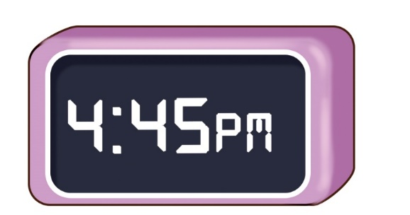
What time is it?
A. It’s four forty- five.
B. It’s four thirty-five.

Slide 45
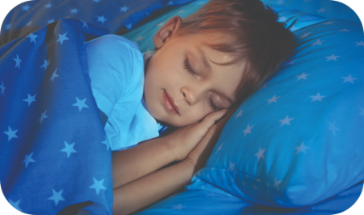
________ do you go to bed?
A. Who
B. What time

Slide 46
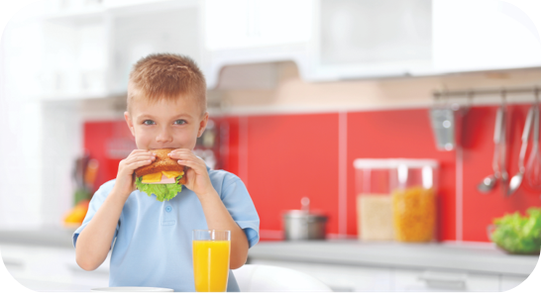
What time do you ______?
A. have lunch
B. have breakfast

Slide 47
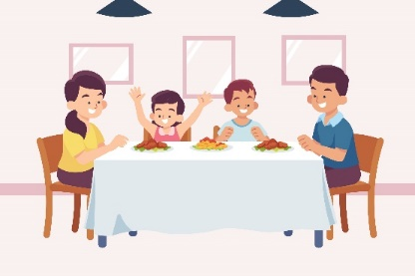
What time do you have dinner?
A. I have dinner at seven o’ clock.
B. I. have dinner at seven thirty.

Slide 48
EXIT

Slide 49
Wrap up

Slide 50
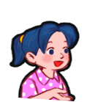
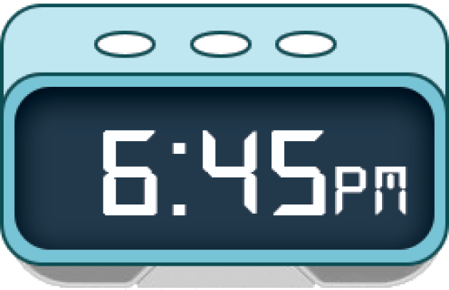
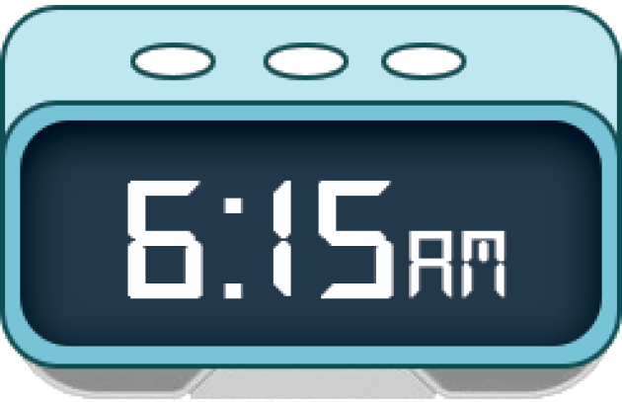
Unit 2 lesson 1
What time is it?
It’s _______.
it’s = it is
Bùi Liễu
0968142780
six o’clock
six forty- five
six fifteen
six thirty

Slide 51
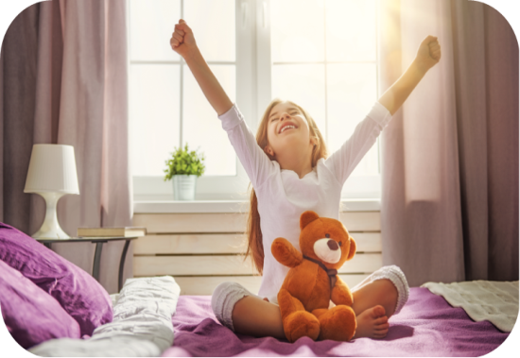
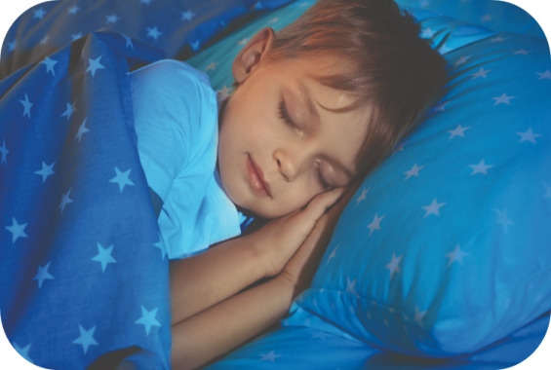
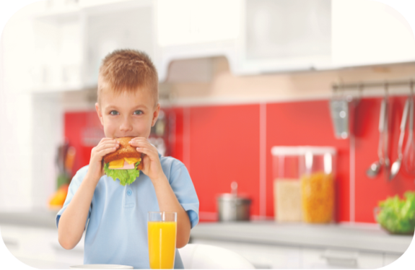
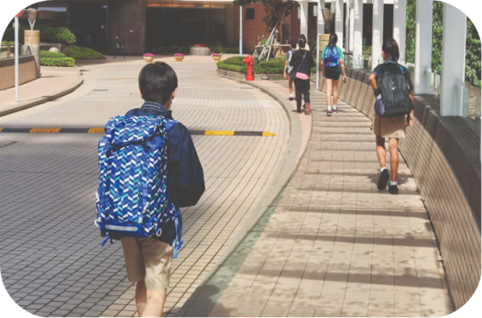
Unit 2 lesson 2
What time do you _____?
I ____ at ____.
Bùi Liễu
0968142780
get up
go to bed
have breakfast
go to school

Slide 52
Homework
Learn by heart all the new words.
Read again the dialogue in part 1.

Slide 53
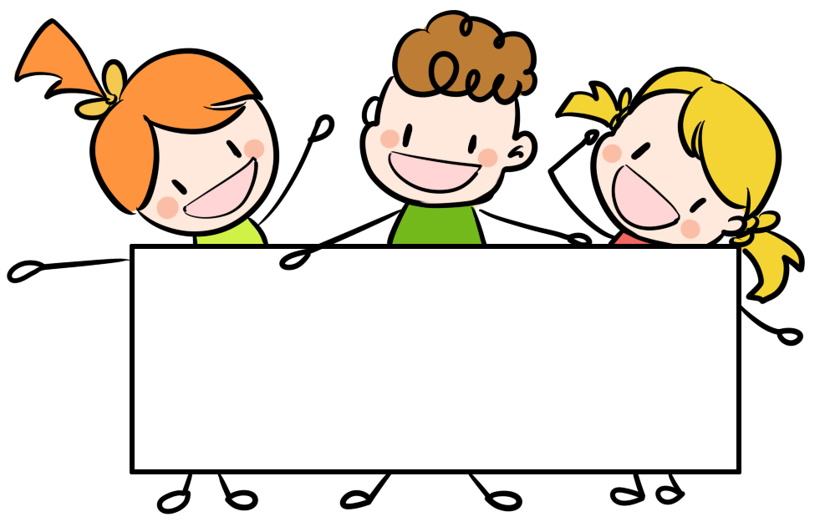
Thank you!

