Slide 1
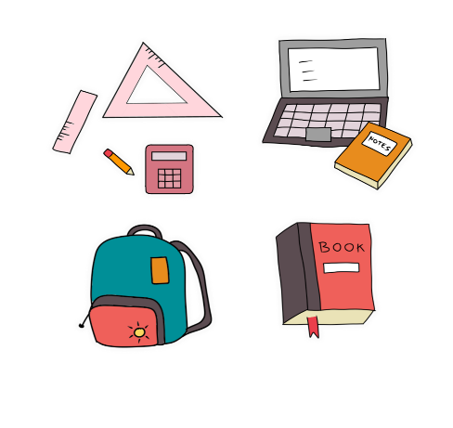
Tuesday, November 28th 2023
My school things
Unit
8
Lesson 2
Facebook : Bùi Liễu
0968142780
Notes:
Facebook : Bùi Liễu
Mobile phone: 0968142780

Slide 2
Warm-up

Slide 3
Let’s play!

Slide 4
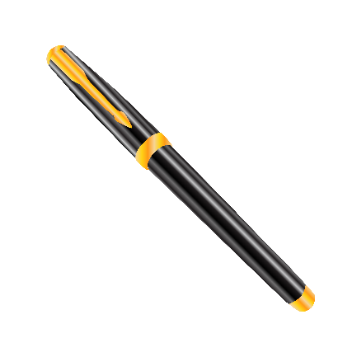
Game: Sentence puzzle
(Reorder the words)
pen.
have
I
a
I
have
a
pen.
Notes:
Sentence Puzzle
Divide the class into groups of four. Give each group a sentence that is broken/cut in to pieces. Ask them to arrange them to make a complete sentence, then read it aloud.
The group makes it first will be the winner.

Slide 5
book.
have
a
I
I
have
a
book.
Notes:
Sentence Puzzle
Divide the class into groups of four. Give each group a sentence that is broken/cut in to pieces. Ask them to arrange them to make a complete sentence, then read it aloud.
The group makes it first will be the winner.

Slide 6
I
have
a
pencil.
I
have
a
pencil.
Notes:
Sentence Puzzle
Divide the class into groups of four. Give each group a sentence that is broken/cut in to pieces. Ask them to arrange them to make a complete sentence, then read it aloud.
The group makes it first will be the winner.

Slide 7
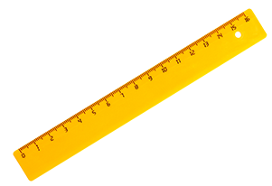
I
have
a
ruler.
I
have
a
ruler.
Notes:
Sentence Puzzle
Divide the class into groups of four. Give each group a sentence that is broken/cut in to pieces. Ask them to arrange them to make a complete sentence, then read it aloud.
The group makes it first will be the winner.

Slide 8
Well done!

Slide 9
Contents
Look, listen
and repeat.
Let’s talk.
Read and
match.
Listen, point
and say.
Listen
and number.
Let’s play.

Slide 10
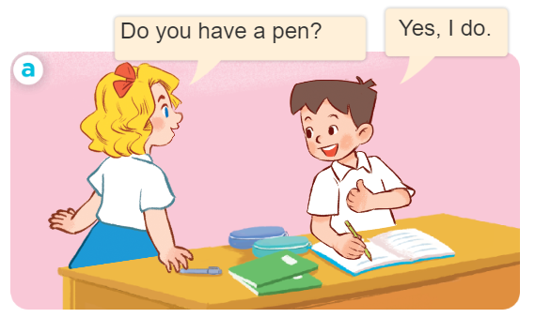
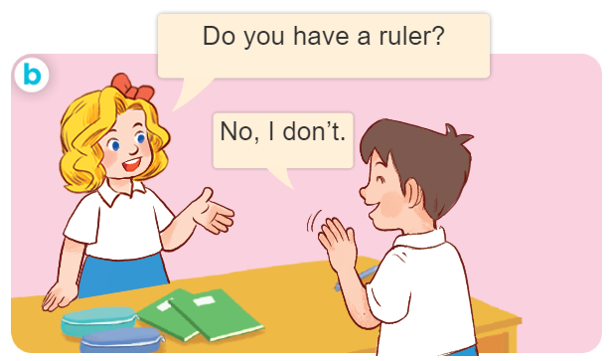
1. Look, listen and repeat.
Facebook : Bùi Liễu
0968142780
Facebook : Bùi Liễu
0968142780
What are they doing?
Where are they?
Who are they?
Notes:
Facebook : Bùi Liễu
Mobile phone: 0968142780

Slide 11
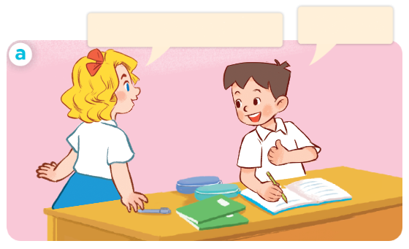
1. Look, listen and repeat.
Click on the sentences to hear the sound.
Facebook : Bùi Liễu
0968142780
Yes, I do.
Do you have a pen?
Facebook : Bùi Liễu
0968142780
Notes:
Facebook : Bùi Liễu
Mobile phone: 0968142780

Slide 12
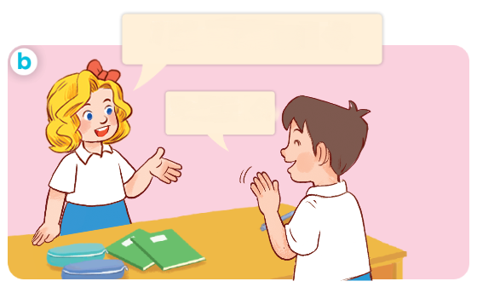
1. Look, listen and repeat.
Click on the sentences to hear the sound.
Facebook : Bùi Liễu
0968142780
Do you have a ruler?
Facebook : Bùi Liễu
0968142780
No, I don’t.
Notes:
Facebook : Bùi Liễu
Mobile phone: 0968142780

Slide 13
Facebook : Bùi Liễu
0968142780
Vocabulary

Slide 14
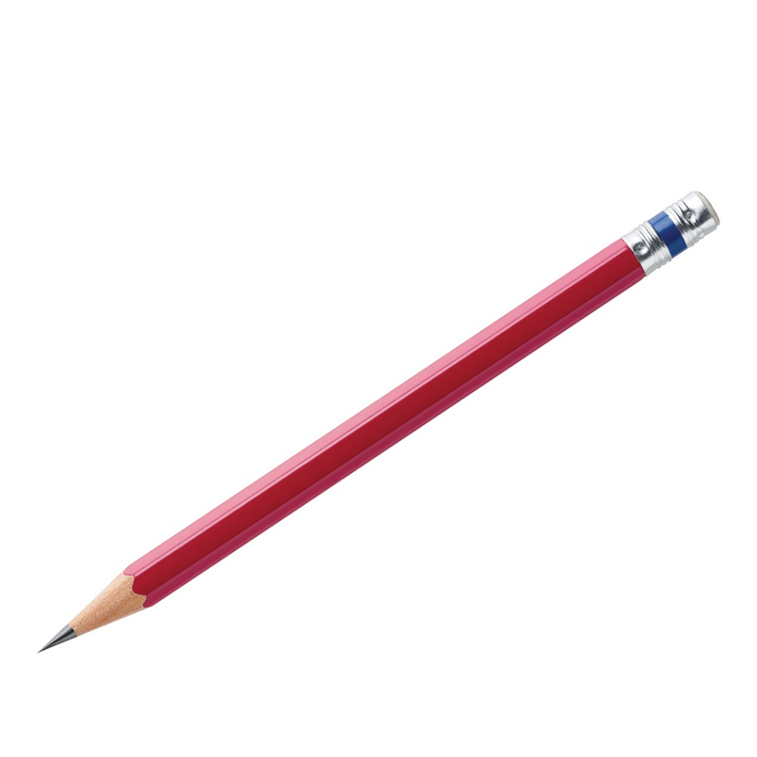
Vocabulary
Facebook : Bùi Liễu
0968142780
pencil
/ˈpen.səl/
bút chì

Slide 15
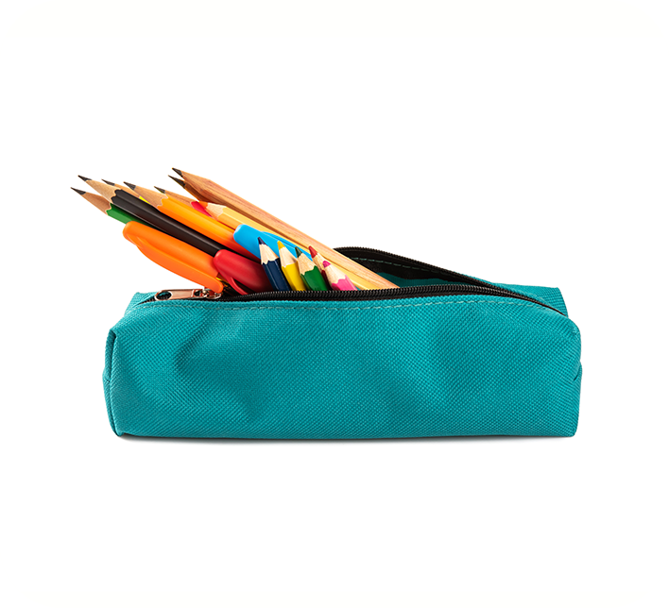
Vocabulary
Facebook : Bùi Liễu
0968142780
pencil case
/ˈpen.səl ˌkeɪs/
hộp bút

Slide 16
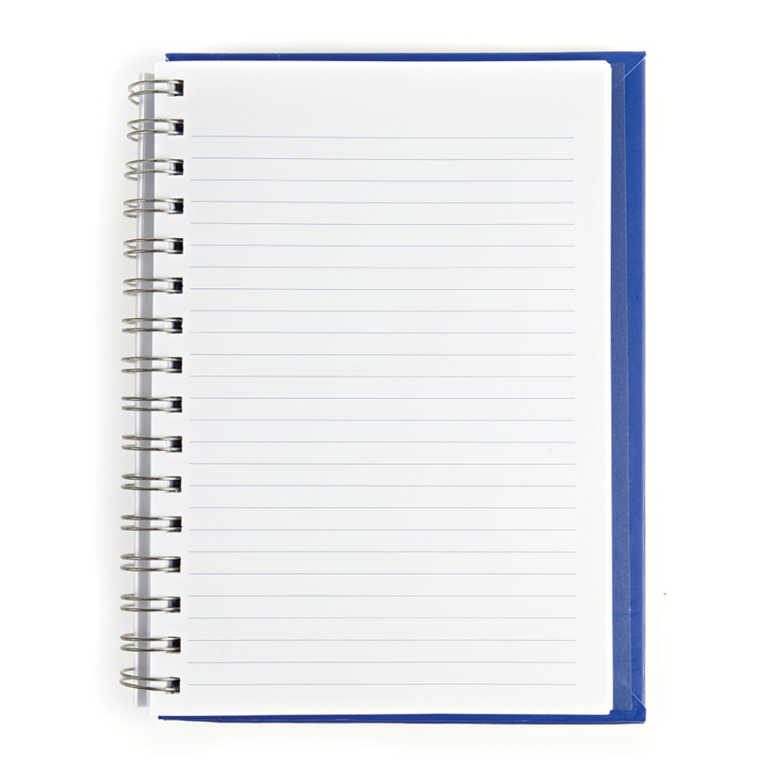
Vocabulary
Facebook : Bùi Liễu
0968142780
notebook
/ˈnəʊt.bʊk/
vở viết

Slide 17
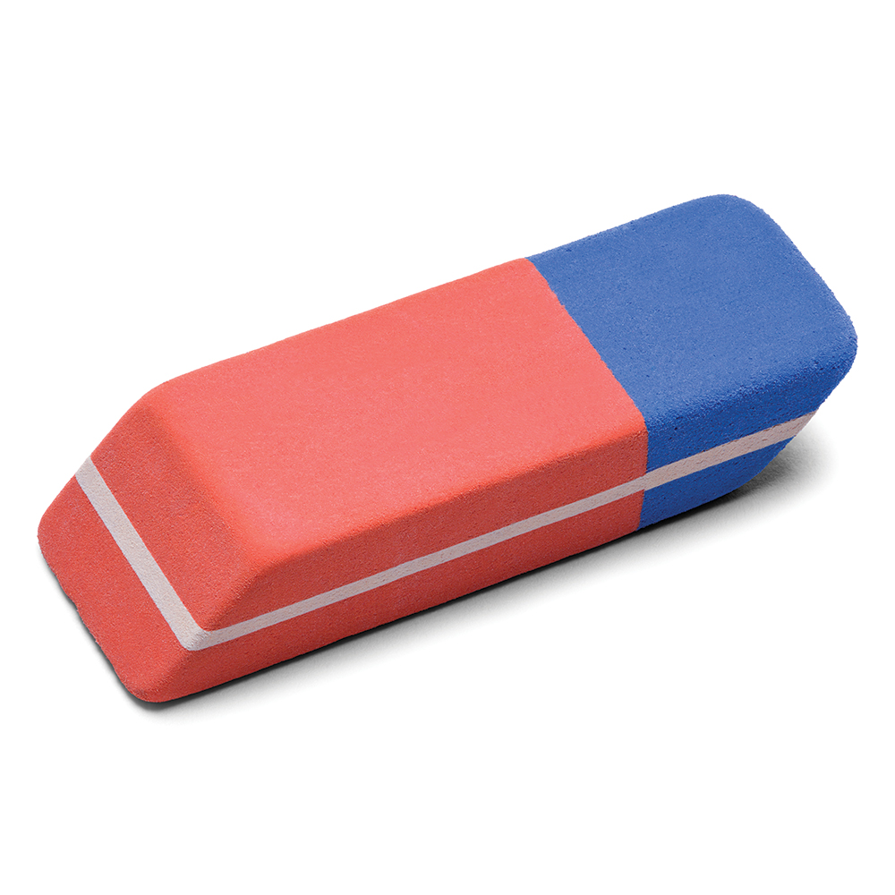
Vocabulary
Facebook : Bùi Liễu
0968142780
eraser
/ɪˈreɪ.zər/
cục tẩy

Slide 18
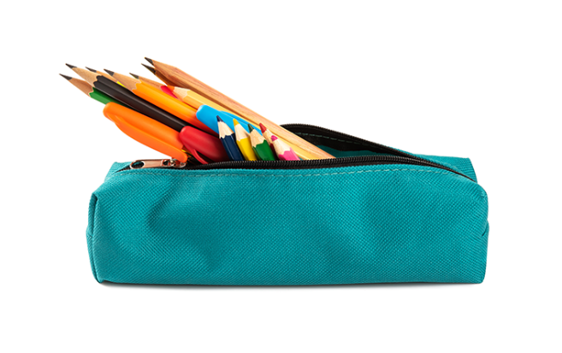
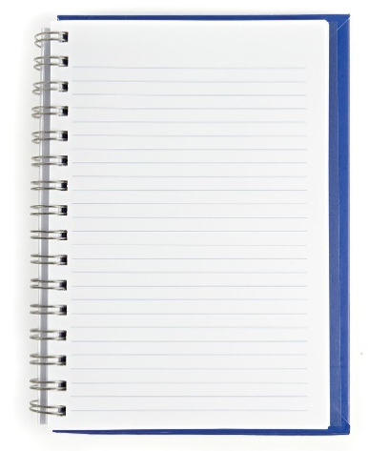
Review
pencil
pencil case
notebook
eraser

Slide 19
Vocabulary
Facebook : Bùi Liễu
0968142780
- pencil: bút chì
- pencil case: hộp bút
- notebook: vở viết
- eraser: cục tẩy

Slide 20
Facebook : Bùi Liễu
0968142780
Model sentences

Slide 21
* Hỏi và trả lời ai đó có cái gì không?.
- Do you have _______?
+ Yes, I do.
+ No, I don’t.
- Bạn có ______ không?
+ Ừ, tớ có.
+ Không, tớ không có.

Slide 22
Facebook : Bùi Liễu
0968142780
Let’s play!
Notes:
Facebook : Bùi Liễu
Mobile phone: 0968142780

Slide 23
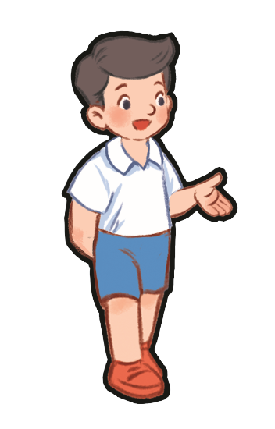
Do you have a pencil?
A. Yes, I do.
B. No, I don’t.

Slide 24
Do you have a ruler?
A. Yes, I do.
B. No, I don’t.

Slide 25
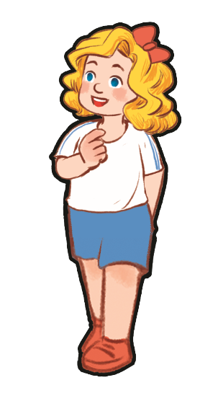
Do you have a book?
A. Yes, I do.
B. No, I don’t.

Slide 26
Do you have an eraser?
A. Yes, I do.
B. No, I don’t.

Slide 27
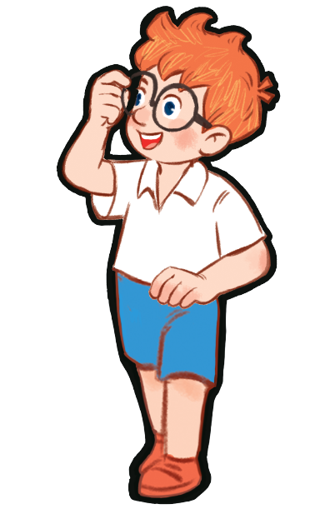
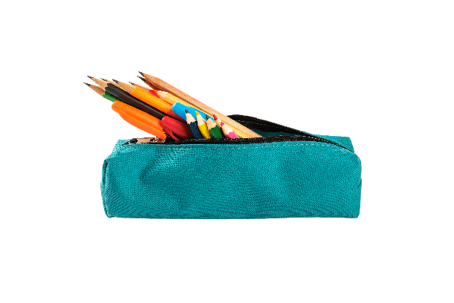
Do you have a pencil case?
A. Yes, I do.
B. No, I don’t.

Slide 28
Do you have a pencil case?
A. Yes, I do.
B. No, I don’t.

Slide 29
Do you have a ruler?
A. Yes, I do.
B. No, I don’t.

Slide 30
Do you have a pen?
A. Yes, I do.
B. No, I don’t.

Slide 31
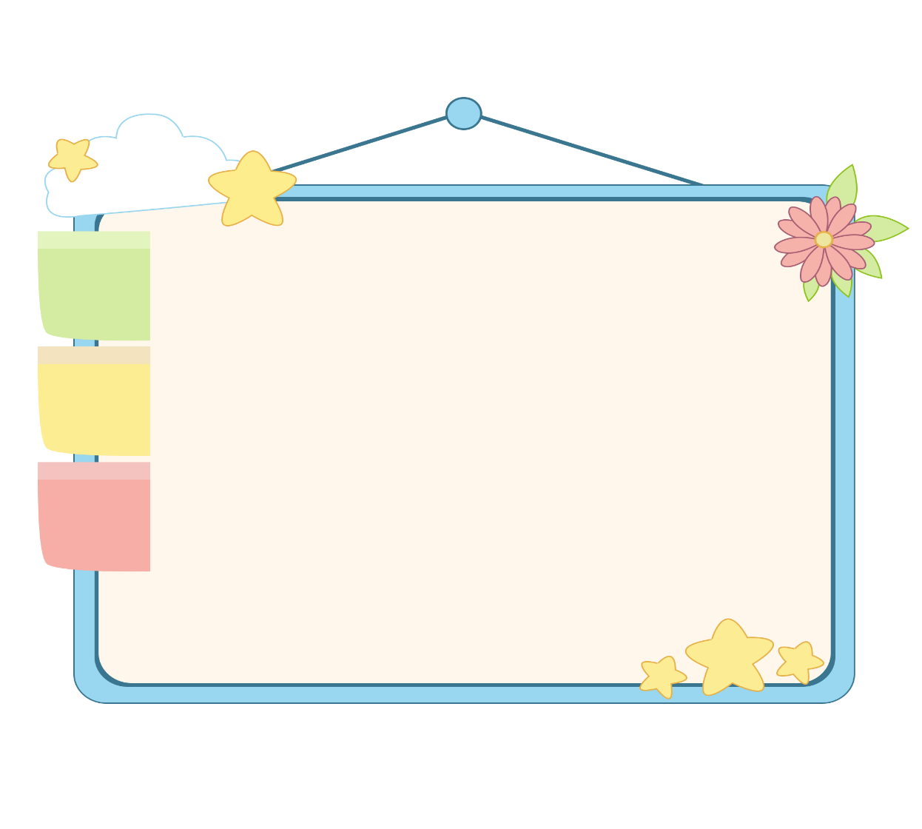
Facebook : Bùi Liễu
0968142780
WELL DONE!

Slide 32
2. Listen, point and say.
a
b
Do you have _____?
Yes, I do.
a pencil / yes
a pencil case / no
No, I don’t.
c
d
don’t = do not
a notebook / yes
an eraser / no

Slide 33
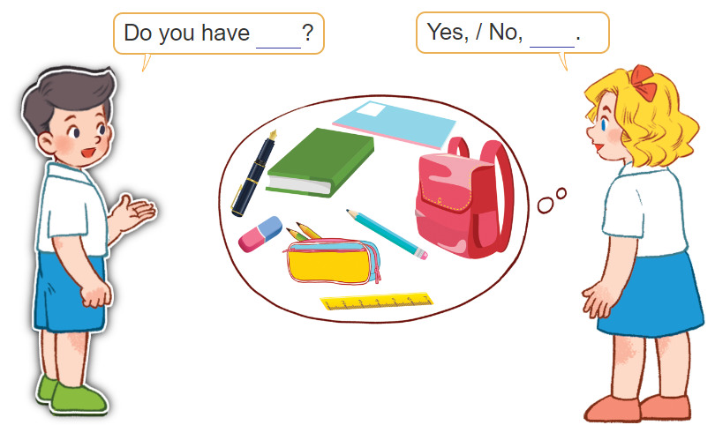
3. Let’s talk.

Slide 34
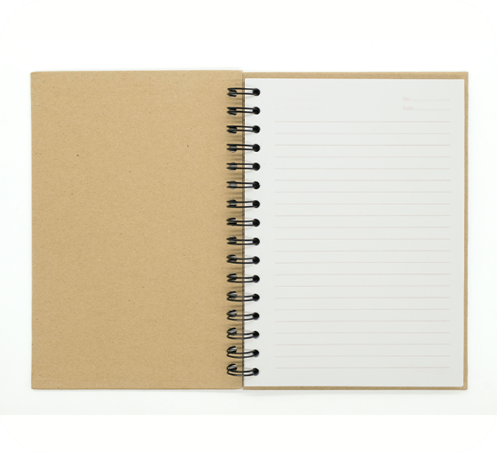
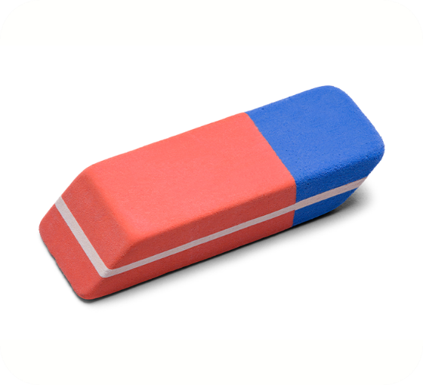
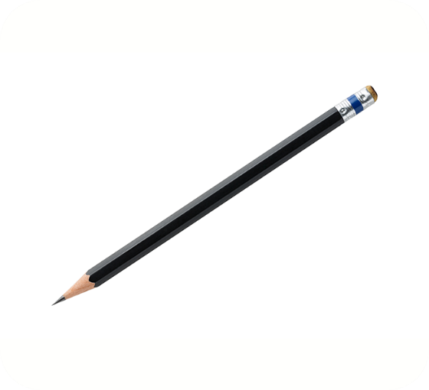
4. Listen and number.
3
4
1
2
a
b
c
d

Slide 35
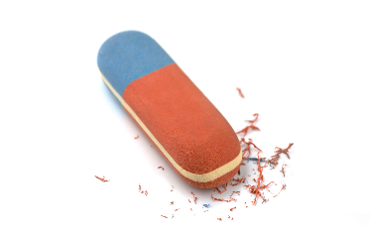
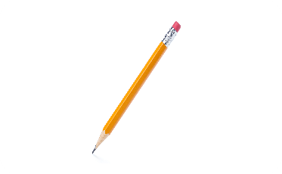
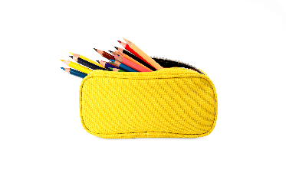
5. Read and match.
a
1. A: Do you have a notebook?
B: Yes, I do.
b
2. A: Do you have a school bag?
B: No, I don’t. I have a pencil case.
3. A: Do you have an eraser?
B: Yes, I do.
c
4. A: Do you have a pen?
B: No, I don’t. I have a pencil.
d
1 - d
2 - c
3 - a
4 - b

Slide 36
6. Let’s play.
Notes:
Facebook : Bùi Liễu
Mobile phone: 0968142780

Slide 37
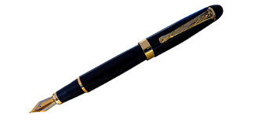
Matching game
pencil
pencil case
pen
Notes:
Click the card to show the words/picture. Click again to close it.

Slide 38
Matching game
book
eraser
pen
Notes:
Click the card to show the words/picture. Click again to close it.

Slide 39
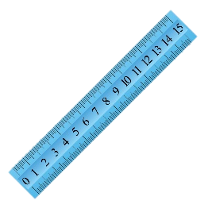
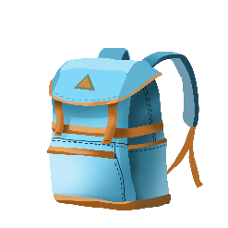
Matching game
notebook
school bag
ruler
Notes:
Click the card to show the words/picture. Click again to close it.

Slide 40
Wrap up
Notes:
Facebook : Bùi Liễu
0968142780

Slide 41
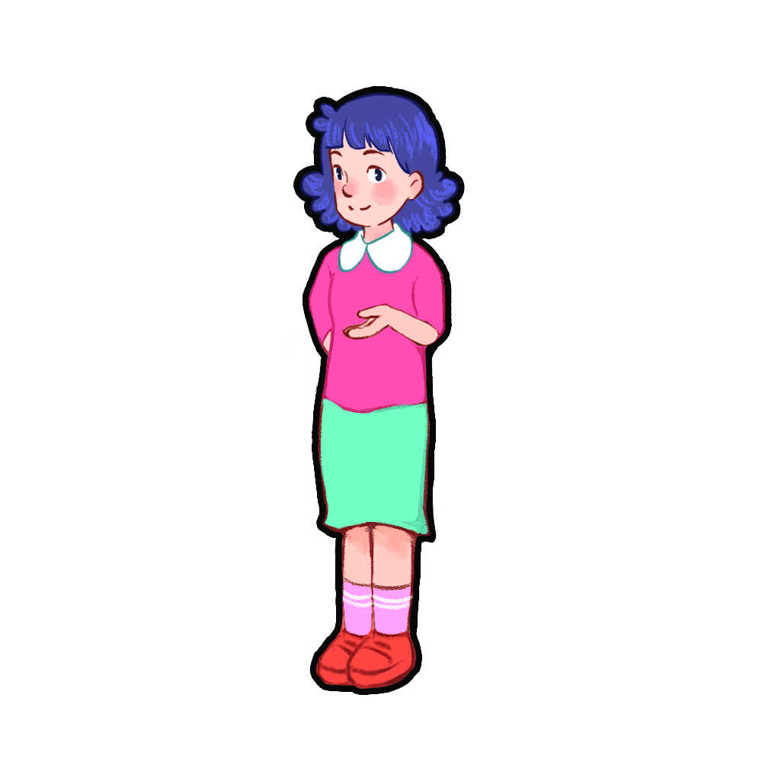
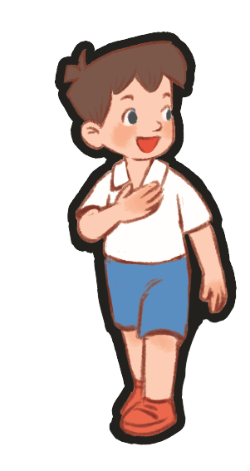
Show me: pencil, eraser, pen!
pencil, eraser, pen!
pencil, eraser, pen!
pencil, eraser, pen!
Notes:
Teacher tells pupils to put out their school things on the desk.
Ask them to show the school things with the correct order. (example: Show me: pencil, eraser, pen). Who can make it fastest is the winner.
Ask pupils to show those school things and repeat.

Slide 42
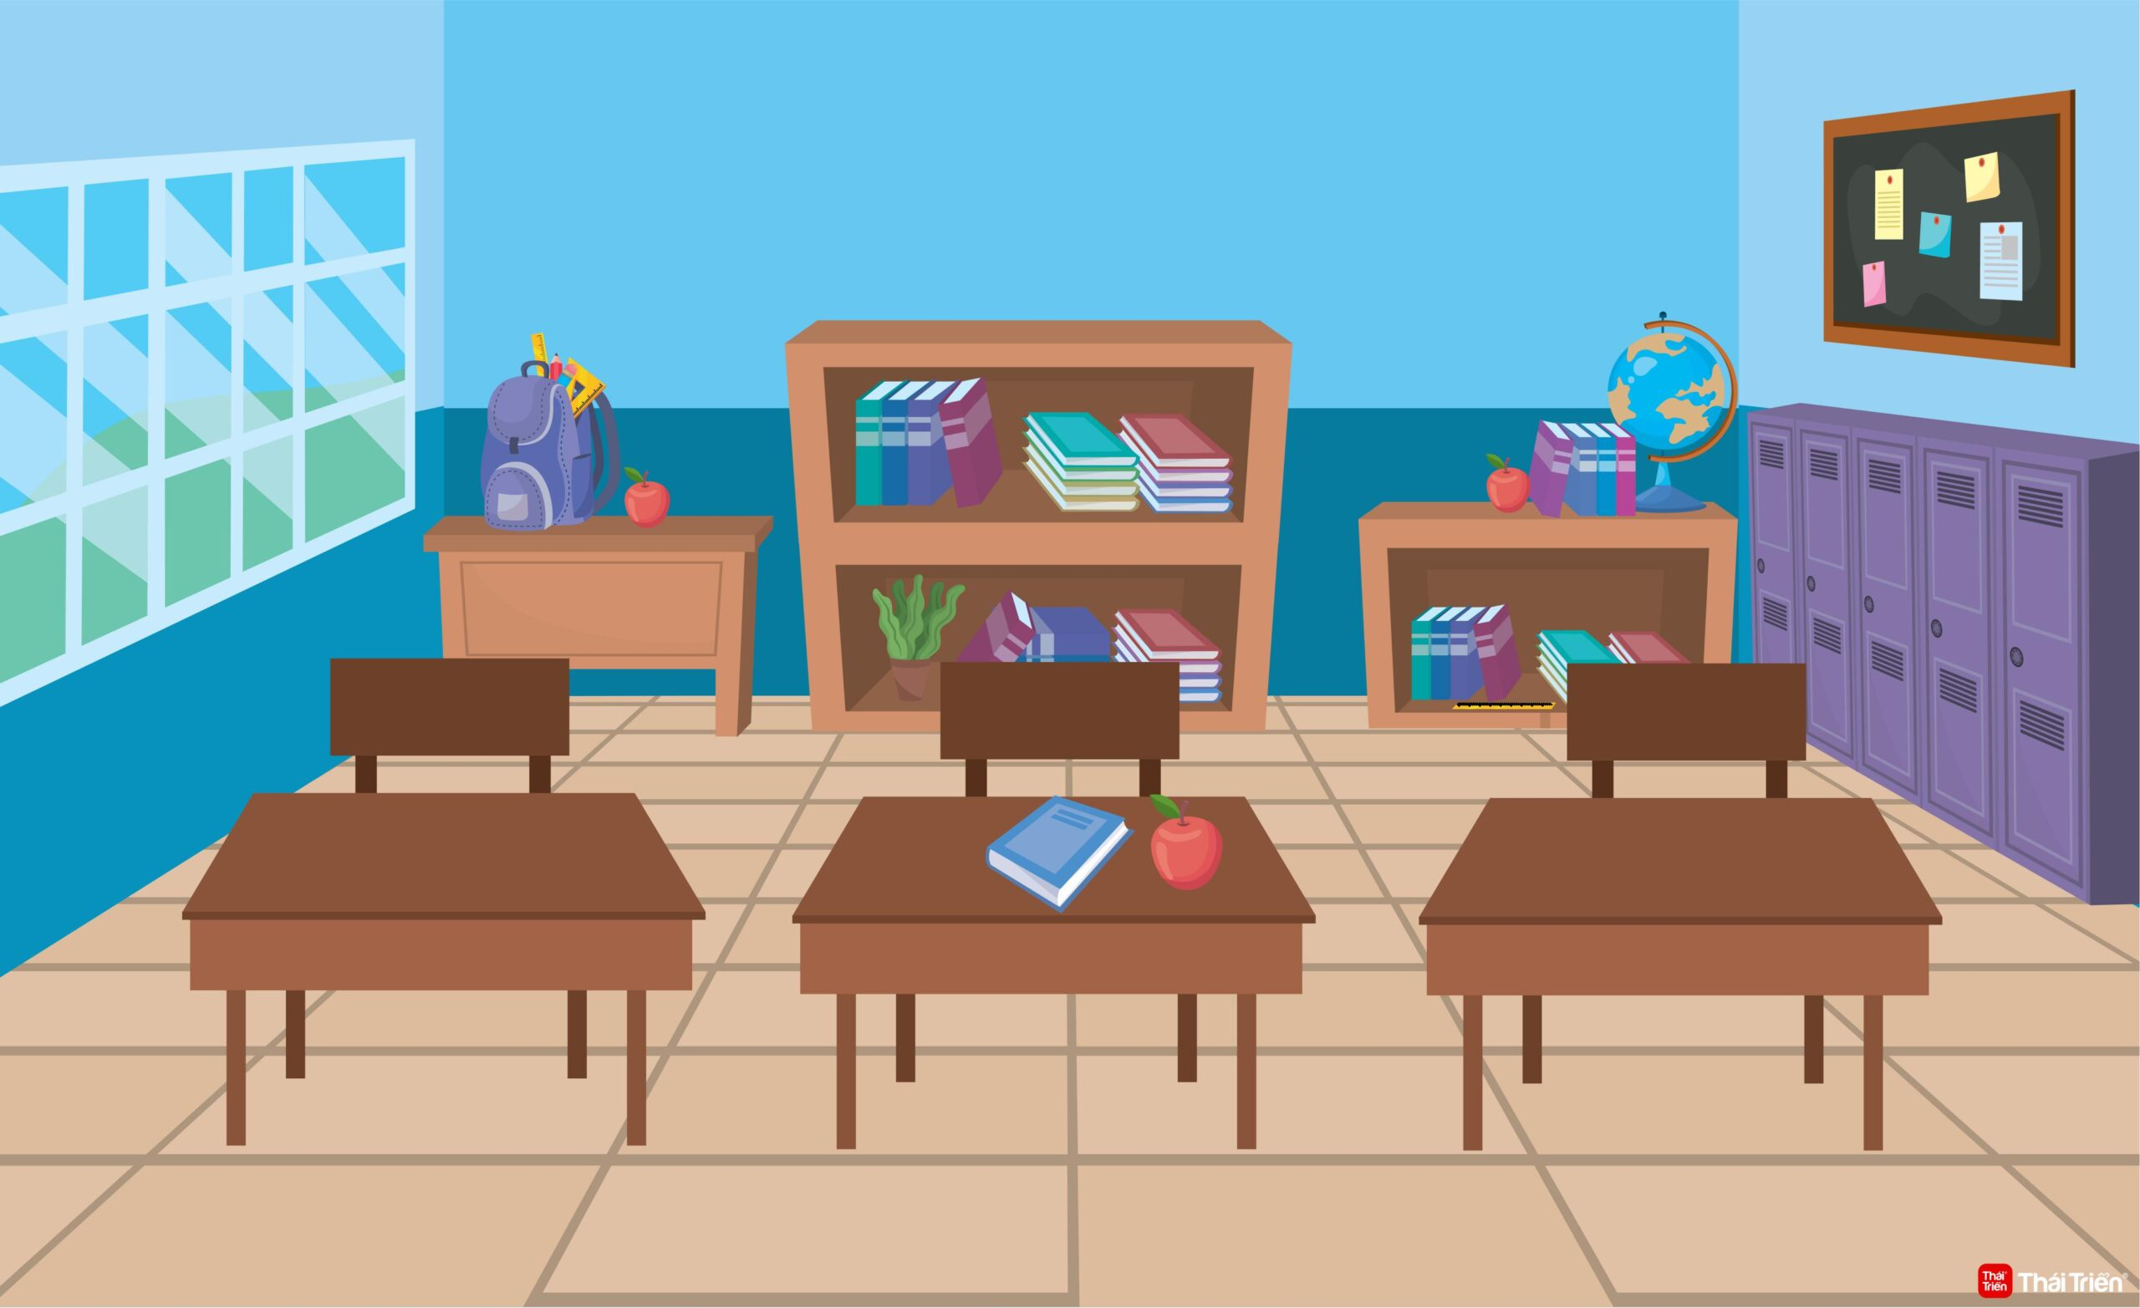
Do you have a ruler?
No, I don’t.
Yes, I do.
Yes, I do.
Notes:
Teacher tells pupils to put out their school things on the desk.
Ask them: Do you have a pen/book/ruler…?
Ask pupils if they have, say: Yes, I do. / if not: No, I don’t.

Slide 43
Homework
Learn by heart all the new words.
Read again the dialogue in part 1.
Notes:
Facebook : Bùi Liễu
0968142780

Slide 44
Thank you!
Facebook : Bùi Liễu
0968142780
Notes:
Facebook : Bùi Liễu
0968142780

