Slide 1
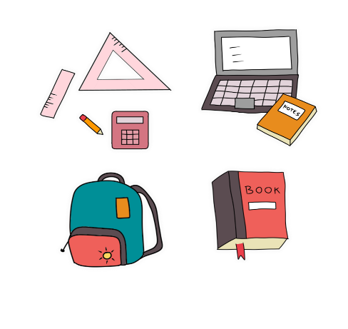
Thursday, November 30th 2023
My school things
Unit
8
Lesson 3
Facebook : Bùi Liễu
0968142780
Notes:
Facebook : Bùi Liễu
Mobile phone: 0968142780

Slide 2
Warm-up

Slide 3
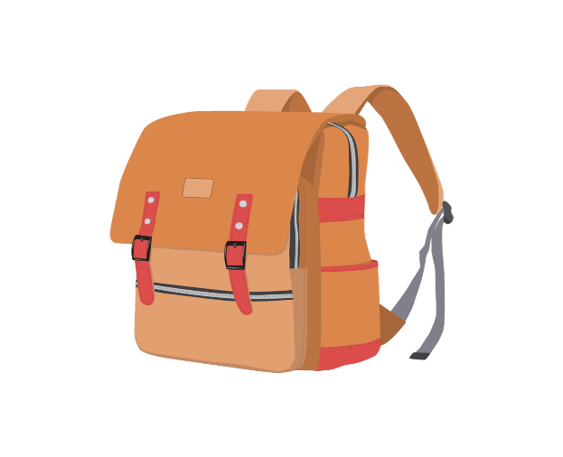
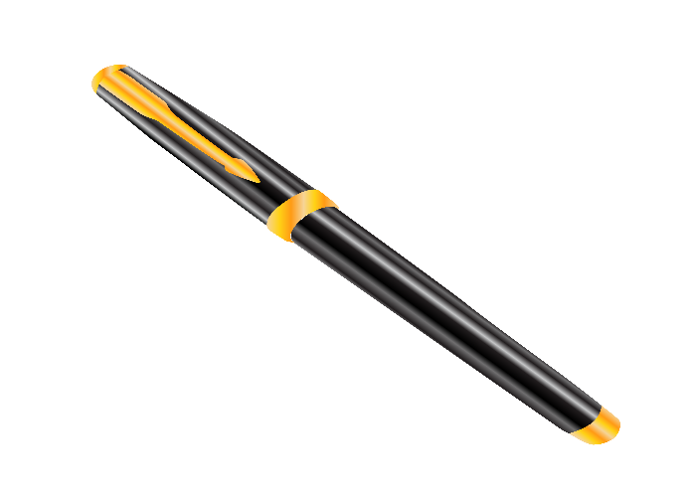
✓
Choose the right answer.
A
B
C
Click on the square to choose the answer.

Slide 4
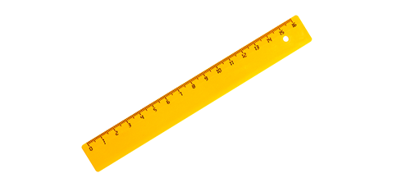
✓
Choose the right answer.
A
B
C
Click on the square to choose the answer.

Slide 5
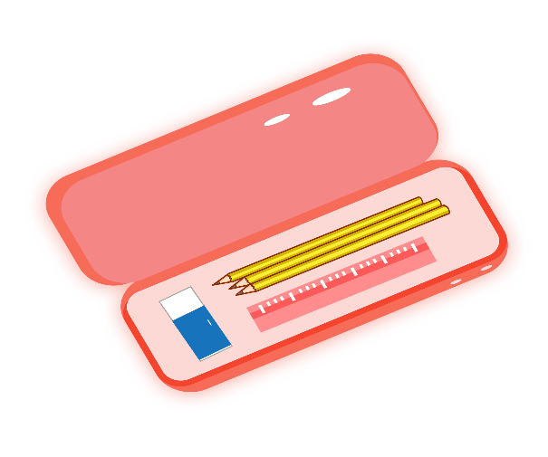
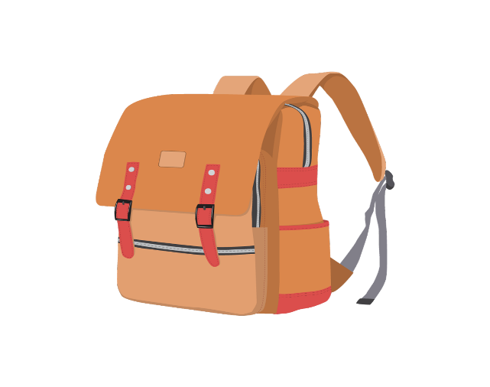
✓
Choose the right answer.
A
B
C
Click on the square to choose the answer.

Slide 6
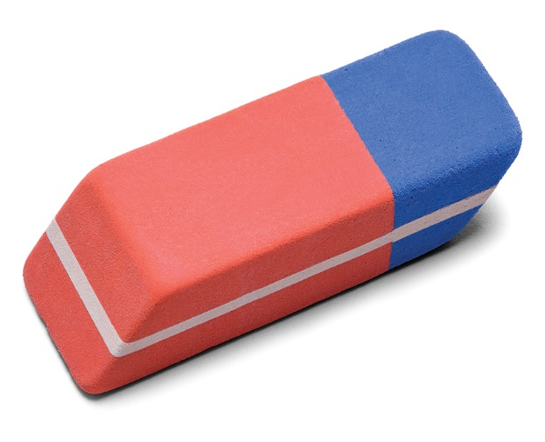
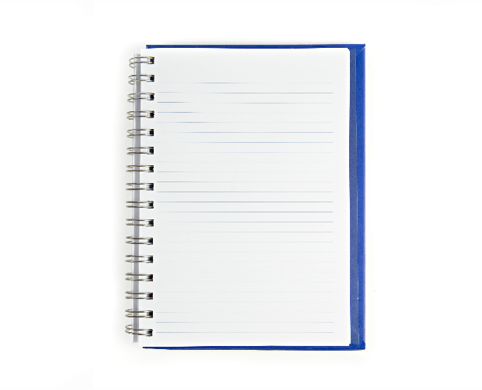
✓
Choose the right answer.
A
B
C
Click on the square to choose the answer.

Slide 7
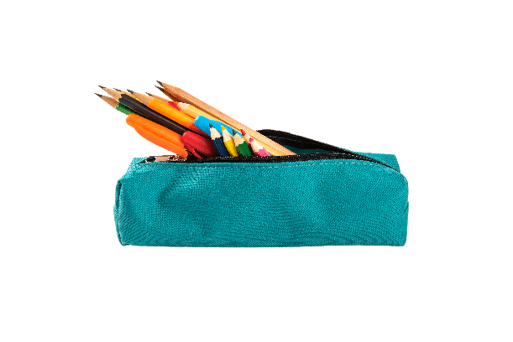
✓
Choose the right answer.
A
B
C
Click on the square to choose the answer.

Slide 8
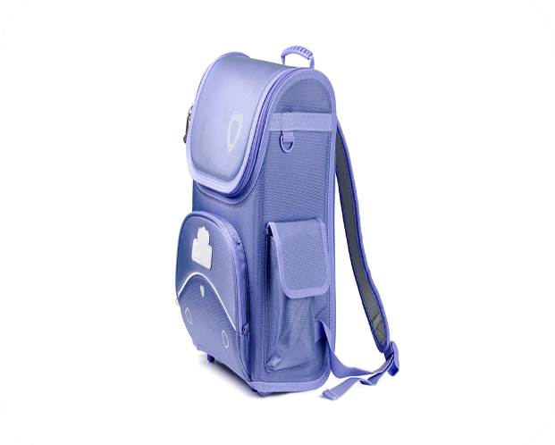
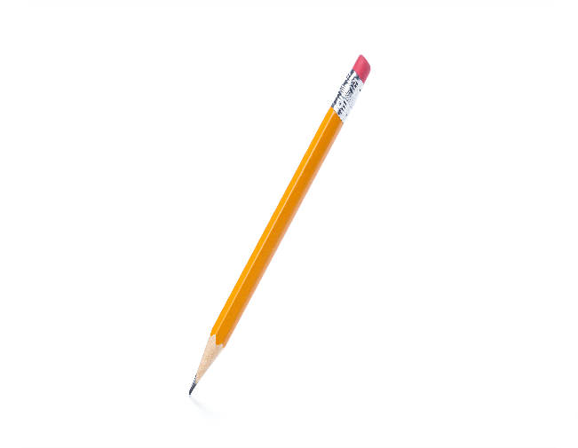
✓
Choose the right answer.
A
B
C
Click on the square to choose the answer.

Slide 9
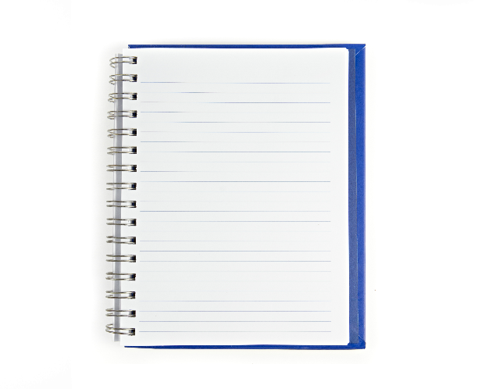
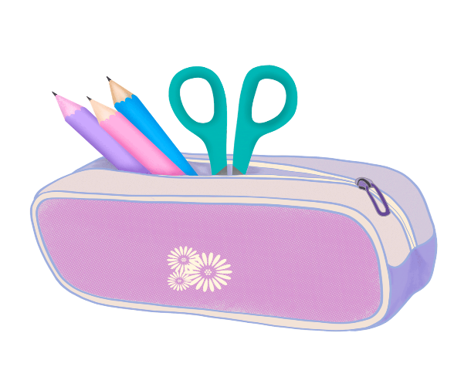
✓
Choose the right answer.
A
B
C
Click on the square to choose the answer.

Slide 10
Facebook : Bùi Liễu
0968142780
WELL DONE!

Slide 11
Contents
Facebook : Bùi Liễu
0968142780
Listen and repeat.
Listen and circle.
Let’s chant.
Read and complete.
Let’s write.
Project.
Notes:
Facebook : Bùi Liễu
Mobile phone: 0968142780

Slide 12
1. Listen and repeat.

Slide 13
2. Listen and circle.

Slide 14
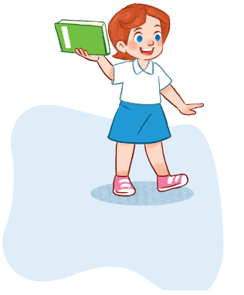
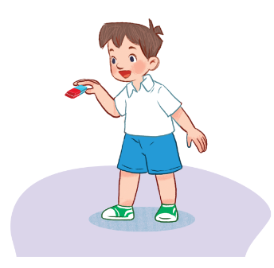
3. Let’s chant.
Book, book, book.
I have a book.
Do you have a book?
Yes, I do. Yes, I do.
Eraser, eraser, eraser.
I have an eraser.
Do you have an eraser?
No, I don’t. No, I don’t.

Slide 15
3. Let’s chant.
Click on the video
to watch and chant.

Slide 16
4. Read and match.
eraser have my pen
Look at my school things. I (1) ______ a notebook, a (2) _______ , a pencil case, an (3) _______ and an English book. I like (4) ________ school things. Do you have any school things?
have
pen
eraser
my

Slide 17
5. Let’s write.
My name is ______. Look at my school things. I have ________ and ___________.
Lieu
a pen
an eraser

Slide 18
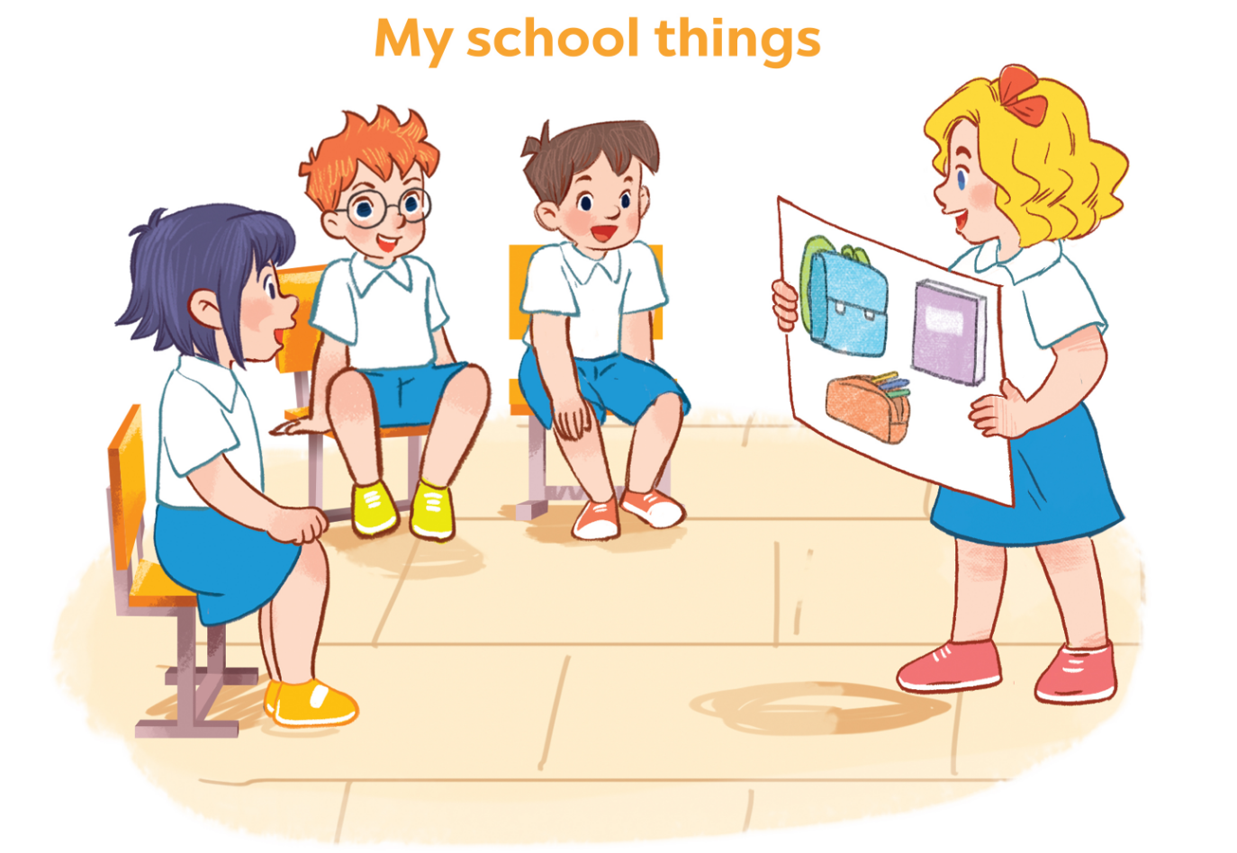
6. Project.

Slide 19
Facebook : Bùi Liễu
0968142780
Let’s play!
Notes:
Facebook : Bùi Liễu
Mobile phone: 0968142780

Slide 20
Arrange me!
1. / Do / pen / ? / a / you / have /
2. / have / I / . / eraser / an /
3. / have / Do/ ? / notebook / a / you /
4. / a / school bag / have / . / I /

Slide 21
Arrange me!
1. / Do / pen / ? / a / you / have /
Do you have a pen?

Slide 22
Arrange me!
2. have / I / . / eraser / an /
I have an eraser.

Slide 23
Arrange me!
3. have / Do/ ? / notebook / a / you /
Do you have a notebook?

Slide 24
Arrange me!
4. a / school bag / have / . / I /
I have a school bag.

Slide 25
Facebook : Bùi Liễu
0968142780
WELL DONE!

Slide 26
Wrap up unit 8
Notes:
Facebook : Bùi Liễu
0968142780

Slide 27
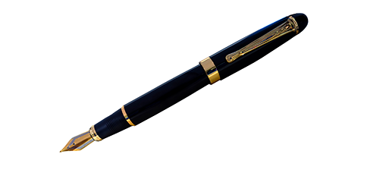
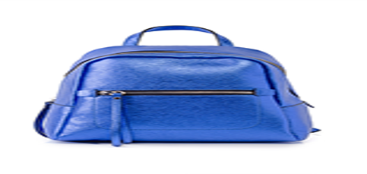
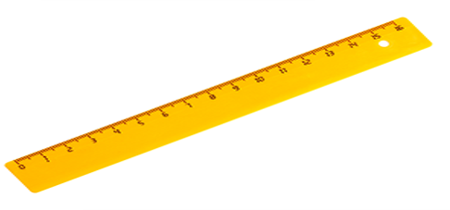
Vocabulary
school things
pen
book
ruler
school bag
Notes:
Facebook : Bùi Liễu
Mobile phone: 0968142780

Slide 28
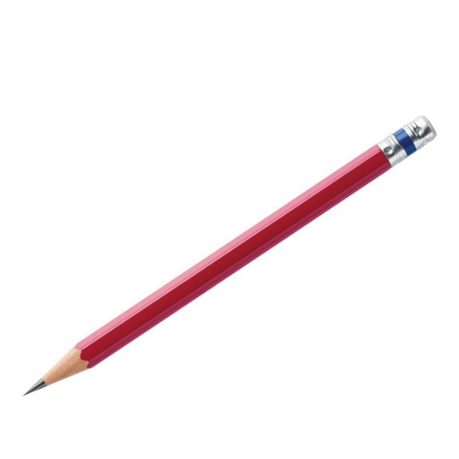
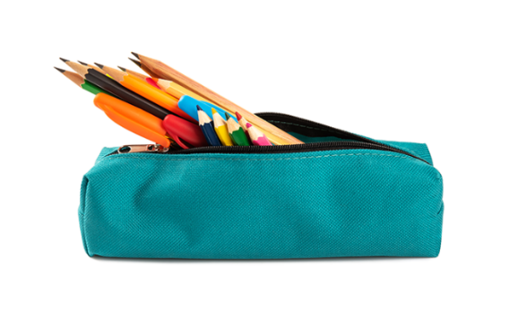
Vocabulary
pencil
pencil case
notebook
eraser

Slide 29
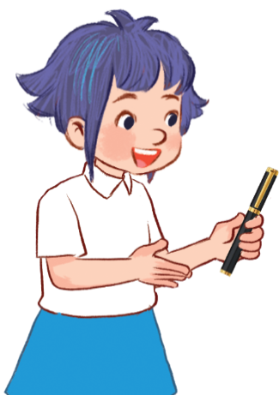
Structures
Khi muốn nói bản thân có cái gì đấy, ta sử dụng
mẫu câu.
- I have ______.
(Tớ có ____.)
Example:
I have a pen.

Slide 30
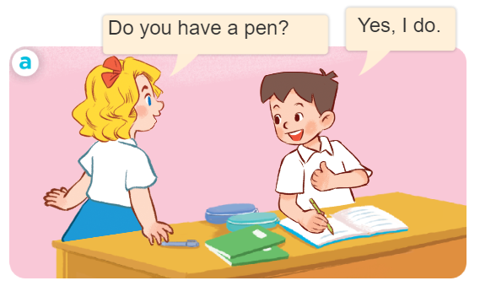
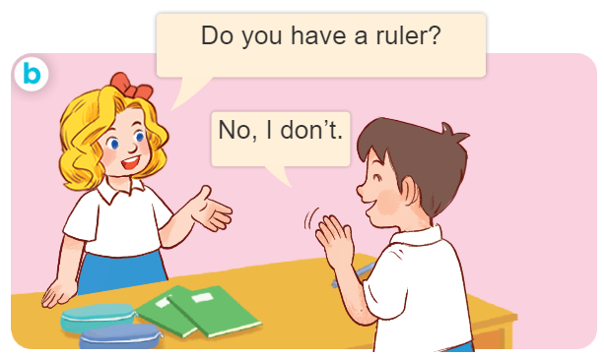
Hỏi và trả lời ai đó có cái gì không?.
- Do you have _______?
+ Yes, I do.
+ No, I don’t.
- Bạn có ______ không?
+ Ừ, tớ có.
+ Không, tớ không có.

Slide 31
Homework
.......................................
........................................
Notes:
Facebook : Bùi Liễu
0968142780

Slide 32
Thank you!
Facebook : Bùi Liễu
0968142780
Notes:
Facebook : Bùi Liễu
0968142780

