Slide 1
Unit 19
Which place would you like to visit?
Lesson 3

Slide 2
Warm-up

Slide 3
Pronunciation

Slide 4
1. Listen and repeat.
1. | Which place would you like to visit, ↷ Trang Tien Bridge ⤻ or Thien Mu Pagoda? ↷
2. | I'd like to visit Thien Mu Pagoda. ↷
3. | What do you think of Thien Mu Pagoda? ↷
4. | It's more beautiful than I expected. ↷

Slide 5
2. Listen and mark the sentence intonation (↷ or ⤻).
Then say the sentences aloud.
1. Which place would you like to visit, __ Thong Nhat Park __ or the Museum of History? __
I'd like to visit the Museum of History. __
2. What do you think of the Museum of History?
It's more interesting than I expected. __
3. Which place would you like to visit, __ Bai Dinh Pagoda __ or Hoa Lu Temple? __
I'd like to visit Hoa Lu Temple. __
4. What do you think of Hoa Lu Temple? __
It's more attractive than I expected.
↷
⤻
↷
↷
↷
↷
⤻
↷
↷
↷

Slide 6
Pratise

Slide 7
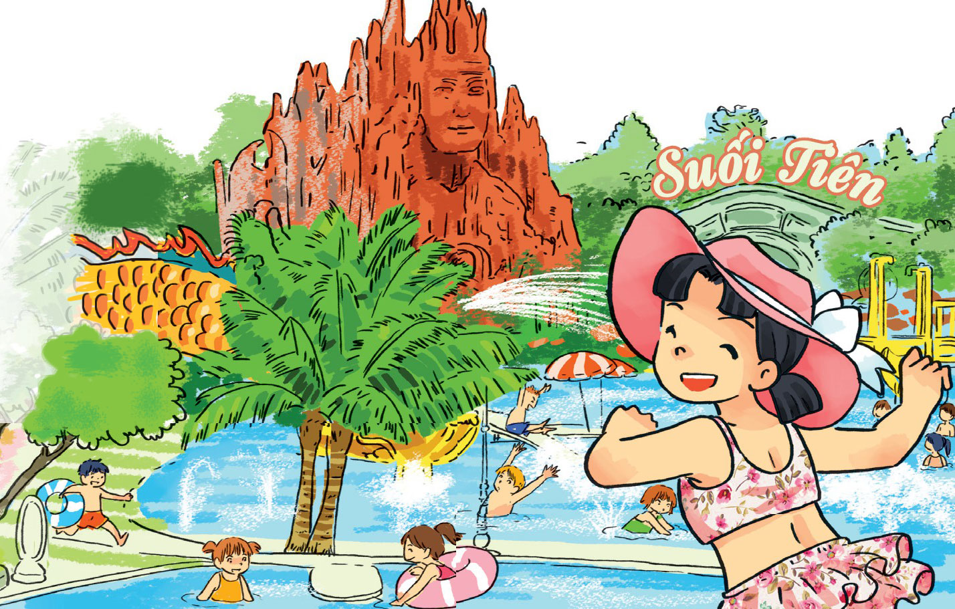
3. Let’s chant.
What do you think of it?
Here I am
At Suoi Tien Park.
What do you think of it?
What do you think of it?
It's more beautiful,
More attractive,
More interesting
And more exciting
Than I expected!

Slide 8
4.1. Complete the passage.
My name's Tom. Yesterday, I visited Tran Quoc (1) _________. It is on an island in the middle of West Lake and not far from the (2) _________ of Ha Noi. I went there by bike. Tran Quoc Pagoda is very quiet. It is more (3) _________han I expected. There are (4) _________statues and trees in the yard. I met some (5) _________ there. My friends and I learn more about the history of Ha Noi after the visit.
beautiful
friends
pagoda
centre
a lot of
Pagoda
centre
beautiful
a lot of
friends

Slide 9
4.2 Answer the questions.
1. When did Tom visit Tran Quoc Pagoda?
Tom visited it yesterday.
2. Where is Tran Quoc Pagoda?
It's on an island in the middle of West Lake.
3. What does Tom think of Tran Quoc Pagoda?
It is more beautiful than he expected.
4. What did Tom and his friends learn about?
They learnt more about the history of Ha Noi after the visit.

Slide 10
5. Write about your last summer holiday.
1. Where did you go last summer holiday?
_________________________________.
2. What places did you visit?
_________________________________.
3. What were they like?
_________________________________.
4. What did you think of them?
_________________________________.

Slide 11
6. Project

