Slide 1
Unit 20:
WHICH ONE IS MORE EXCITING,
LIFE IN THE CITY OR
LIFE IN THE COUNTRYSIDE?
Lesson 3

Slide 2
Warm-up

Slide 3
Pronounciation

Slide 4
1. Listen and repeat
1. | Which one is bigger, ↷ London ⤻ or Hue? ↷ I think London is. ↷
2. | Which one is more beautiful, ↷ Ha Long City ⤻ or Nha Trang? ↷ I think Ha Long City is. ↷

Slide 5
2. Listen and mark the sentence intonation (↷ or ⤻).
Then say the sentences aloud.
A: Which one is bigger, __ New York City __ or London? __
B: I think London is. __
A: Which one is larger, __ New York City __ or Da Nang? __
B: I think New York City is. __
A: Which one is more beautiful, __ London __ or Sydney? __
1
↷
⤻
↷
↷
2
↷
⤻
↷
↷
3
↷
⤻
↷
B: I think London is. __
↷

Slide 6
Practise

Slide 7
3. Let’s chant.

Slide 8
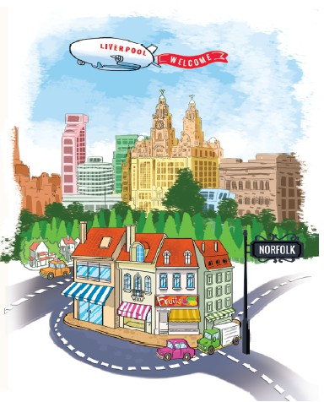
4. Read and answer
1. Where does Anna live?
She lives in Liverpool.
2. Where does she often go for her summer holiday?
She often goes to King's Lynn.
3. Which one is smaller, Liverpool or King's Lynn?
King's Lynn is.
4. Which one is noisier, Liverpool or King's Lynn?
Liverpool is.
5. Where are things more expensive, in Liverpool or in King's Lynn?
Things in Liverpool are more expensive than in
Hello. My name's Anna. I live in Liverpool, a very big city in England. It has a lot of people and interesting buildings. It's very noisy. But I enjoy living here because life is exciting. During summer holidays, I often stay with my grandparents in King's Lynn, a town in the east of England, in a county called Norfolk. It's much smaller and quieter than Liverpool. There are not so many people there, but the shops are really nice and things are cheaper. I like Norfolk because the people are very friendly.

Slide 9
5. Write about where you live
My name is _________.
I live in _________. It's a _________ in Viet Nam.
There are_________. It's _________.
I enjoy living here because it's_________.

Slide 10
6. Project

