Slide 1
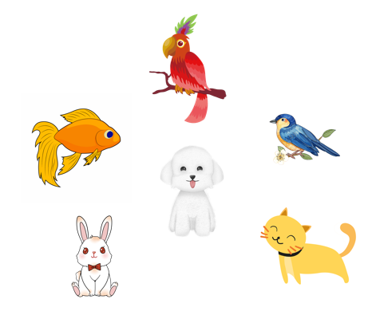
..................................
My pets
Unit
16
Lesson 2 (4+5+6)
Facebook : Bùi Liễu
0968142780

Slide 2
Warm-up

Slide 3
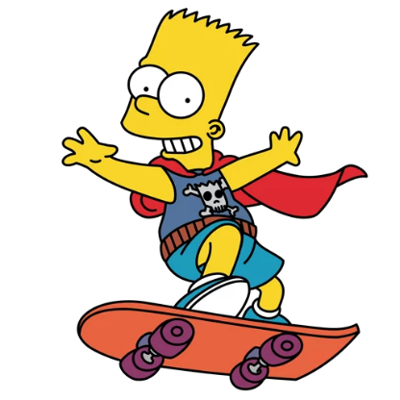
WHERE IS
BART
?

Slide 4
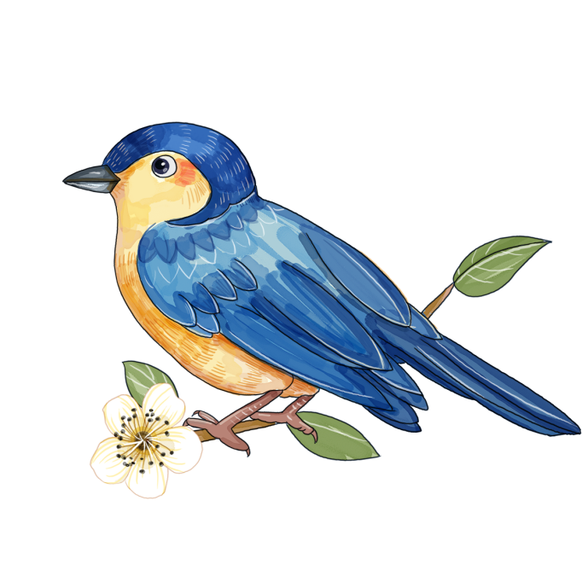
TIME’S UP
NEXT
A
cat
B
bird
C
rabbit

Slide 5
TIME’S UP
NEXT
A
bird
B
dog
C
cat

Slide 6
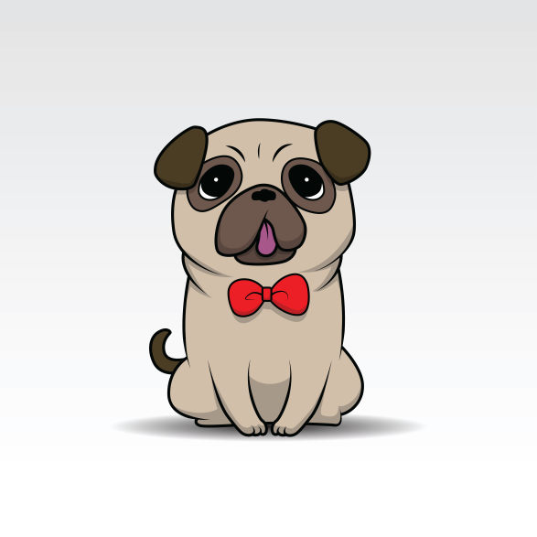
TIME’S UP
NEXT
A
dog
B
dogs
C
cat

Slide 7
TIME’S UP
NEXT
A
cat
B
goldfish
C
rabbit

Slide 8
TIME’S UP
p_ _rot
NEXT
A
or
B
er
C
ar

Slide 9
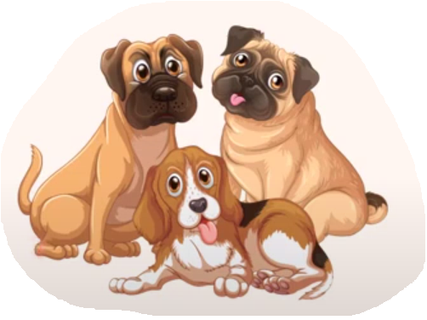
TIME’S UP
NEXT
A
some
B
many
C
cat

Slide 10
TIME’S UP
NEXT
A
dog
B
parrot
C
rabbit

Slide 11
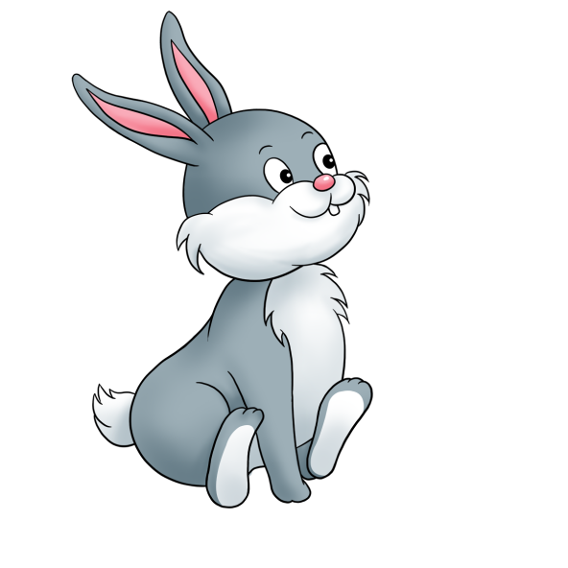
TIME’S UP
NEXT
A
rabbit
B
bird
C
cat

Slide 12
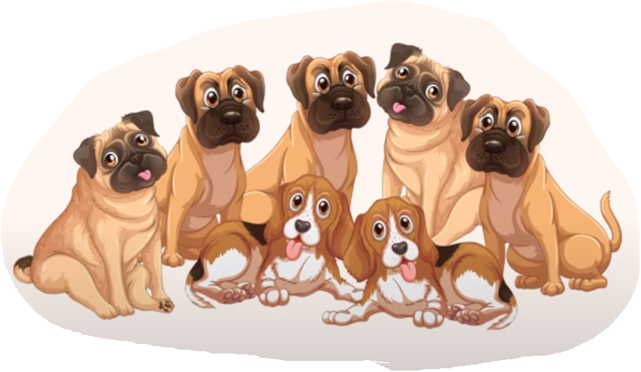
How many dogs do you have?
TIME’S UP
NEXT
A
I have some.
B
I have many.

Slide 13
How many parrots do you have?
TIME’S UP
NEXT
A
I have many.
B
I have some.

Slide 14
____ many dogs do you have?
I have many.
TIME’S UP
NEXT
A
Where
B
How
C
What

Slide 15
How many dogs do you have?
I ____some.
TIME’S UP
NEXT
A
had
B
have
C
has

Slide 16
Well done!
END

Slide 17
Contents
Facebook : Bùi Liễu
0968142780
Listen and number.
Look, complete and read.
Let’s play.

Slide 18
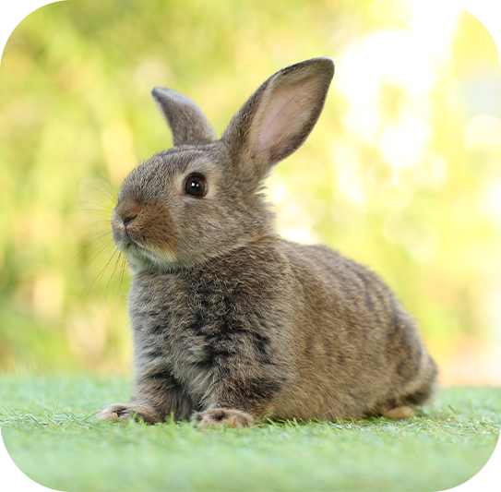
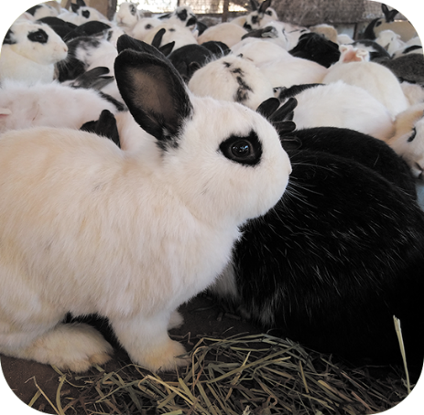
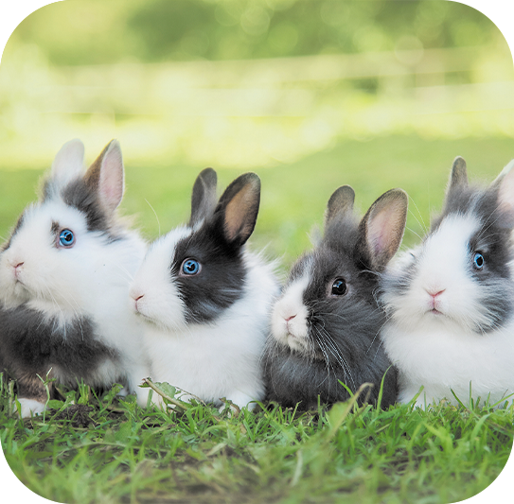
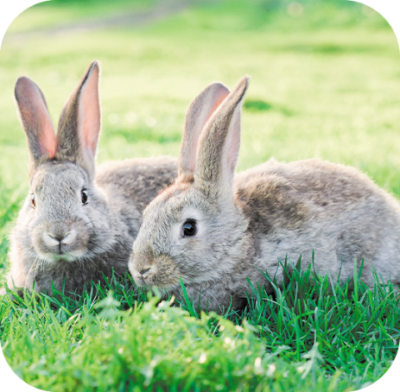
4. Listen and number.
a
b
c
d
4
1
2
3

Slide 19
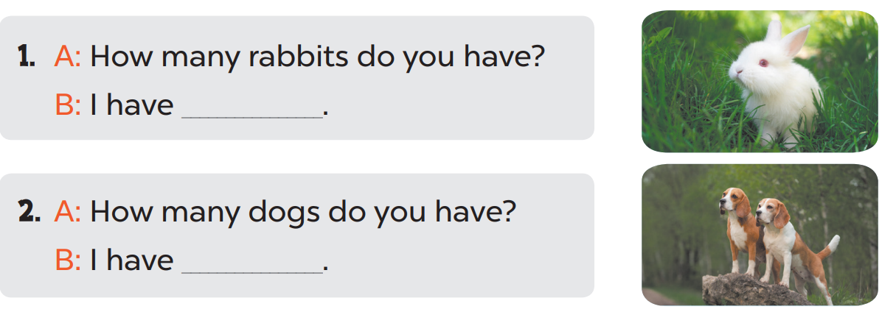
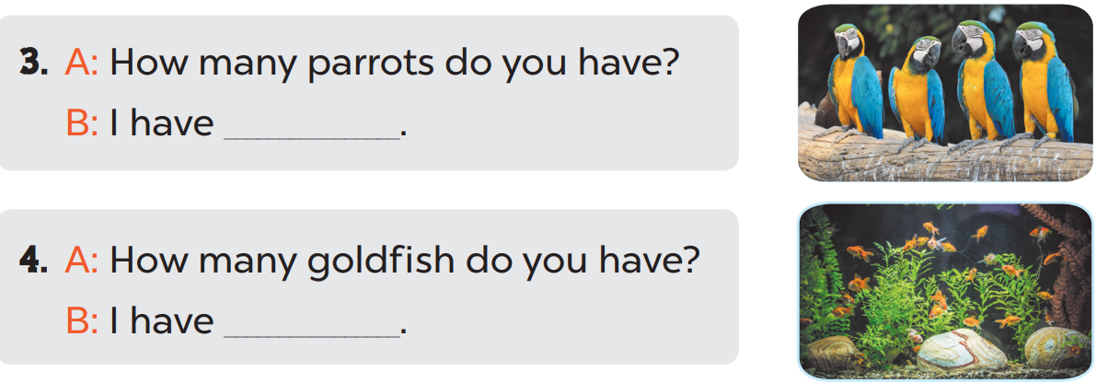
5. Look, complete and read.
one
two
some
many

Slide 20
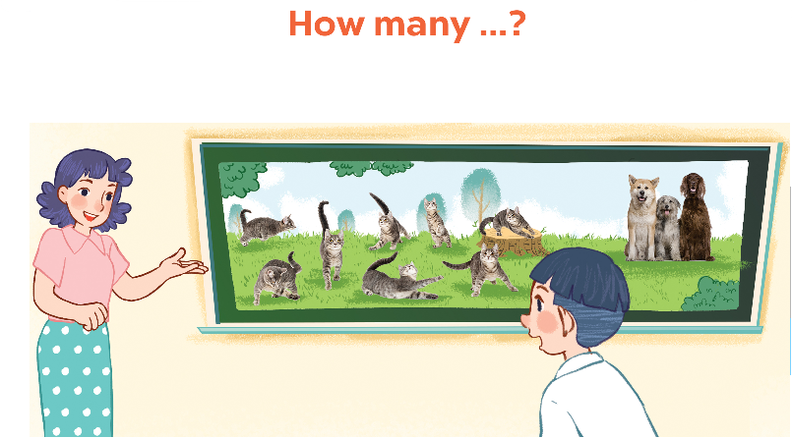
6. Let’s play.

Slide 21
Wrap up

Slide 22
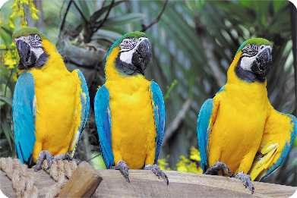
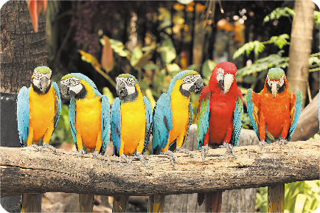
Review
dogs
goldfish
some
many

Slide 23
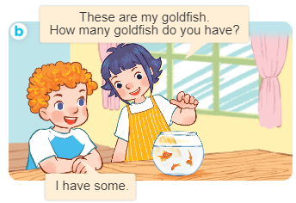
Structures
Cách hỏi và trả lời về số lượng vật nuôi.
- How many _____ do you have?
I have __________.

Slide 24
Facebook : Bùi Liễu
0968142780
Thank you!

