Slide 1
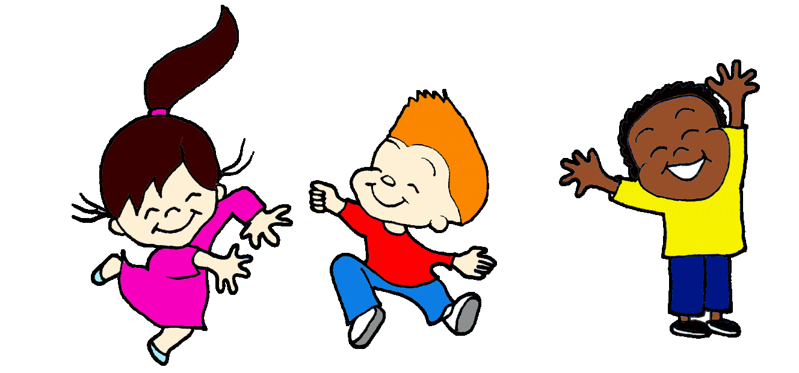

Slide 2
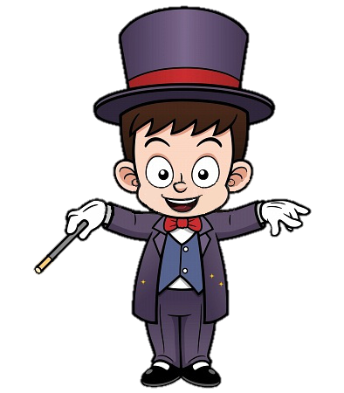
Rule:
Class will be divided into 2 teams. Take turn to play.
The magician will show a thing and you have to answer the question “What shape is it?”
NEXT

Slide 3
Unit 2: Shapes
Lesson 2

Slide 4
Letter Pp

Slide 5
Introduction:
Letter P makes the sound p

Slide 6
How to write letter Pp?
P
p

Slide 7
Pp pen

Slide 8
Pp penguin

Slide 9
Listen and repeat. Write.

Slide 10
p
p
p p __en
p p __enguin

Slide 11
Part C
Sing

Slide 12
I have a ,
p, p, .
I have a ,
p, p, p.

Slide 14
Letter Qq

Slide 15
Introduction:
Letter Q makes the sound q

Slide 16
How to write letter Qq?
Q
q

Slide 17
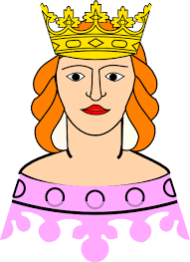
Qq queen

Slide 18
What’s your name?
Qq question

Slide 19
Listen and repeat. Write.

Slide 20
What’s your name?
q
q
q q __ueen
q q __uestion

Slide 21
Part C
Sing

Slide 22
This is a ,
q, q, .
This is a ,
q, q, q.

Slide 24
Rule:
This game can be played individually or in teams.
You have to choose the right answer for each picture shown on the slide.
LET’S PLAY!

Slide 25
Excellent!
Letter Qq
Letter Pp
(_____________)

Slide 26
Excellent!
queen
penguin
(_____________)

Slide 27
Excellent!
queen
pen
(_____________)

Slide 28
Excellent!
queen
question
(_____________)

Slide 29
Excellent!
pen
penguin
(_____________)

Slide 30
Excellent!
Letter Qq
Letter Pp
(_____________)

Slide 31
Excellent!
queen
penguin
(_____________)

Slide 32
Excellent!
Letter Pp
Letter Qq
What’s your name?
(_____________)

Slide 33
