Slide 1
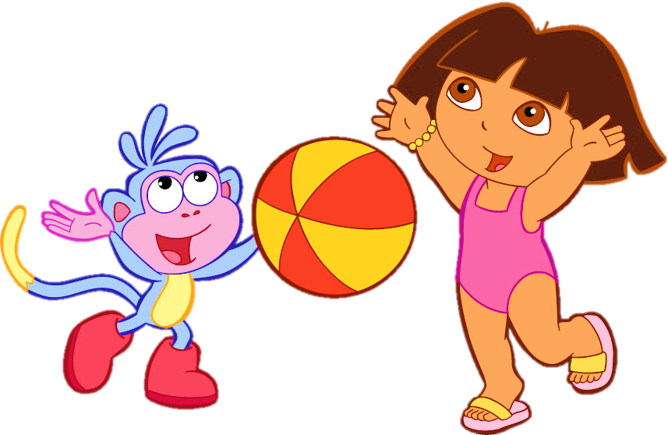
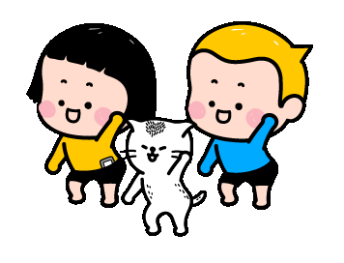
Warm-up:

Slide 2
Unit 3: Numbers
Lesson 2

Slide 3
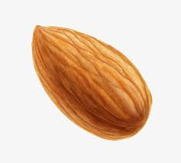
Letter Nn

Slide 4
Letter Oo

Slide 5
Letter Pp

Slide 6
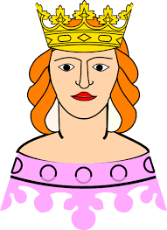
Letter Qq
What’s your name?

Slide 7
Part E
Draw lines.

Slide 8
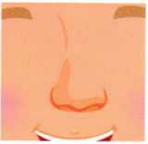
Oo
Nn

Slide 9
Part G
Circle the odd-one-out.

Slide 10
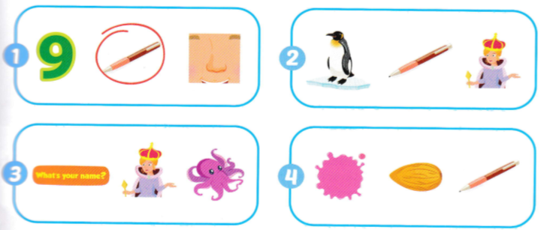
G

Slide 11
Game
Stepping stone

Slide 12
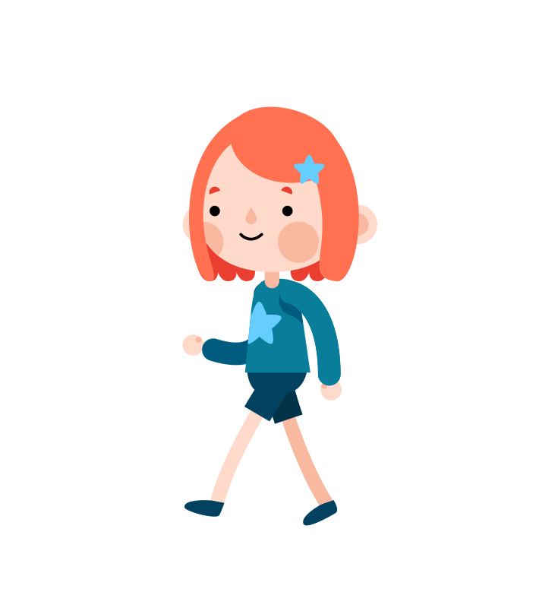
Game: Stepping stones
N
A
q
p
Rule:
Class will be divided into 2 teams. Team BOY and team GIRL. Take turn to play.
At each rock, there is a question that you have to answer. If you’re correct, you can move on. Which team move to the finish rock first will be the winner.
B
Q

Slide 13
N
A
q
p
B
Q

Slide 14
What sound is this?
“p”

Slide 15
Letter O is for….

Slide 16
Letter Q is for….

Slide 17
What sound is this?
“q”

Slide 18
Letter P is for….

Slide 19
What letter is this?
N

Slide 20
What letter is this?
Q

Slide 21
Letter P is for….

