Slide 1
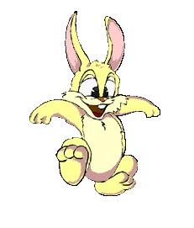
Warm-up:
Game: Go to the top!
Rule:
Class will be divided into 2 teams. Team RABBIT and team TIGER. Take turn to play.
Each team will take turn to choose question from 1 to 5. If your answer is correct, you can hop up on the next rock.
Which team goes to the top first will be the winner.

Slide 2
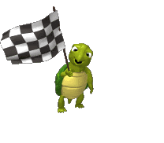
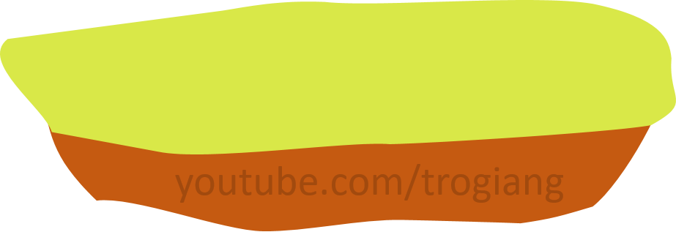
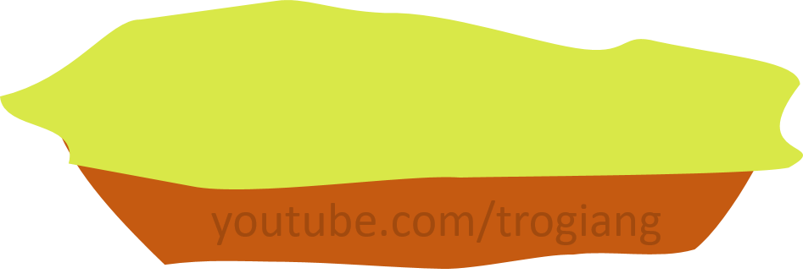
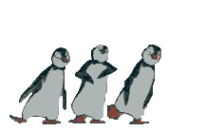
CONGRATULATIONS
CONGRATULATIONS
5
5
4
4
3
3
2
2
1
1

Slide 3
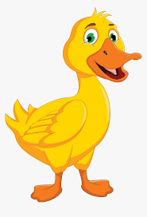
RABBIT TEAM
What animal is this?
It’s a duck.

Slide 4
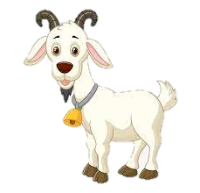
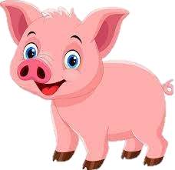
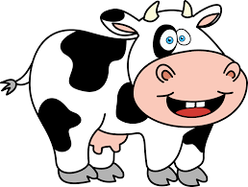
RABBIT TEAM
Which animal says “Moo-moo”
A. B. C.
C.

Slide 5
RABBIT TEAM
What animal says “Oink-oink”?
A. B. C.
A.

Slide 6
RABBIT TEAM
Which one is the goat?
A. B. C.
A.

Slide 7
RABBIT TEAM
What animal is this?
It’s a cow.

Slide 8
TIGER TEAM
What animal is this?
It’s a pig.

Slide 9
TIGER TEAM
What animal is this?
It’s a goat.

Slide 10
TIGER TEAM
What animal says “quack-quack”?
A. B. C.
C.

Slide 11
TIGER TEAM
Which one is the cow?
A. B. C.
A.

Slide 12
TIGER TEAM
Which one is the goat?
A. B. C.
B.

Slide 13
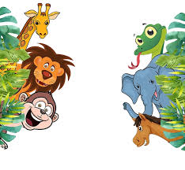
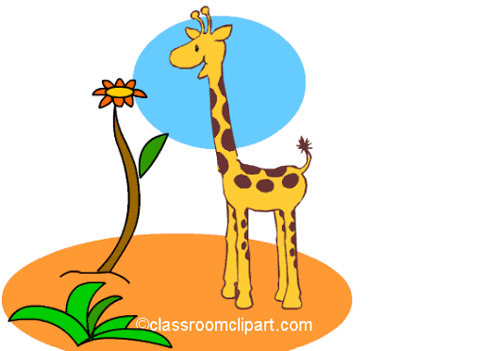
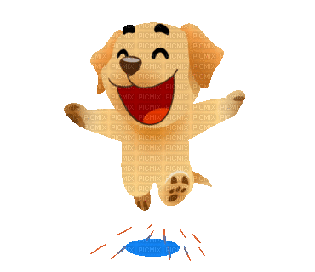
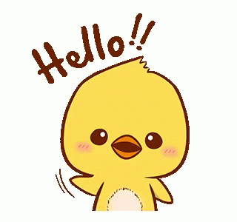
Unit 4: Animals
Lesson 2

Slide 14
Letter Rr

Slide 15
Introduction:
Letter R makes the sound r

Slide 16
How to write letter Rr?
R
r

Slide 17
Rr rabbit

Slide 18
Rr robot

Slide 19
Part B
Listen and repeat. Write.

Slide 20
r
r
r r __abbit
r r __obot

Slide 21
Part C
Sing

Slide 22
I have a ,
r, r, .
I have a ,
r, r, r.

Slide 24
Letter Ss

Slide 25
Introduction:
Letter S makes the sound s

Slide 26
How to write letter Ss?
S
s

Slide 27
Ss sea

Slide 28
Ss sun

Slide 29
Part E
Listen and repeat. Write.

Slide 30
s
s
s s __ea
s s __un

Slide 31
Part C
Sing

Slide 32
This is the ,
s, s, .
This is the ,
s, s, s.

Slide 34
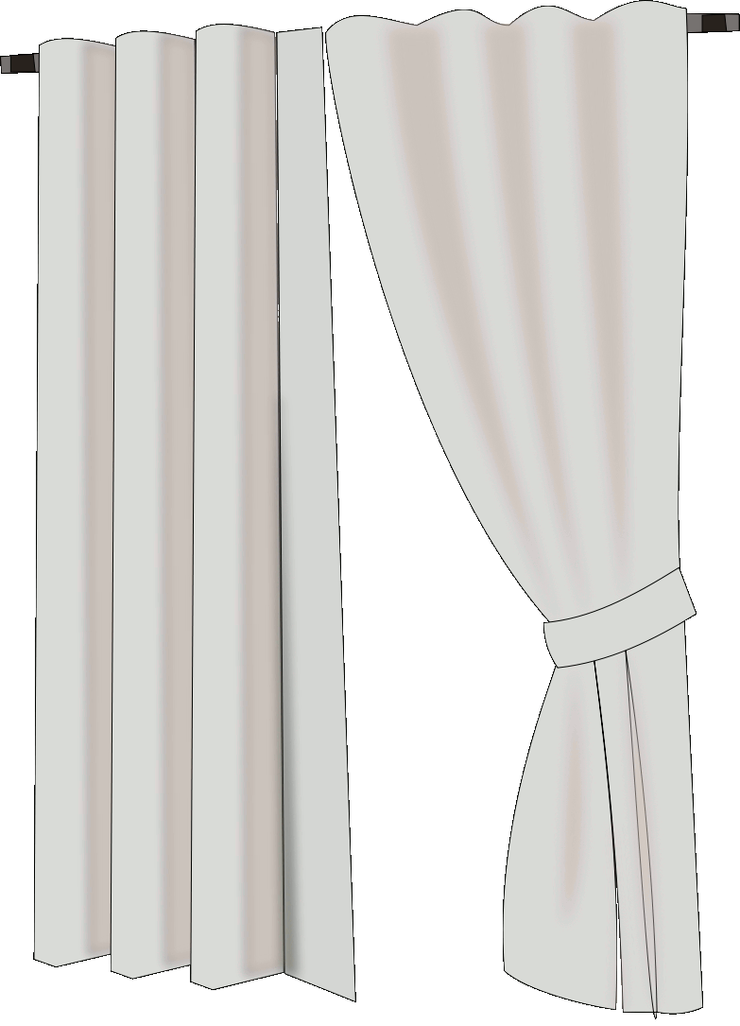
GUESSING GAME
?
Rule:
This game is played individually.
You have to guess what is behind the curtains in three seconds

Slide 35
TIME’S UP
sea

Slide 36
TIME’S UP
rabbit

Slide 37
TIME’S UP
sun

Slide 38
What letter is behind the curtain?
TIME’S UP
Ss
Letter Ss

Slide 39
TIME’S UP
robot

Slide 40
What letter is behind the curtain?
TIME’S UP
Rr
Letter Rr

Slide 41
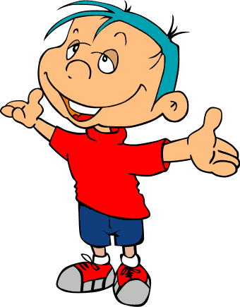
GOOD JOB!

