Slide 1
Warm up:
Activity Quiz
Rule:
This game is played individually.
You have to choose the correct option that shown on each slide..

Slide 2
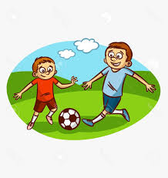
Choose the correct option.
Play soccer
Play tag
Play soccer.

Slide 3
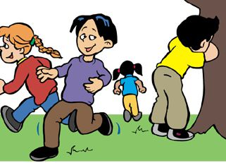
Choose the correct option.
Play hide and seek
Play hopscotch
Play hide and seek.

Slide 4
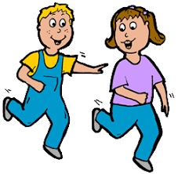
Choose the correct option.
Play tag
Play soccer
Play tag.

Slide 5
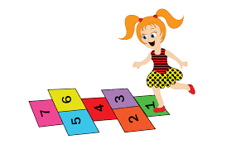
Choose the correct option.
Play hopscotch
Play tag
Play hopscotch.

Slide 6
Choose the correct option.
Play hide and seek
Play soccer
Play soccer.

Slide 7
Choose the correct option.
Play tag
Play hopscotch
Play tag.

Slide 8
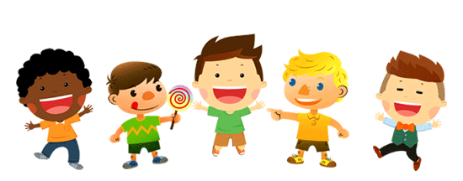
Unit 5:
Free time activities
Lesson 2

Slide 9
Letter Tt.

Slide 10
Introduction:
Letter T makes the sound t

Slide 11
How to write letter Pp?
T
t

Slide 12
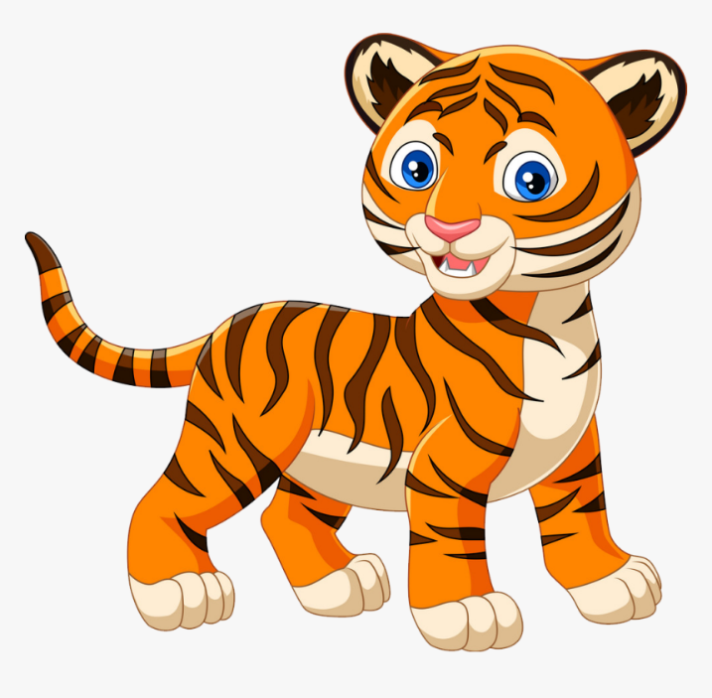
Tt tiger

Slide 13
Tt top

Slide 14
Part B:
Listen and repeat. Write.

Slide 15
t
t
t t __iger
t t __op

Slide 16
Part G:
Sing.

Slide 17
I can see a ,
t, t, .
I can see a ,
t, t, t.

Slide 19
Letter Uu.

Slide 20
Introduction:
Letter U makes the sound u

Slide 21
How to write letter Uu?
U
u

Slide 22
Uu umbrella

Slide 23
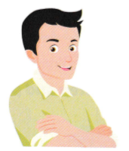
Uu uncle

Slide 24
Part F:
Listen and repeat. Write.

Slide 25
s
s
s s __ea
s s __un

Slide 26
Part G:
Sing.

Slide 27
This is my ,
u, u, .
This is my ,
u, u, u.

Slide 29
