Slide 1
Warm-up:
Do the actions

Slide 3
Unit 5:
Free time activities
Lesson 3

Slide 4
Part A
Listen and point. Repeat.

Slide 5
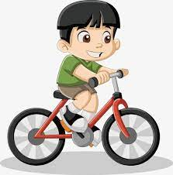
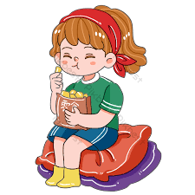
New words:

Slide 6
Click on the picture to listen to the word.
ride my bike

Slide 7
Click on the picture to listen to the word.
read books

Slide 8
Click on the picture to listen to the word.
listen to music

Slide 9
Click on the picture to listen to the word.
eat snacks

Slide 10
Part B
Listen and point.

Slide 11
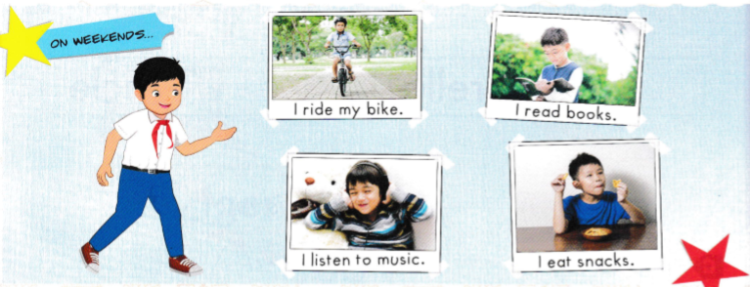

Slide 12
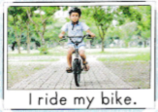
Let’s check.
1

Slide 13
Let’s check.
2

Slide 14
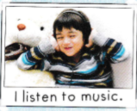
Let’s check.
3

Slide 15
Let’s check.
4

Slide 16
Structure:
I ride my bike.
Mang ý nghĩa “Mình làm một việc gì đó”. Ví dụ: Tôi đi xe đạp.

Slide 17
Part D
Listen and read.

Slide 18
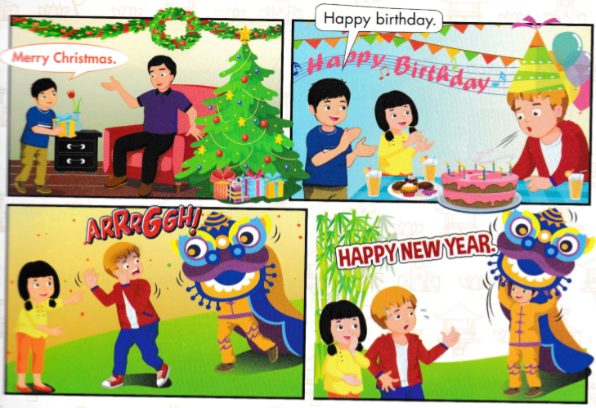

Slide 19
Structure:
Happy New Year!
Mery Chrisrtmas!
Lời chúc (Năm Mới/ Giáng Sinh) đến ai đó

Slide 20
Part E
Role-play.

Slide 21
Thank you!
Happy New Year!
Merry Christmas!
Happy birthday!

Slide 22
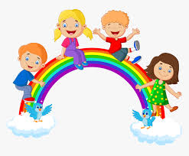
Playtime
Game: Who’s faster?
Rule: Divide class into 2 teams. Look quickly the train that carrying a picture. Which team say the word first will get a point.

Slide 31
Thank you !

